Slide 1
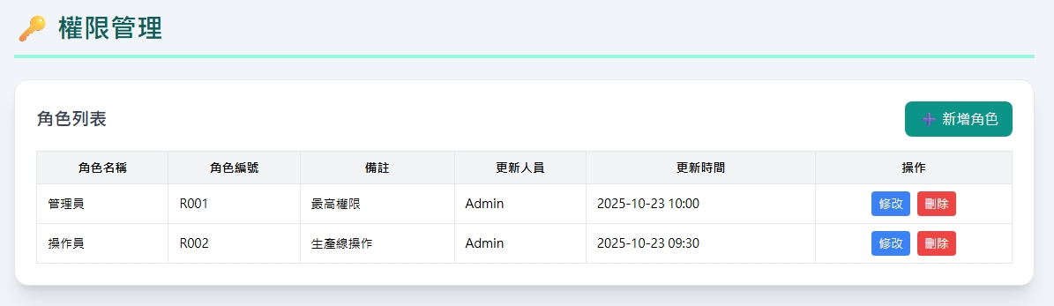
Date | App / Web | Protocol | description
2026/04/27 | Web | Api | 權限管理

Slide 2
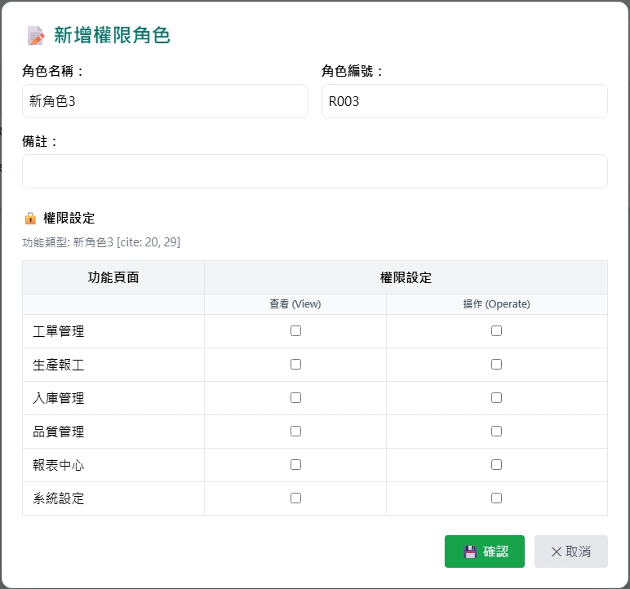
新增 Dialog
rname
rno
remark
Web
App
需用頁籤區分網頁與APP權限
暫時沒有 APP 權限
web/auth/role/get
rid = -1
fncname
hasRead
hasWrite

Slide 3
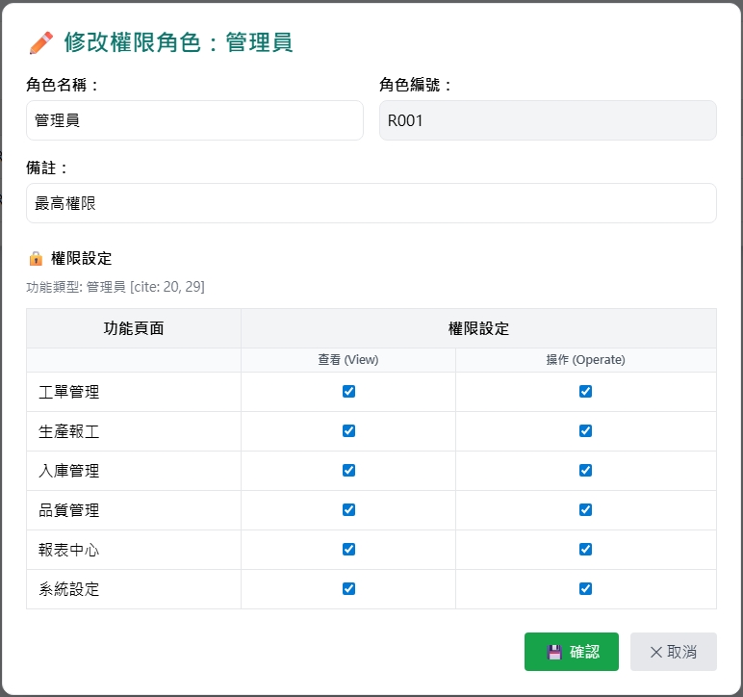
修改 Dialog
rname
rno
remark
Web
App
需用頁籤區分網頁與APP權限
暫時沒有 APP 權限
web/auth/role/get
fncname
hasRead
hasWrite

Slide 4
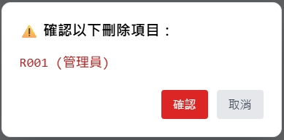
刪除 Dialog

Slide 5
進入頁面
API
完成
web/auth/role/list
rname
rno
remark
updateBy
updateDt

Slide 6
點下新增
新增dialog
API
完成
web/auth/role/create

Slide 7
點下修改
修改dialog
API
完成
web/auth/role/update

Slide 8
點下刪除
刪除dialog
API
完成
web/auth/role/delete

Slide 9
web/auth/role/list
Server | Method | Request Param | Response Param
https://localhost: | GET | page INT? pageSize INT? | Page<Role> --------------------------------- public class Page<Role> { public int PageNumber public int PageSize public int TotalPage public int TotalCount public List<Role> List } public class Role { public int rid public string rno public string rname public string? remark public string updateBy public string updateDt }

Slide 10
web/auth/role/get
Server | Method | Request Param | Response Param
https://localhost: | GET | rid short // -1 用於新增，或給角色id(rid) 查看權限 | public class RoleFuncode { public int rid public string rno public string rname public string? remark public List<Funcode> funcodes } public class Funcode { public int fncid public string fncname public bool isApp public bool isWeb public bool hasRead public bool hasWrite }

Slide 11
web/auth/role/create
Server | Method | Request Param | Response Param
https://localhost: | Post | public class Create { public int? page public int? pageSize public string rno public string rname public string? remark public List <Funcode> funcodes } public class Funcode { public short fncid public bool hasRead public bool hasWrite } | Page<Role> --------------------------------- public class Page<Role> { public int PageNumber public int PageSize public int TotalPage public int TotalCount public List<Role> List } public class Role { public int rid public string rno public string rname public string? remark public string updateBy public string updateDt }

Slide 12
web/auth/role/update
Server | Method | Request Param | Response Param
https://localhost: | PUT | public class Update { public int? page { get; set; } public int? pageSize public short rid public string rname public string? remark public List<Funcode> funcodes } | Page<Role> --------------------------------- public class Page<Role> { public int PageNumber public int PageSize public int TotalPage public int TotalCount public List<Role> List } public class Role { public int rid public string rno public string rname public string? remark public string updateBy public string updateDt }

Slide 13
web/auth/role/delete
Server | Method | Request Param | Response Param
https://localhost: | GET | public class Delete { public int? page public int? pageSize public short rid } | Page<Role> --------------------------------- public class Page<Role> { public int PageNumber public int PageSize public int TotalPage public int TotalCount public List<Role> List } public class Role { public int rid public string rno public string rname public string? remark public string updateBy public string updateDt }

