Slide 1
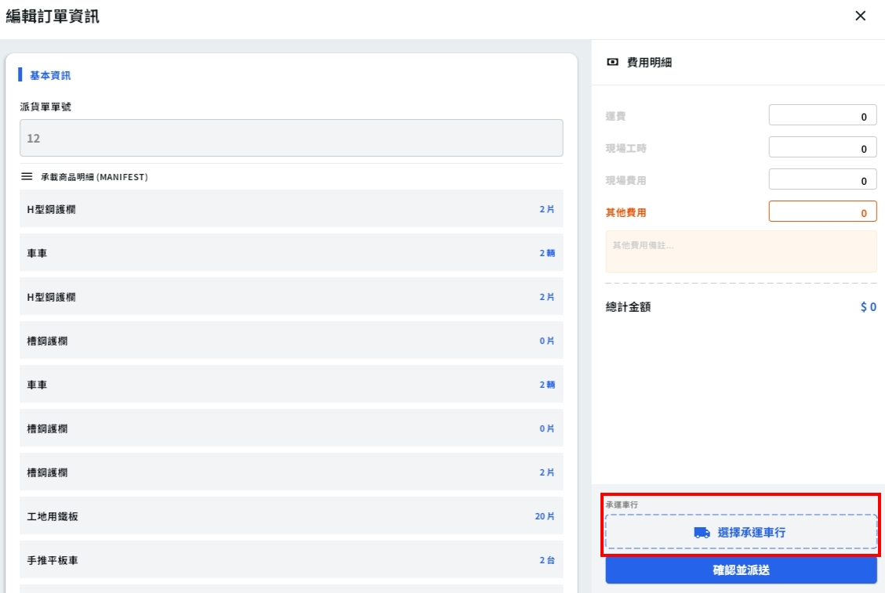
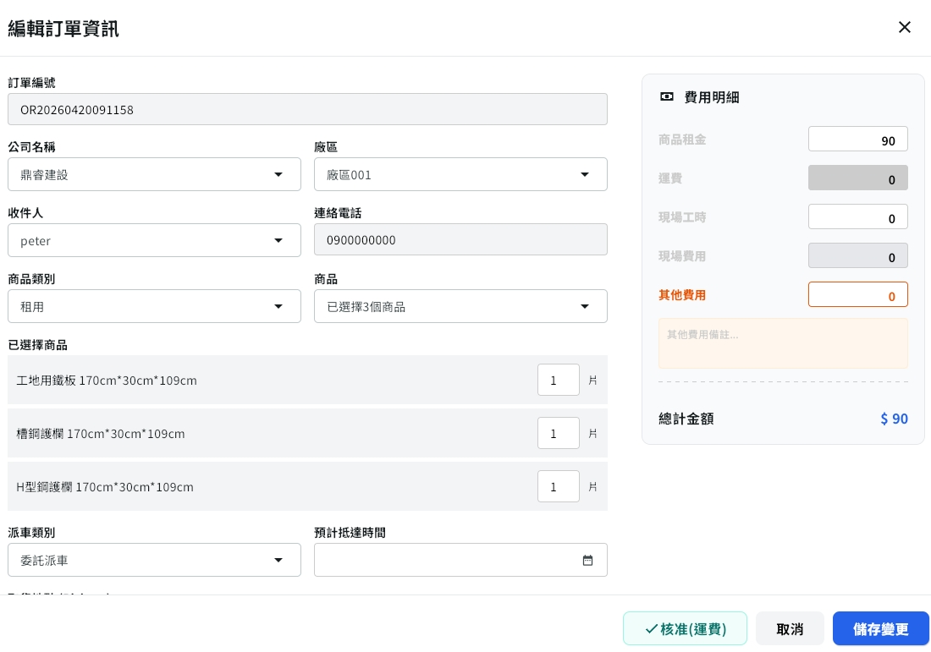
Date | App / Web | Protocol | description
2026/04/13 | Web | Api | 運費計算
2026/04/20 | WEB | Api | 運費計算拆分商城訂單與配送單
配送單
商城訂單

Slide 2
選下
車行後
API
完成
mgmt/freight/shipOrder

Slide 3
點下
配送單後
API
完成
mgmt/freight/salesOrder

Slide 4
mgmt/freight/shipOrder
Server | Method | Request Param | Response Param
https://localhost:7093 | POST | public class Request { public int compId public List<Area> areas public class Area { public int cityId public int districtId } } | public class Data { public int freightPrice }

Slide 5
mgmt/freight/salseOrder
Server | Method | Request Param | Response Param
https://localhost:7093 | POST | public class Request { public int compId // 固定給 -1 public List<Area> areas public List<Shelf> shelfs public class Area { public int cityId public int districtId } public class Shelf { public int shelfId public int amount } } | public class Data { public int freightPrice }

