Slide 1
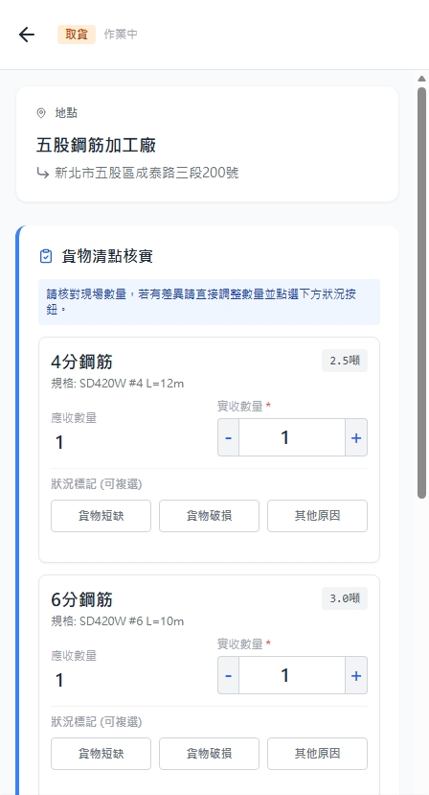
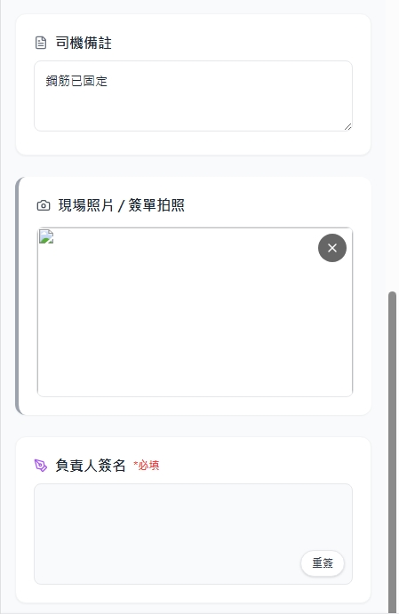
Date | App / Web | Protocol | description
2026/02/25 | App | Api | 拿工作細項
2026/03/03 | APP | Api | 狀況標記功能調整
P1
P2

Slide 2
PPT
taskList
進入頁面
API
完成
Pass [shId] / [seq]
app/task/info
地點
[目前沒有這個欄位]
[addr]
[goodsName]
[weight]
規格 : L = [length] W = [width] H = [height]
應收數量
實收數量
[boardQty]
狀況標記
[ct_reason_id]
[ct_reason_id]
其他原因

Slide 3
點下完成
API
API
ppt
taskList
api/fs/upload
app/task/checkout
先建立圖片 :
簽名圖片 [fsIdSign]
現場拍照 [fsIdPic]
isOtherReason

Slide 4
app/task/info
Server | Method | Request Param | Response Param
https://localhost:7093 | GET | shId long seq int | public class Info { public string addr public string custName public string custPhone public List <Item> items public class Item { public long shiptaskId public string goodsName public float length public float width public float height public float weight public int boardQty public List<Reason> reasons } } ------------------------------------ public class Reason { public int ct_reason_id public string reason_no public string reason_name }

Slide 5
api/fs/upload
Server | Method | Request Param | Response Param
https://localhost:7093 | POST | public class UploadFileInfo { public IFormFile File public string ContentType public string RefNo } | String fs_id

Slide 6
app/task/checkout
Server | Method | Request Param | Response Param
https://localhost:7093 | POST | public class CheckOut { public string remarkDriver public string fsIdPic public string fsIdSign public List<Item> items public class Item { public long shiptaskId public int handoverQty public bool isOtherReason public List<Reason> reasons } } ------------------------------------ public class Reason { public int ct_reason_id } | String “工作項目已完成”

