Slide 1
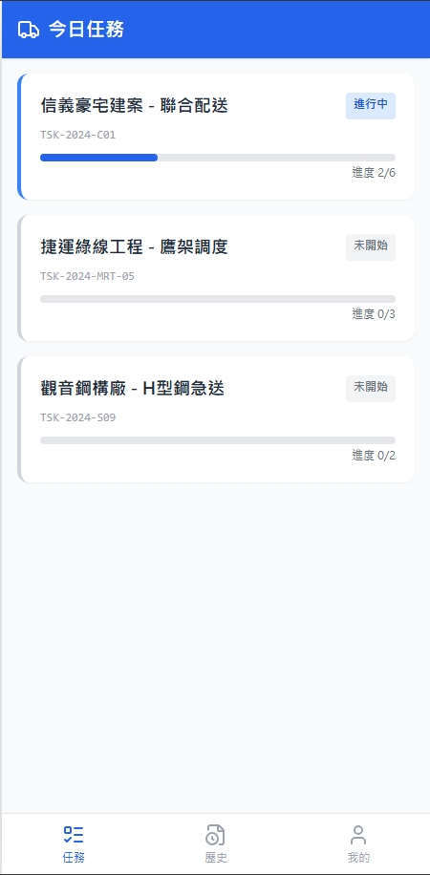
Date | App / Web | Protocol | description
2026/02/25 | App | Api | 拿工作清單
2026/04/13 | App | Api | 增加行政區與配送單類型
2026/04/14 | APP | Api | 補上訂單類型 (租 / 退 / 叫車)

Slide 2
進入頁面
API
完成
app/order/list/processing
[cityName][districtName]
[shOrderState]
[shOrderNo]
[orderTypeName]
[estArrivedDt]
進度 [completeCount] / [taskCount]

Slide 3
點下單
Pass
[shId]
ppt
taskList

Slide 4
app/order/list/processing
Server | Method | Request Param | Response Param
https://localhost:7093 | GET | driverId INT | List<Processing> -------------------------------------- public class Processing { public long shId public string shOrderNo public string shOrderState public int completeCount public int taskCount public string cityName public string districtName public string orderTypeName public string estArrivedDt public int ctSoTypeId public string ctSoTypeName }

