Slide 1
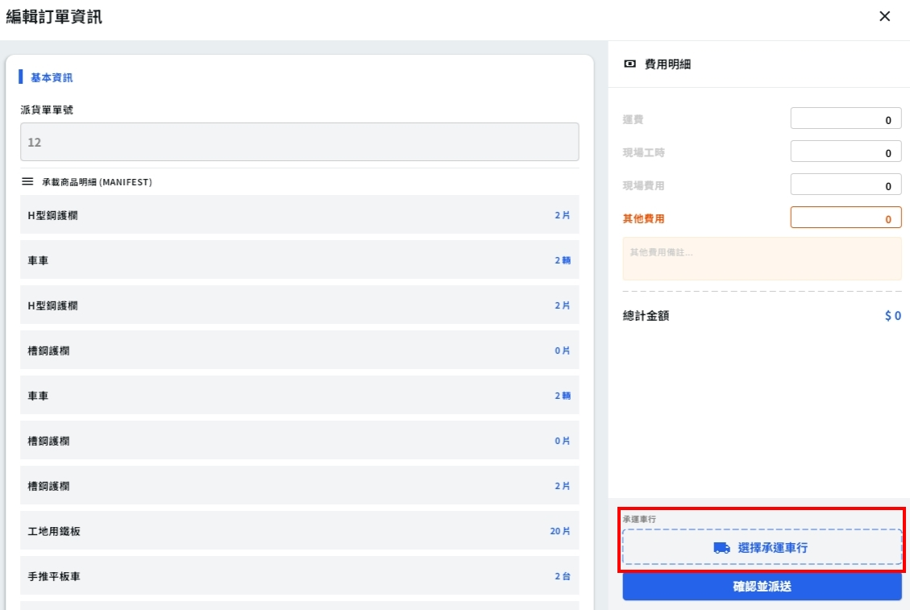
Date | App / Web | Protocol | description
2026/04/13 | Web | Api | 運費計算

Slide 2
選下
車行後
API
完成
mgmt/freight/calculator

Slide 3
mgmt/freight/calculator
Server | Method | Request Param | Response Param
https://localhost:7093 | POST | public class Request { public int compId public List<Area> areas public class Area { public int cityId public int districtId } } | public class Data { public int freightPrice }

