Slide 1
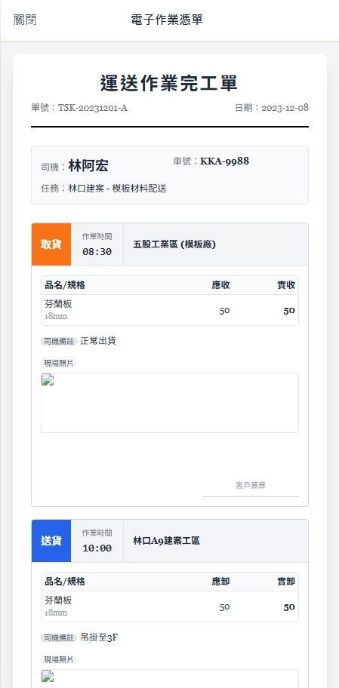
Date | App / Web | Protocol | description
2026/03/02 | App | Api | 拿歷史工作內容(已結案)

Slide 2
進入頁面
API
完成
app/task/list/history
司機 : [driver_name]
車號 : [license_plate]
任務 : [DB沒有欄位]
[taskAction]
作業時間
[handoverDt]
[addr]
[goodsName]
[board_qty]
[handover_qty]
L = [length] W = [width] H = [height]
司機備註 : [remark]
現場照片 :
[pic]
[sign]

Slide 3
app/task/list/history
Server | Method | Request Param | Response Param
https://localhost:7093 | GET | shId BIGINT | public class History { public string driver_name public string license_plate public List <History.HistoryTask> historyTasks public class HistoryTask { public string taskAction public DateTime handover_dt public string addr public string goodsName public float length public float width public float height public float weight public int board_qty public int handover_qty public string remark public List<Pic> pic public List<Pic> sign } public class Pic { public FileInfo file public string content_type } }

