Slide 1
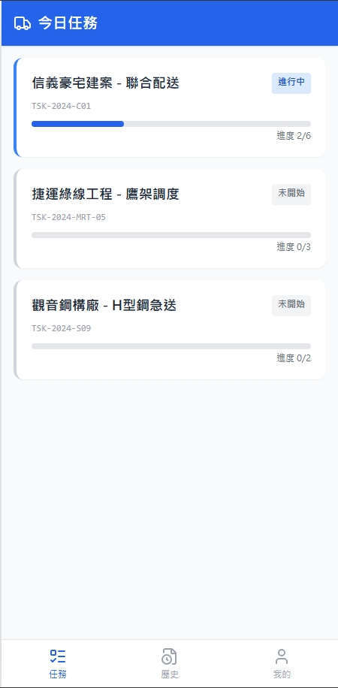
Date | App / Web | Protocol | description
2026/02/25 | App | Api | 拿工作清單
2026/04/13 | App | Api | 增加行政區與配送單類型

Slide 2
進入頁面
API
完成
app/order/list/processing
[cityName][districtName]
[shOrderState]
[shOrderNo]
[orderTypeName]
進度 [completeCount] / [taskCount]

Slide 3
點下單
Pass
[shId]
ppt
taskList

Slide 4
app/order/list/processing
Server | Method | Request Param | Response Param
https://localhost:7093 | GET | driverId INT | List<Processing> -------------------------------------- public class Processing { public long shId public string shOrderNo public string shOrderState public int completeCount public int taskCount public string cityName public string districtName public string orderTypeName }

