Slide 1
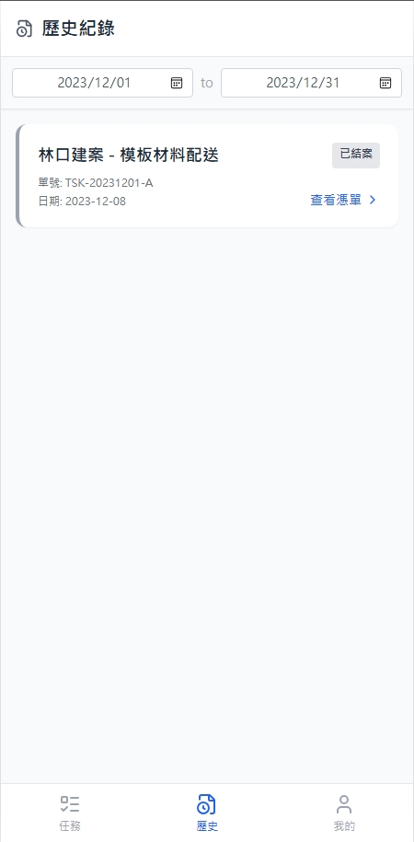
Date | App / Web | Protocol | description
2026/03/02 | App | Api | 拿歷史工作清單(已結案)

Slide 2
進入頁面
API
完成
app/order/list/history
[目前DB沒有欄位]
[shOrderState]
[shOrderNo]
[closed_dt]
查看憑單 >

Slide 3
點下單
Pass
[shId]
ppt
taskHistoryList

Slide 4
app/order/list/history
Server | Method | Request Param | Response Param
https://localhost:7093 | GET | driverId INT strDt DATETIME endDt DATETIME | List<History> -------------------------------------- public class History { public long shId public string shOrderNo public string shOrderState public DateTime closed_dt }

