Slide 1
Date | App / Web | Protocol | description
2026/04/01 | Web | Api | 使用者管理與登入
使用者名稱
帳號
操作
[displayName]
[loginName]
更新
更新密碼
頁籤

Slide 2
新增使用者
更新使用者
更新密碼
使用者名稱
使用者名稱
密碼
帳號
密碼

Slide 3
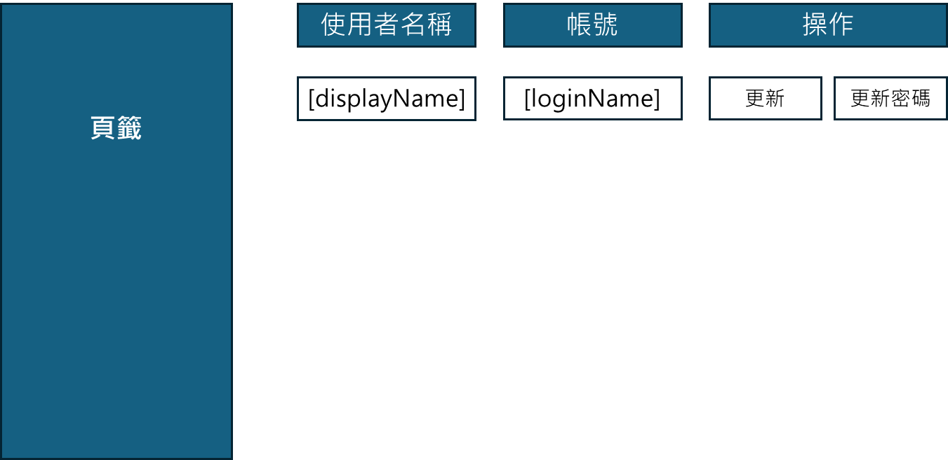
進入頁面
API
完成
mgmt/user/list

Slide 4
新增 dialog
API
完成
mgmt/user/create

Slide 5
更新 dialog
API
完成
mgmt/user/update

Slide 6
更新密碼 dialog
API
完成
mgmt/user/update/pwd

Slide 7
刪除提醒
API
完成
mgmt/user/delete

Slide 8
mgmt/user/list
Server | Method | Request Param | Response Param
https://localhost: | GET | page INT? pageSize INT? searchStr String? | Page<Data> --------------------------------- public class Page<Data> { public int PageNumber public int PageSize public int TotalPage public int TotalCount public List<Data> List } public class Data { public int userId public string displayName public string loginName }

Slide 9
mgmt/user/create
Server | Method | Request Param | Response Param
https://localhost: | POST | public class Create { public string loginName public string password public string displayName } | String “OK”

Slide 10
mgmt/user/update
Server | Method | Request Param | Response Param
https://localhost: | PUT | public class Update { public int userId public string displayName } | String OK

Slide 11
mgmt/user/update/pwd
Server | Method | Request Param | Response Param
https://localhost: | Post | public class UpdatePwd { public int userId public string password } | String OK

Slide 12
mgmt/user/delete
Server | Method | Request Param | Response Param
https://localhost: | DELETE | public class Delete { public int userId } | String “OK”

