Slide 1
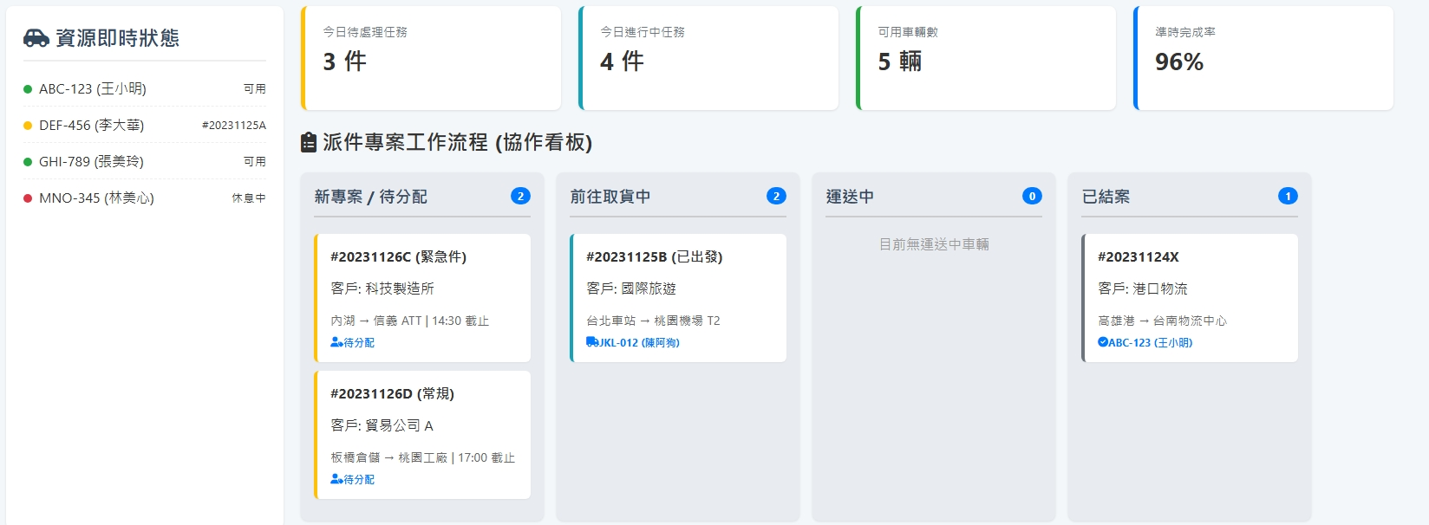
Date | App / Web | Protocol | description
2026/03/24 | web | Api | 車輛資源清單
pendingCount
processCount
vehicleCount
licensePlate(driverName)
shNo
custName
regionFrom > regionTo orderSchArrDt
State = 1 >> 可用
State = 2 >>List<string>shNos
State = 3 >> 休息
licensePlate(driverName)

Slide 2
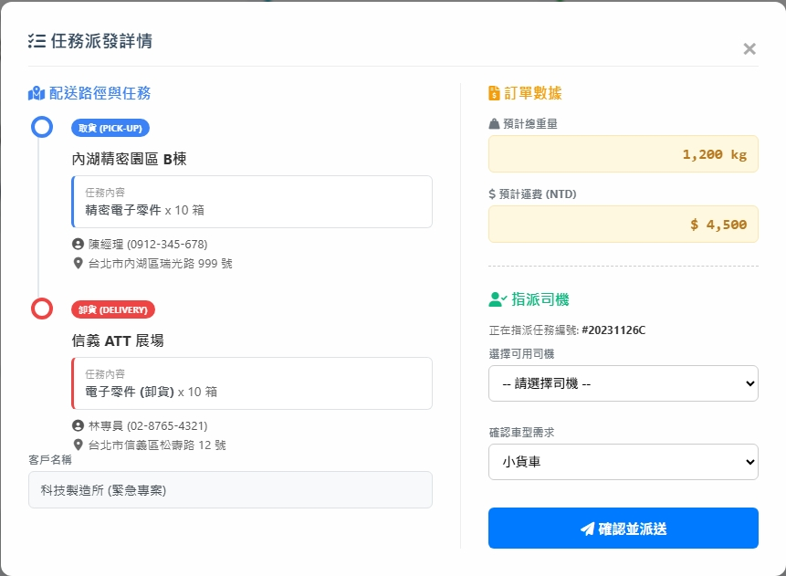
taskAction
totalWeight
resource/order/detail
goodName * itemCount
deliveryPrice
custName / custPhone
addr
resource/driver/list
shNo
resource/order/assign

Slide 3
進入頁面
API
完成
resource/order/dashboard/list
resource/driver/current/list
resource/order/dashboard/summary

Slide 4
指派
指派 dialog
API
完成
resource/order/assign

Slide 5
resource/order/dashboard/list
Server | Method | Request Param | Response Param
https://localhost: | GET |  | public class Order { public List<OrderBase> pendingOrder public List<OrderBase> processingOrder public List<OrderBase> closedOrder public class OrderBase { public long shId public string shNo public List<Routing> routings public class Routing { public string custName public string region_from public string region_to public string? orderSchArrDt public string userTo public string? driverName public string? licensePlate } } }

Slide 6
resource/order/dashboard/summary
Server | Method | Request Param | Response Param
https://localhost: | GET |  | public class OrderSummary { public int processCount public int pendingCount public int vehicleCount }

Slide 7
resource/driver/current/list
Server | Method | Request Param | Response Param
https://localhost: | GET |  | public class CurrentData { public int driverId public string driverNo public string driverName public string licensePlate { get; set; } public int state // 1 可用 2 配送 3 休息 public List<string> shNos }

Slide 8
resource/driver/list
Server | Method | Request Param | Response Param
https://localhost: | GET | page INT? pageSize INT? searchStr STRING is_free bool // true 拿未綁的司機 | Page<Data> --------------------------------- public class Page<Data> { public int PageNumber public int PageSize public int TotalPage public int TotalCount public List<Data> List } public class Data { public int driverId public int? vehicleId public int? compId public string driverNo public string driverName public string phone public string licensePlate public bool isAppAuth public string appAc }

Slide 9
resource/order/detail
Server | Method | Request Param | Response Param
https://localhost: | GET | shId long | public class OrderDetail { public float totalWeight public decimal deliveryPrice public string shNo public List<Task> tasks public class Task { public int seq public string taskState public int taskActionId public string taskAction public string addr public string custName public string custPhone public int itemCount public string goodName } }

Slide 10
resource/order/assign
Server | Method | Request Param | Response Param
https://localhost: | GET | public class Assing { public long shId public int driverId } | STRING OK

