Slide 1
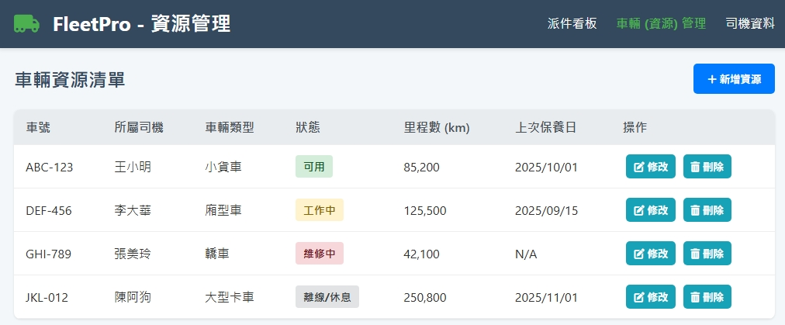
Date | App / Web | Protocol | description
2026/03/24 | web | Api | 車輛資源清單
派件看板
配送訂單管理
車輛管理
司機管理
[licensePlate]
[driverName]
[vehicle
TyprName]
[vehicle
StateName]
[mileage]
[maintainDt]

Slide 2
新增車輛
更新車輛
車輛編號 (必填)
車輛編號 (必填)
resource/ct/vehicle/type/list
車輛名稱 (必填)
車輛名稱 (必填)
resource/ct/vehicle/state/list
resource/driver/list
車號 (必填)
車號 (必填)
resource/ct/comp/list
所屬公司
所屬公司
所屬司機
所屬司機
車輛類型
車輛類型
資源狀態
資源狀態
自有車輛
自有車輛
選項只有 [自有] / [租賃]
選項只有 [自有] / [租賃]
目前里程數
目前里程數
上次保養日期
上次保養日期

Slide 3
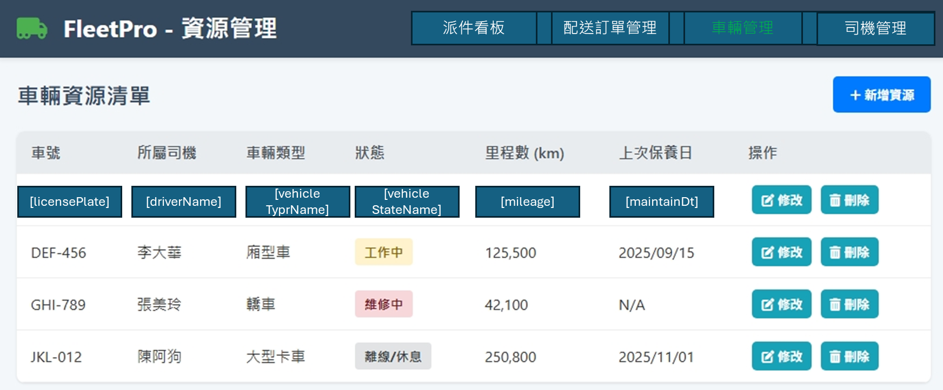
進入頁面
API
完成
resource/vehicle/list

Slide 4
新增
新增 dialog
API
完成
resource/vehicle/create

Slide 5
更新
修改 dialog
API
完成
resource/vehicle/update

Slide 6
刪除
提醒 dialog
API
完成
resource/vehicle/delete

Slide 7
resource/ct/vehicle/type/list
Server | Method | Request Param | Response Param
https://localhost: | GET |  | List<VehicleType> --------------------------------- public class VehicleType { public int vehicleTypeId public string vehicleTypeName }

Slide 8
resource/ct/vehicle/state/list
Server | Method | Request Param | Response Param
https://localhost: | GET |  | List<VehicleState> --------------------------------- public class VehicleState { public int vehicleStateId public string vehicleStateName }

Slide 9
resource/ct/comp/list
Server | Method | Request Param | Response Param
https://localhost: | GET |  | List<Comp> --------------------------------- public class Comp { public int compId public string compNo public string compName }

Slide 10
resource/driver/list
Server | Method | Request Param | Response Param
https://localhost: | GET | page INT? // 給 NULL pageSize INT? // 給 NULL searchStr STRING // 給 NULL is_free bool // true 拿未綁的司機 | Page<Data> --------------------------------- public class Page<Data> { public int PageNumber public int PageSize public int TotalPage public int TotalCount public List<Data> List } public class Data { public int driverId public string driverNo public string driverName public string phone }

Slide 11
resource/vehicle/list
Server | Method | Request Param | Response Param
https://localhost: | GET | page INT? // 給 NULL pageSize INT? // 給 NULL is_free bool // true 拿未綁的車輛 | Page<Data> --------------------------------- public class Page<Data> { public int PageNumber public int PageSize public int TotalPage public int TotalCount public List<Data> List } public class Data { public int vehicleId public string vehicleNo public string vehicleName public int driverId public string driverNo public string driverName public byte vehicleStateId public byte vehicleTypeId public int compId public string vehicleStateName public string vehicleTypeName public decimal mileage public string licensePlate public bool isOwn public string? createDt public string? updateDt public string? maintainDt }

Slide 12
resource/vehicle/create
Server | Method | Request Param | Response Param
https://localhost: | POST | public class Create { public string vehicleNo public string vehicleName public byte vehicleTypeId public byte vehicleStateId public int? driverId public int? compId public decimal mileage public string licensePlate public bool isOwn public DateTime? maintainDt public int updateBy } | String “OK”

Slide 13
resource/vehicle/update
Server | Method | Request Param | Response Param
https://localhost: | PUT | public class Update { public int vehicleId public string vehicleNo public string vehicleName public byte vehicleTypeId public byte vehicleStateId public int? driverId public int? compId public decimal mileage public string licensePlate public bool isOwn public DateTime? maintainDt public int updateBy } | String OK

Slide 14
resource/vehicle/delete
Server | Method | Request Param | Response Param
https://localhost: | DELETE | public class Delete { public int vehicleId public int updateBy } | String “OK”

