Slide 1
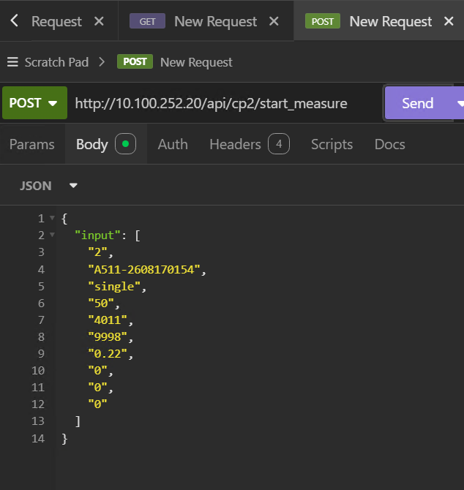
nth_time_measured (每次量測傳送該runcard_no量測觸發app次數)
runcard_no
Preset_flie_name(料號[dbo].[p]新增欄位)
design_code
material_code
base_curve
Thickness
nominal_pwr
nominal_cyl
nominal_add

Slide 2
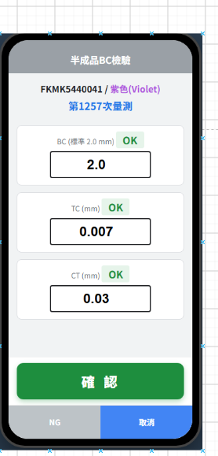
亨泰_檢驗的app TYPE 發生因檢驗項目過多,被確認按鈕擋住,需要側邊增加 >>> 滾動條

