Slide 1
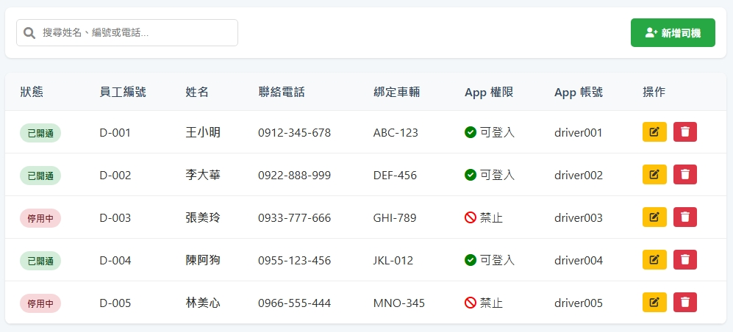
Date | App / Web | Protocol | description
2026/03/24 | web | Api | 司機資源清單
[driverNo]
[driverName]
[phone]
[licensePlate]
[isAppAuth]
[appAc]

Slide 2
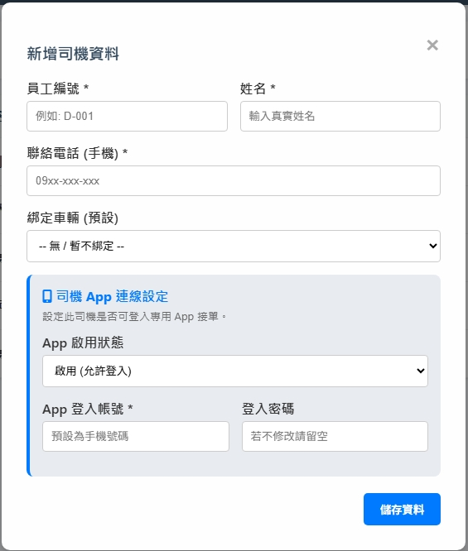
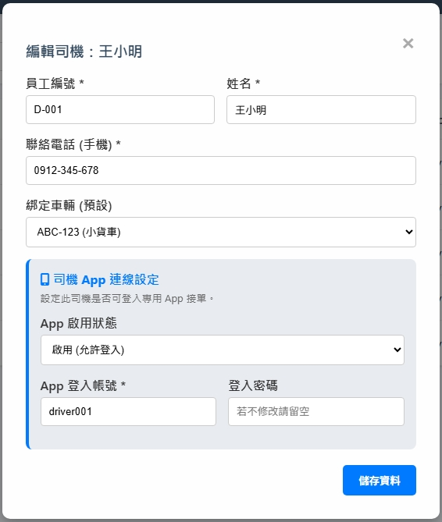
resource/vehicle/list

Slide 3
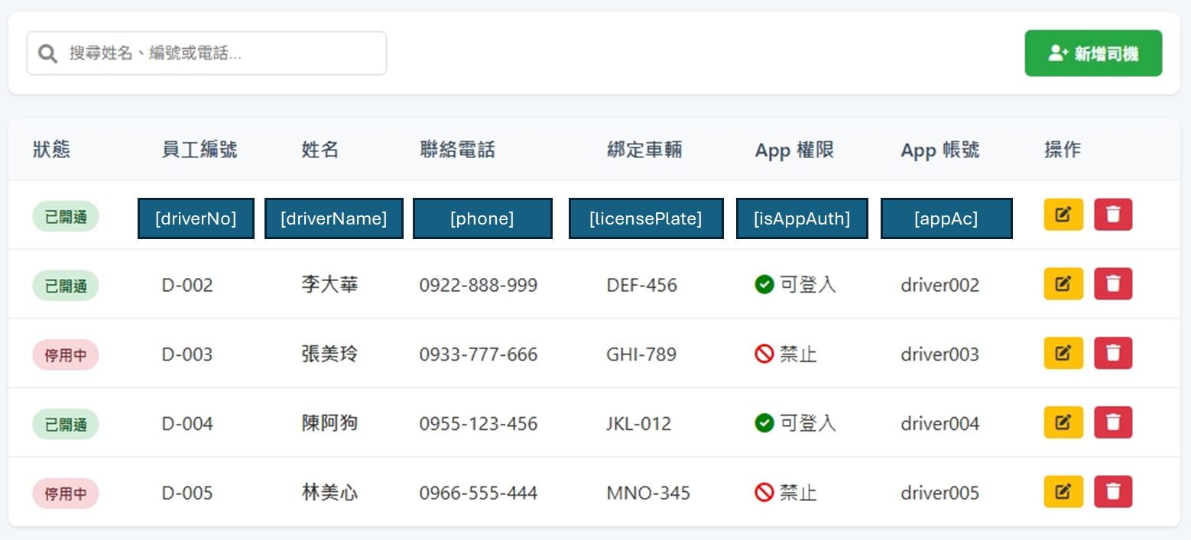
進入頁面
API
完成
resource/driver/list

Slide 4
新增
新增 dialog
API
完成
resource/driver/create

Slide 5
更新
修改 dialog
API
完成
resource/driver/update

Slide 6
刪除
提醒 dialog
API
完成
resource/driver/delete

Slide 7
resource/vehicle/list
Server | Method | Request Param | Response Param
https://localhost: | GET | page INT? // 給 NULL pageSize INT? // 給 NULL | Page<Data> --------------------------------- public class Page<Data> { public int PageNumber public int PageSize public int TotalPage public int TotalCount public List<Data> List } public class Data { public int vehicleId public string vehicleNo public string vehicleName public int driverId public string driverNo public string driverName public byte vehicleStateId public byte vehicleTypeId public int compId public string vehicleStateName public string vehicleTypeName public decimal mileage public string licensePlate public bool isOwn public string? createDt public string? updateDt public string? maintainDt }

Slide 8
resource/driver/list
Server | Method | Request Param | Response Param
https://localhost: | GET | page INT? pageSize INT? searchStr STRING | Page<Data> --------------------------------- public class Page<Data> { public int PageNumber public int PageSize public int TotalPage public int TotalCount public List<Data> List } public class Data { public int driverId public string driverNo public string driverName public string phone public string licensePlate public bool isAppAuth public string appAc }

Slide 9
resource/driver/create
Server | Method | Request Param | Response Param
https://localhost: | POST | public class Create { public int? vehicleId public int? compId public string driverNo public string driverName public string phone public string appAc public string appPw public bool isAppAuth public int updateBy } | String “OK”

Slide 10
resource/driver/update
Server | Method | Request Param | Response Param
https://localhost: | PUT | public class Update { public int driverId public int? vehicleId public int? compId public string driverNo public string driverName public string phone public string appAc public string? appPw public bool isAppAuth public int updateBy } | String OK

Slide 11
resource/driver/delete
Server | Method | Request Param | Response Param
https://localhost: | DELETE | public class Delete { public int driverId public int updateBy } | String “OK”

