Slide 1
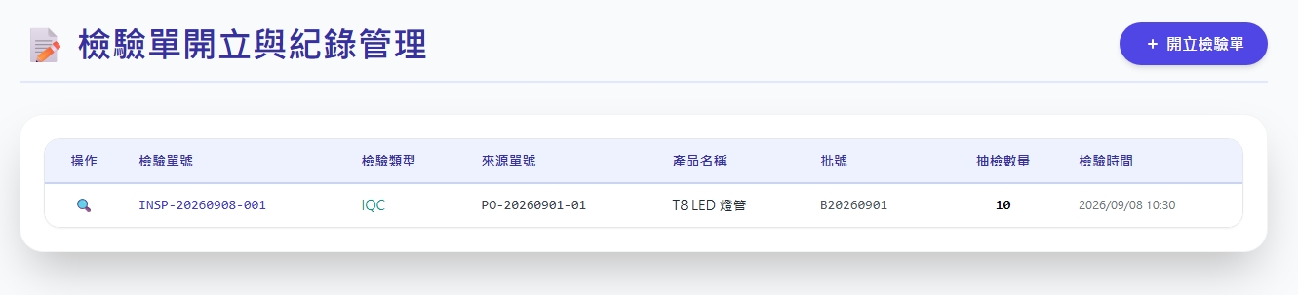
Date | App / Web | Protocol | description
2026/07/07 | Web | Api | 模具管理-下載
搜尋單號
搜尋料號
搜尋

Slide 2
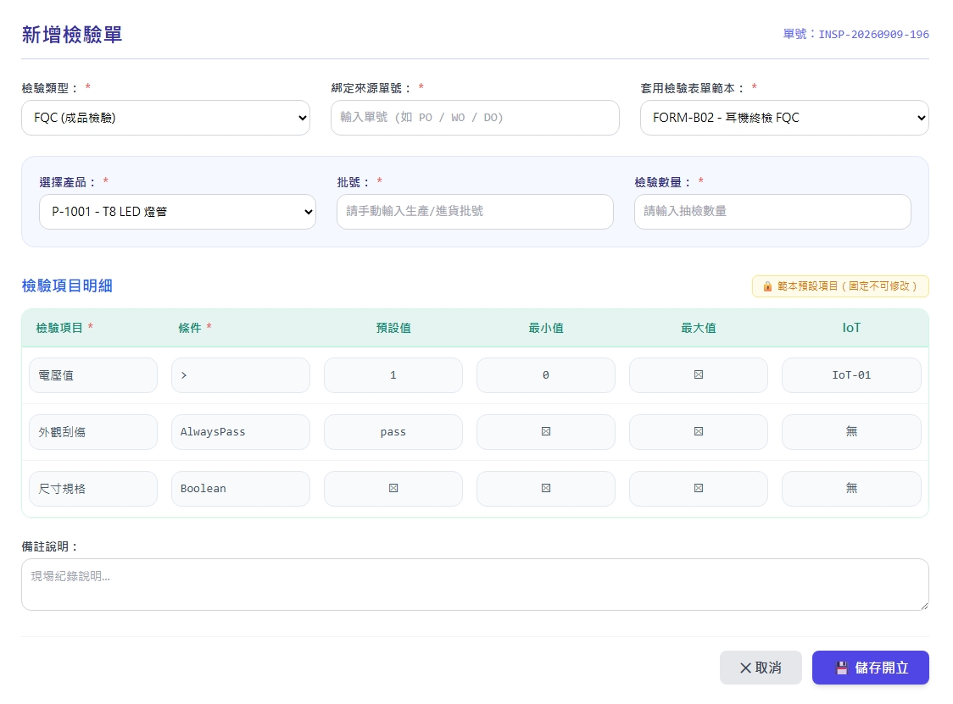
新增 Dialog
web/sheet/ct/type/list
web/sheet/list
web/part/option/all
web/sheet/get

Slide 3
檢視 Dialog
web/invinsp/get
SheetTypeId
InvInspoidNo
Sheetid
pid
Bchno
SampleQty

Slide 4
進入頁面
API
完成
web/maintain/mold/list
搜尋單號
搜尋料號
搜尋
InvInspoidNo
SheetTypeName
Pno/pname
Bchno
SampleQty
CreateDt

Slide 5
點下新增
新增 dialog
API
完成
web/invinsp/create

Slide 6
web/invinsp/list
Server | Method | Request Param | Response Param
https://localhost: | GET | [FromQuery] string orderNo = "", [FromQuery] string pno = "", [FromQuery] int pageIndex = 1, [FromQuery] short pageSize = 10 | Page<Data> --------------------------------- public class Data { public long InvInspoid public string InvInspoidNo public long Pid public int SampleQty public int Qty public string Bchno public string CreateDt public string CreateBy public long Sheetid public string Sheetno public string Sheetname public byte SheetTypeId public string SheetTypeName }

Slide 7
web/invinsp/get
Server | Method | Request Param | Response Param
https://localhost: | GET | [FromQuery] long invInspoid | public class Data { public long InvInspoid public string InvInspoidNo public long Pid public int SampleQty public int Qty public string Bchno public string CreateDt public string CreateBy public long Sheetid public string Sheetno public string Sheetname public byte SheetTypeId public string SheetTypeName }

Slide 8
web/invinsp/create
Server | Method | Request Param | Response Param
https://localhost: | POST | public class Create { public byte? result { get; set; } public string? invInspoIdNo { get; set; } public int sheetId { get; set; } public long pid { get; set; } public double sampleQty { get; set; } public double? qty { get; set; } public string bchno { get; set; } public string remark { get; set; } } | String invInspNo

