Slide 1
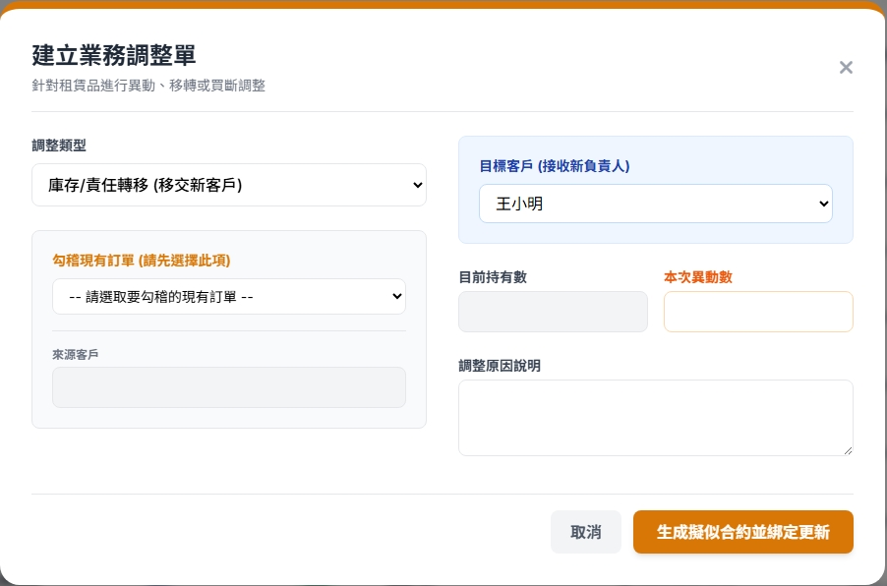
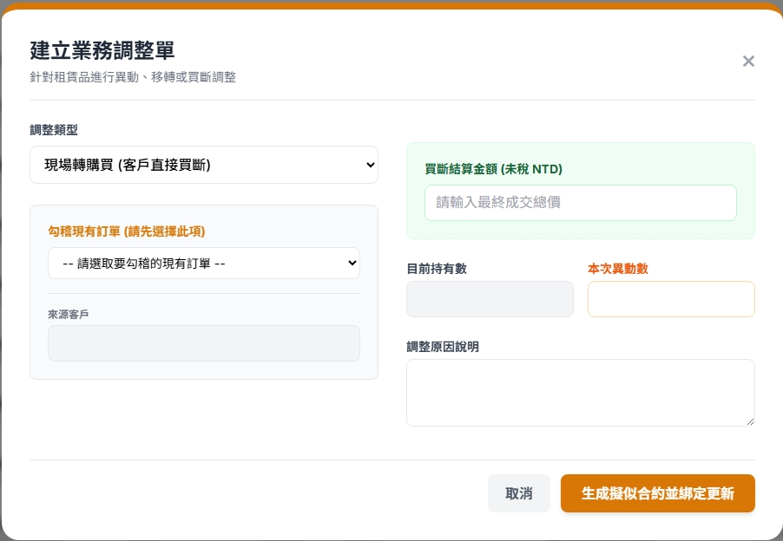
Date | App / Web | Protocol | description
2026/03/13 | Web | Api | 庫存管理
目標客戶 (接收新負責人)
目標廠區

Slide 2
目標客戶 (接收新負責人)
目標廠區
mgmt/ct/custinfo/filter
先選客戶才會有廠區
選了廠區不再打 API
mgmt/order/item/trans/list
mgmt/order/item/trans

Slide 3
mgmt/ct/custinfo/filter
Server | Method | Request Param | Response Param
https://localhost:7093 | GET | custId INT? = NULL //固定 deptId INT? facId INT? | public class CustomerFilter { public List<CustomerPartial> customers public List<DepartmentPartial> depts public List<FacilityPartial> facilities public class CustomerPartial { public int custId public string cust_no public string cust_name public string phone } public class DepartmentPartial { public int deptId public string dept_no public string dept_name public string dept_region public string dept_address } public class FacilityPartial { public int facId public string facNo public string facName public string facRegion public string facAddress } }

Slide 4
mgmt/order/item/trans/list
Server | Method | Request Param | Response Param
https://localhost:7093 | GET |  | List<Item> ----------------------- public class Item { public long soId { get; set; } public string soNo { get; set; } public string shelfNo { get; set; } public string shelfName { get; set; } public string userFrom { get; set; } public int qty { get; set; } }

Slide 5
mgmt/order/item/trans
Server | Method | Request Param | Response Param
https://localhost:7093 | POST | public class Create { public long soId public long soItemId public int? toCustId public int? toFacId public int qty public decimal price public bool isBuy public string remark } | String OK

