Slide 1
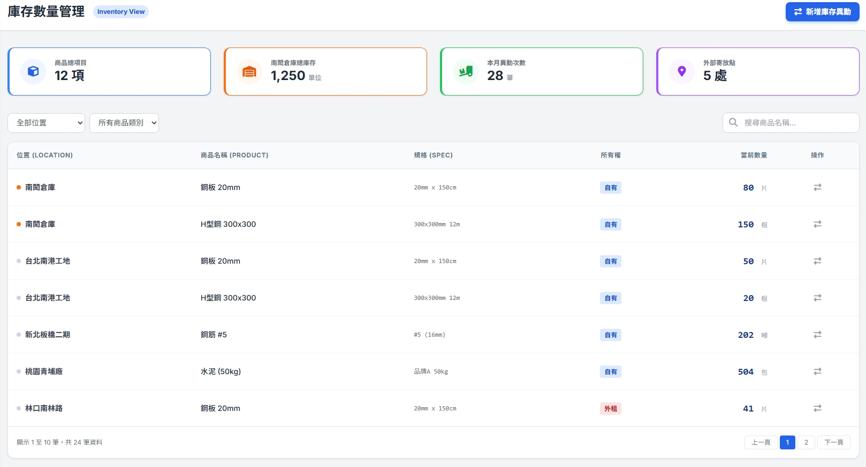
Date | App / Web | Protocol | description
2026/03/13 | Web | Api | 庫存管理
2026/03/20 | Web | Api | 補上 warehouse list

Slide 2
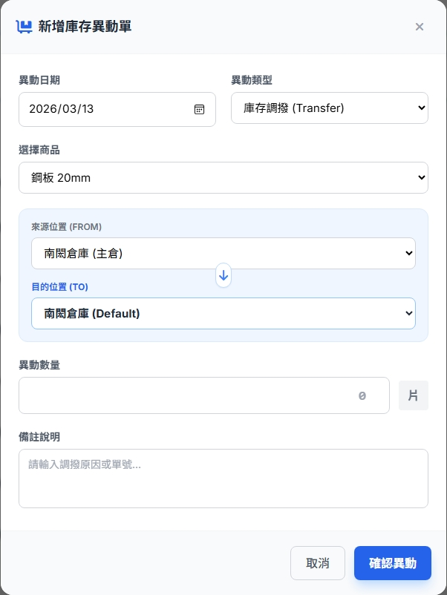
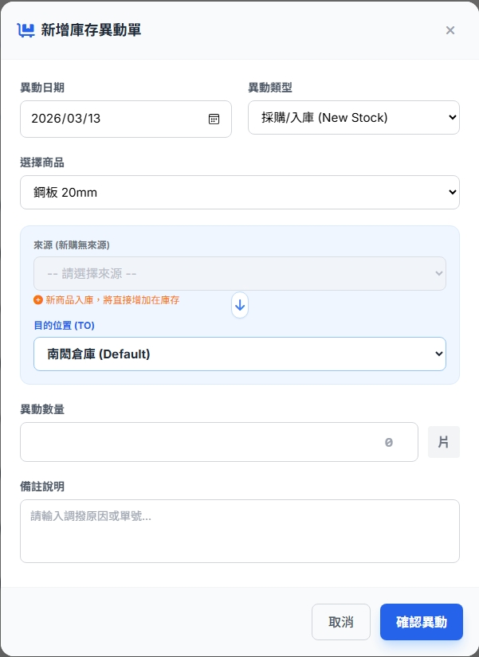
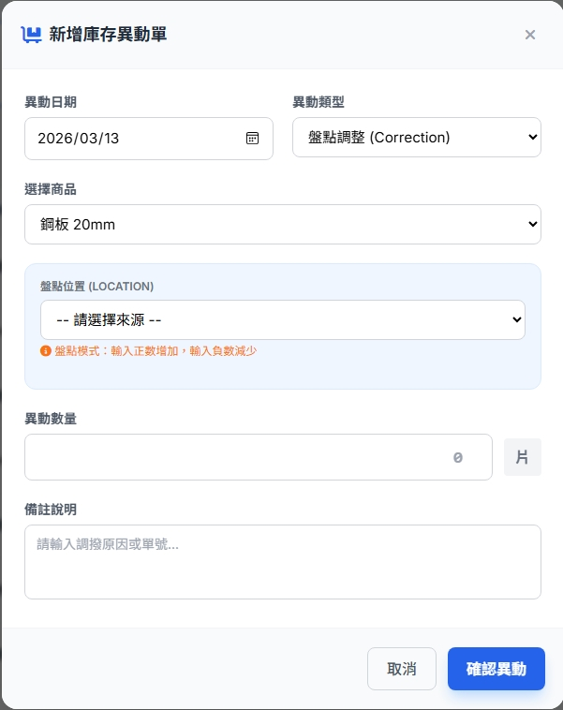
// 正數
{
"transTypeId": 3,
"productId": 101,
"fromWarehousId": null,
“fromOutQty”: null,
"toWarehouseId": 8,
"toInQty": 20,
“remark”: “盤點",
"create_by": 99,
"create_dt": "2026-03-13T17:00:36"
}
// 負數
{
"transTypeId": 3,
"productId": 101,
"fromWarehousId": 5,
“fromOutQty”: 20,
"toWarehouseId": null,
“toInQty”: null,
“remark”: “盤點",
"create_by": 99,
"create_dt": "2026-03-13T17:00:36"
}
{
"transTypeId": 1,
"productId": 101,
"fromWarehousId": 5,
"fromOutQty": 20,
"toWarehouseId": 8,
"toInQty": 20,
“remark”: “庫存調撥",
"create_by": 99,
"create_dt": "2026-03-13T17:00:36"
}
{
"transTypeId": 2,
"productId": 101,
"fromWarehousId": null,
“fromOutQty”: null,
"toWarehouseId": 8,
"toInQty": 20,
“remark”: “採購 入庫",
"create_by": 99,
"create_dt": "2026-03-13T17:00:36"
}

Slide 3
進入頁面
API
完成
mgmt/inventory/stock

Slide 4
庫存異動
dialog
API
更新項目
mgmt/inventory/trans/create

Slide 5
mgmt/inventory/stock
Server | Method | Request Param | Response Param
https://localhost:7093 | GET | page INT? pageSize INT? warehouseId INT? ctProductCatId BYTE? productName STRING? | public class MgmtSummary { public int productCount public int stockCount public int invChangeCount public int outterLocationCount public List<Mgmt> invList public class Mgmt { public int warehourceId public string warehourceNo public string warehourceName public int dept_id public int procudtId public string procudtNo public string procudtName public string attr_name public int qty } }

Slide 6
mgmt/inventory/trans/create
Server | Method | Request Param | Response Param
https://localhost:7093 | POST | public class TransCreate { public int transTypeId public int productId public int? fromWarehousId public int? fromOutQty public int? toWarehouseId public int? toInQty public string remark public int create_by public DateTime create_dt } | STRING “OK”

Slide 7
mgmt/inventory/stock
Server | Method | Request Param | Response Param
https://localhost:7093 | GET | depId INT? facId INT? | List<Data> --------------------------------- public class Data { public int warehourceId public int depId public int facId public string warehouseNo public string warehouseName public string depNo public string depName public string facNo public string facName }

