Slide 1
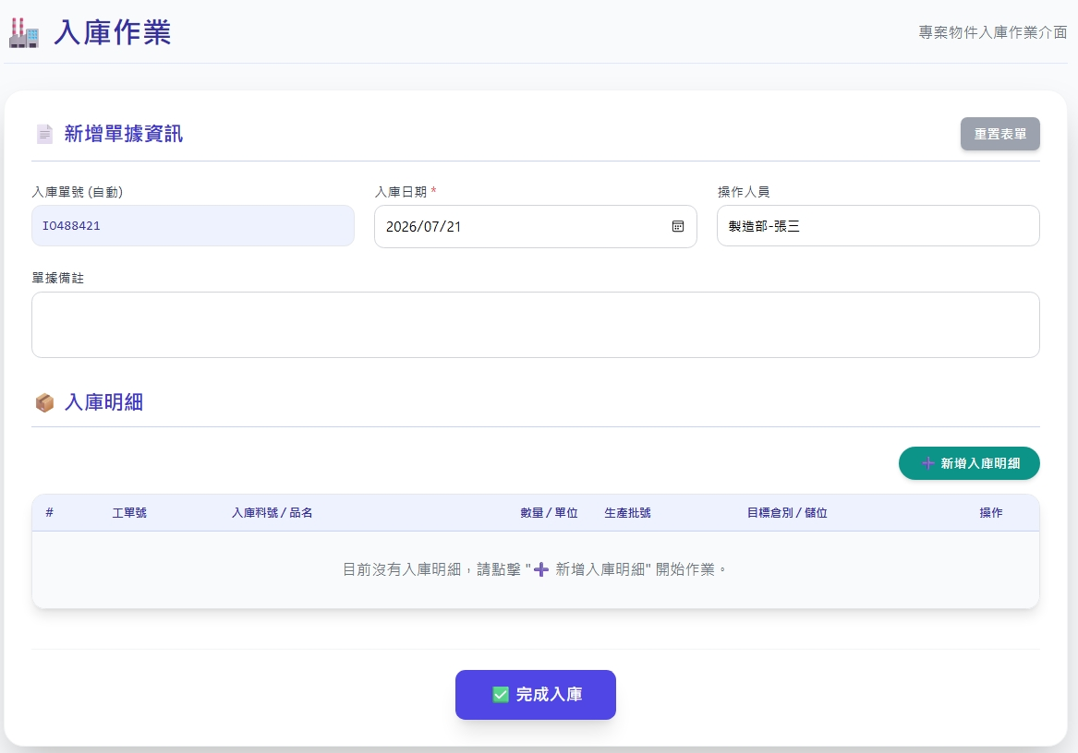
Date | App / Web | Protocol | description
2026/07/17 | Web | Api | 倉庫發料作業
可選填
invEventNo
actionDt
createRemark

Slide 2
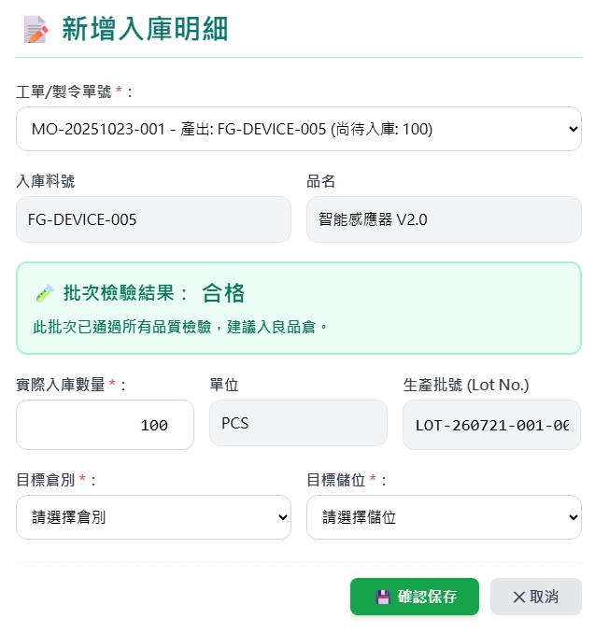
新增 Dialog
Order List
Order Get
web/warehouse/option
選倉後打
web/locator/option

Slide 3
新增 Dialog
Order List
sp_web_runcard_qty_summary
-------------------------
Input :
@rcid BIGINT
Output :
rec_id
rcid
erpno
rcno
bmverid
ver
pid
pno
pname
unit
prdqty // 工單生產數量
qty // 良品數
scrap_qty // 不良數
良品
web/warehouse/option
良品
良品
選倉後打
不良品入庫數量 :
單位
生產批號
web/locator/option
不良品倉別
不良品儲位

Slide 4
進入頁面
完成
可選填
invEventNo
actionDt
createRemark

Slide 5
點下新增
新增dialog
完成

Slide 6
完成
API
完成
web/stocking/combo

Slide 7
web/warehouse/option
Server | Method | Request Param | Response Param
https://localhost: | GET |  | List<Option> --------------------------------- public class Option { public int warehouseId public string warehouseNo public string warehouseName public byte warehouseTypeId public string warehouseTypename }

Slide 8
web/locator/option
Server | Method | Request Param | Response Param
https://localhost: | GET |  | List<Option> --------------------------------- public class Option { public int locatorId public int warehouseId public string locatorNo public string locatorName }

Slide 9
web/stocking/combo
Server | Method | Request Param | Response Param
https://localhost: | Post | public class Create { public long? invInspId // 目前為空 public DateTime actionDt public string? createRemark public string? invEventNo // 可為空，或填寫 public List<ReceivingEventDetail> detail } Public class ShippingEventDetail { public required bool isEntry // 入庫一律為 true public required int wareId // 倉庫 id public required int lctrId // 儲位 id public required long pId // 料號 public required float qty // 數量 public string? bchNo // 批號 public long? erpOrderId // public long? rcId // public long? rtId // 先為 null public int? custId // 入庫一律為 null public int? supplyId // 入庫一律為 null public string? remark } | String OK

