Slide 1
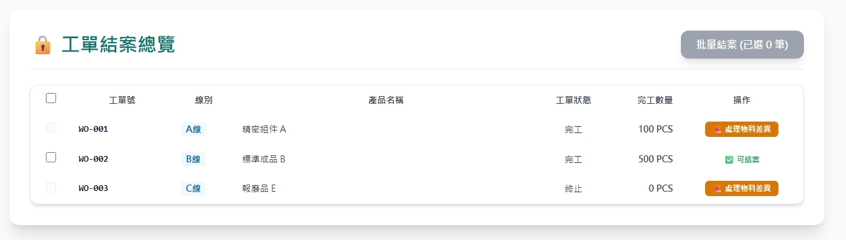
Date | App / Web | Protocol | description
2026/07/20 | Web | Api | 工單結案

Slide 2
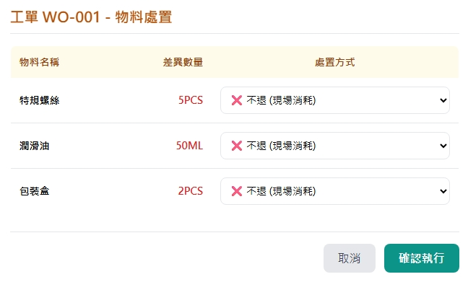
操作 Dialog
web/record/erp/remain
web/warehouse/option
web/warehouse/option
pno / pname
bchno
qty
退料至倉庫
退料至儲位

Slide 3
進入頁面
完成

Slide 4
點下操作
操作dialog
API
完成
退料
API
完成
不退料

Slide 5
web/record/erp/remain
Server | Method | Request Param | Response Param
https://localhost: | GET |  | List<Option> --------------------------------- public class PartSummary { public long pid public string pno public string pname public string? unit public float qty public long invtryid public int warehouseId public string warehouseNo public string warehouseName public int locatorId public string locatorNo public string locatorName public string? bchno public string? bchdt }

Slide 6
web/warehouse/option
Server | Method | Request Param | Response Param
https://localhost: | GET |  | List<Option> --------------------------------- public class Option { public int warehouseId public string warehouseNo public string warehouseName public byte warehouseTypeId public string warehouseTypename }

Slide 7
web/locator/option
Server | Method | Request Param | Response Param
https://localhost: | GET |  | List<Option> --------------------------------- public class Option { public int locatorId public int warehouseId public string locatorNo public string locatorName }

Slide 8
web/invChange/combo
Server | Method | Request Param | Response Param
https://localhost: | Post | public class Create { public long? invInspId // 目前為空 public DateTime actionDt public string? createRemark public string? invEventNo // 可為空，或填寫 public List<ReceivingEventDetail> detail } Public class ReceivingEventDetail { public required bool isEntry // 描述進出倉 public required int wareId // 倉庫 id public required int lctrId // 儲位 id public required long pId // 料號 public required float qty // 數量 public string? bchNo // 批號 public long? erpOrderId // public long? rcId // 退料一律為 null public long? rtId // 退料一律為 null public int? custId // 退料一律為 null public int? supplyId // 退料一律為 null public string? remark } | String OK
// detail 下 為 一出一進
[
// 從 wareid 1 lctrid 1 出去 pid 2 批號 lot_no 共 50 個
{
"isEntry": false,
"wareId": 1,
"lctrId": 1,
"pId": 2,
"qty": 50,
"bchNo": "相同 lot_no",
"erpOrderId": null,
"rcId": null,
"rtId": null,
"custId": null,
"supplyId": null,
"remark": "remark“
},
// 從 wareid 5 lctrid 6 收到 pid 2 批號 lot_no 共 50 個
{
“isEntry”: true,
"wareId": 5,
"lctrId": 6,
"pId": 2,
"qty": 50,
"bchNo": "相同 lot_no",
"erpOrderId": null,
"rcId": null,
"rtId": null,
"custId": null,
"supplyId": null,
"remark": "remark“
}
]

Slide 9
web/remaining/combo
Server | Method | Request Param | Response Param
https://localhost: | Post | public class Create { public long? invInspId // 目前為空 public DateTime actionDt public string? createRemark public string? invEventNo // 可為空，或填寫 public List<ReceivingEventDetail> detail } Public class ReceivingEventDetail { public required bool isEntry // 報銷 都為 false public required int wareId // 倉庫 id public required int lctrId // 儲位 id public required long pId // 料號 public required float qty // 數量 public string? bchNo // 批號 public long? erpOrderId // public long? rcId // 調撥一律為 null public long? rtId // 調撥一律為 null public int? custId // 調撥一律為 null public int? supplyId // 調撥一律為 null public string? remark } | String OK

