Slide 1
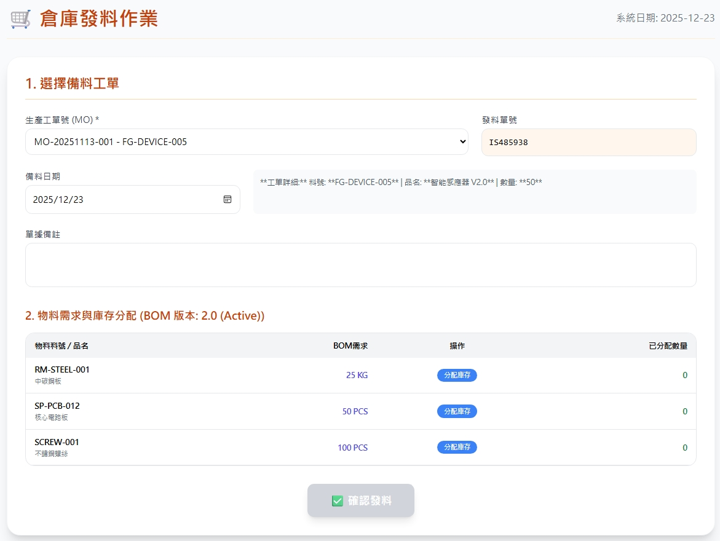
Date | App / Web | Protocol | description
2026/07/17 | Web | Api | 倉庫發料作業
可選填
invEventNo
actionDt
createRemark

Slide 2
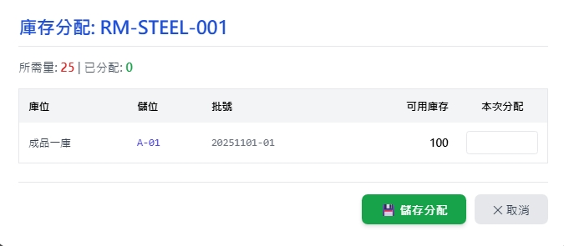
新增 Dialog
web/record/part
warehouseNo
locatorNo
warehouseName
locatorName
bchno
qty

Slide 3
進入頁面
API
完成
Order List

Slide 4
選擇單
API
完成
Get bom

Slide 5
點料
新增dialog
完成

Slide 6
完成
API
完成
web/issuing/combo

Slide 7
web/record/part
Server | Method | Request Param | Response Param
https://localhost: | GET |  | List<PartSummary> --------------------------------- public class PartSummary { public long pid public string pno public string pname public string? unit public float qty public long invtryid public int warehouseId public string warehouseNo public string warehouseName public int locatorId public string locatorNo public string locatorName public string? bchno public string? bchdt }

Slide 8
web/issuing/combo
Server | Method | Request Param | Response Param
https://localhost: | Post | public class Create { public long? invInspId // 目前為空 public DateTime actionDt public string? createRemark public string? invEventNo // 可為空，或填寫 public List<ReceivingEventDetail> detail } Public class ShippingEventDetail { public required bool isEntry // 發料一律為 false public required int wareId // 倉庫 id public required int lctrId // 儲位 id public required long pId // 料號 public required float qty // 數量 public string? bchNo // 批號 public long? erpOrderId // public long? rcId // 發料一律為 null public long? rtId // 發料一律為 null public int? custId // 發料一律為 null public int? supplyId // 發料一律為 null public string? remark } | String OK

