Slide 1
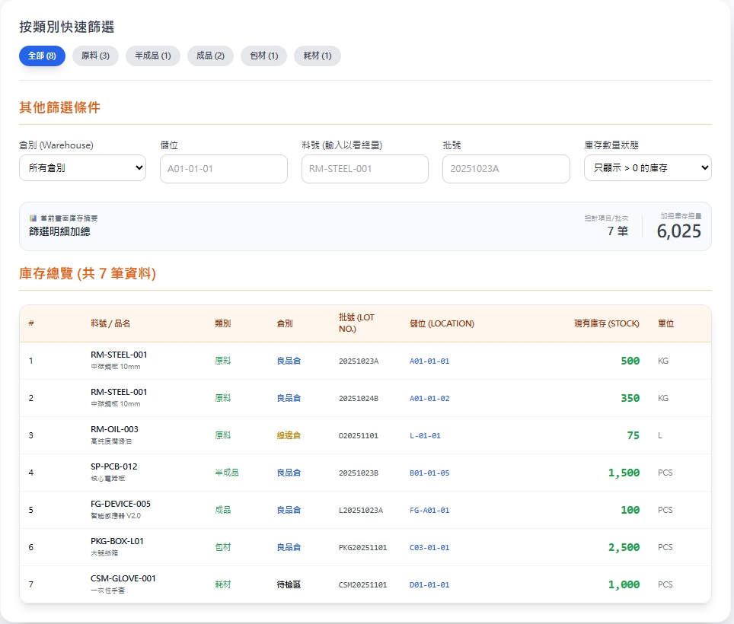
Date | App / Web | Protocol | description
2026/07/20 | Web | Api | 庫存查詢
pno / pname
ptname
bchno
qty
unit
locatorNo / locatorName
warehouseNo / warehouseName

Slide 2
點下完成
API
完成
web/record/list
pno / pname
ptname
bchno
qty
unit
locatorNo / locatorName
warehouseNo / warehouseName

Slide 3
web/record/list
Server | Method | Request Param | Response Param
https://localhost: | GET | [FromQuery] int? ptid, [FromQuery] int? warehouseId, [FromQuery] int? locatorId, [FromQuery] string? pno, [FromQuery] string? bchno, [FromQuery] bool? qtyState, [FromQuery] int pageIndex = 1, [FromQuery] short pageSize = 10 | Page<Data> --------------------------------- public class PartSummary { public long pid public string pno public string pname public string? unit public float qty public long invtryid public int warehouseId public string warehouseNo public string warehouseName public int locatorId public string locatorNo public string locatorName public string? bchno public string? bchdt public int ptid public string ptno public string ptname public byte warehouseTypeId public string warehouseTypeNo public string warehouseTypename }

