Slide 1
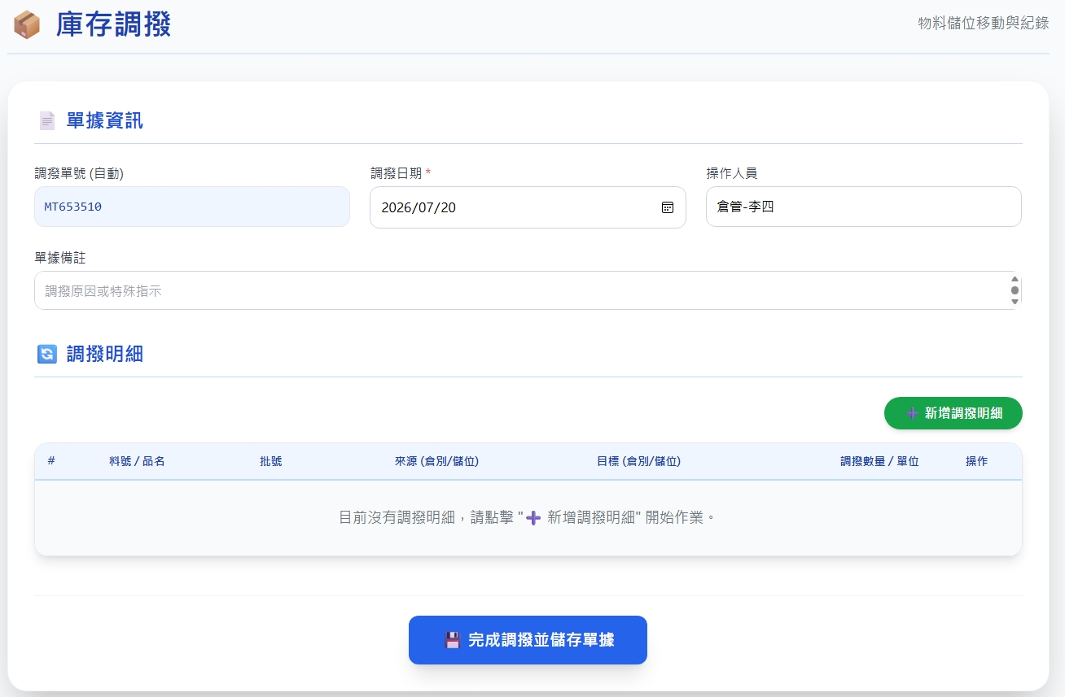
Date | App / Web | Protocol | description
2026/07/20 | Web | Api | 調撥作業
可選填
invEventNo
actionDt
supplyId
createRemark

Slide 2
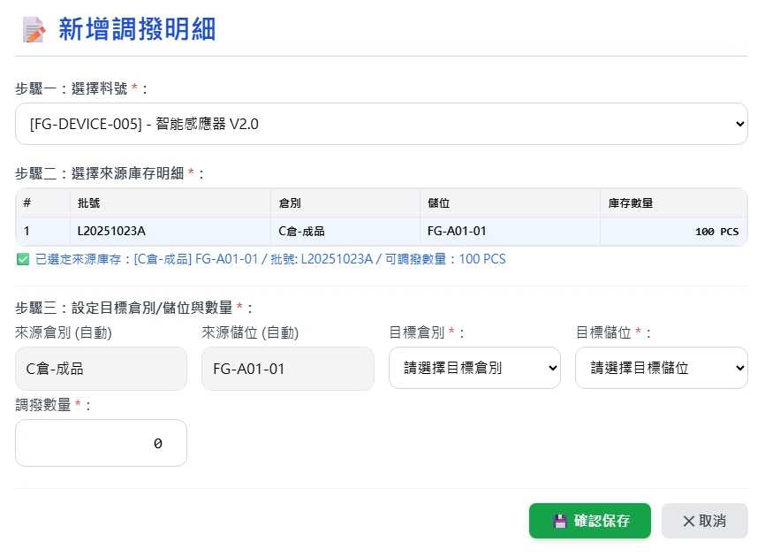
新增 Dialog
web/record/part/summary
web/record/part
web/warehouse/option
web/warehouse/option

Slide 3
進入頁面
完成
可選填
invEventNo
actionDt
createRemark

Slide 4
點下完成
API
完成
web/transfer/combo

Slide 5
web/record/part/summary
Server | Method | Request Param | Response Param
https://localhost: | GET |  | List<Option> --------------------------------- public class PartSummary { public long pid public string pno public string pname public string? unit public float qty }

Slide 6
web/record/part
Server | Method | Request Param | Response Param
https://localhost: | GET |  | List<PartSummary> --------------------------------- public class PartSummary { public long pid public string pno public string pname public string? unit public float qty public long invtryid public int warehouseId public string warehouseNo public string warehouseName public int locatorId public string locatorNo public string locatorName public string? bchno public string? bchdt }

Slide 7
web/warehouse/option
Server | Method | Request Param | Response Param
https://localhost: | GET |  | List<Option> --------------------------------- public class Option { public int warehouseId public string warehouseNo public string warehouseName public byte warehouseTypeId public string warehouseTypename }

Slide 8
web/locator/option
Server | Method | Request Param | Response Param
https://localhost: | GET |  | List<Option> --------------------------------- public class Option { public int locatorId public int warehouseId public string locatorNo public string locatorName }

Slide 9
web/transfer/combo
Server | Method | Request Param | Response Param
https://localhost: | Post | public class Create { public long? invInspId // 目前為空 public DateTime actionDt public string? createRemark public string? invEventNo // 可為空，或填寫 public List<ReceivingEventDetail> detail } Public class ReceivingEventDetail { public required bool isEntry // 描述進出倉 public required int wareId // 倉庫 id public required int lctrId // 儲位 id public required long pId // 料號 public required float qty // 數量 public string? bchNo // 批號 public long? erpOrderId // 調撥一律為 null public long? rcId // 調撥一律為 null public long? rtId // 調撥一律為 null public int? custId // 調撥一律為 null public int? supplyId // 調撥一律為 null public string? remark } | String OK
// detail 下 為 一出一進
[
// 從 wareid 1 lctrid 1 出去 pid 2 批號 lot_no 共 50 個
{
"isEntry": false,
"wareId": 1,
"lctrId": 1,
"pId": 2,
"qty": 50,
"bchNo": "相同 lot_no",
"erpOrderId": null,
"rcId": null,
"rtId": null,
"custId": null,
"supplyId": null,
"remark": "remark“
},
// 從 wareid 5 lctrid 6 收到 pid 2 批號 lot_no 共 50 個
{
“isEntry”: true,
"wareId": 5,
"lctrId": 6,
"pId": 2,
"qty": 50,
"bchNo": "相同 lot_no",
"erpOrderId": null,
"rcId": null,
"rtId": null,
"custId": null,
"supplyId": null,
"remark": "remark“
}
]

