Slide 1
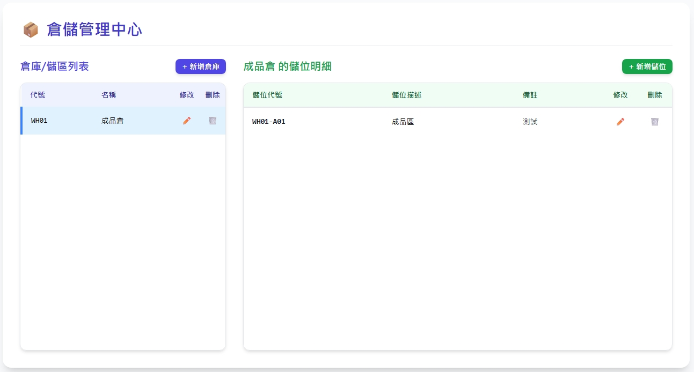
Date | App / Web | Protocol | description
2026/07/17 | Web | Api | 倉儲管理
warehouseNo
warehouseName
warehouseTypename
locatorNo
locatorName
remark

Slide 2
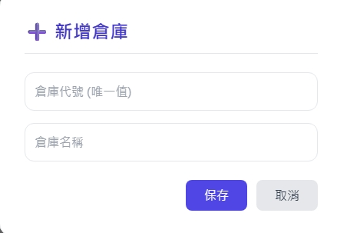
新增倉庫 Dialog
warehouseNo
warehouseName
web/ct/warehouse/type/list
倉庫類型
備註

Slide 3
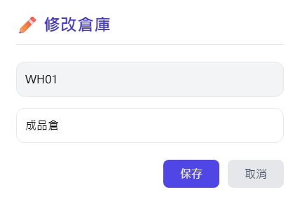
修改倉庫Dialog
web/warehouse/get
warehouseNo
warehouseName
web/ct/warehouse/type/list
倉庫類型
備註

Slide 4
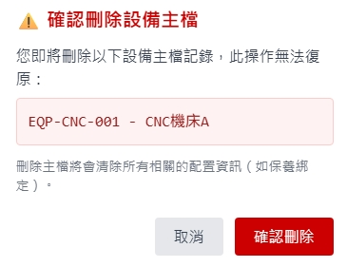
刪除倉庫 Dialog
類似這樣

Slide 5
進入頁面
API
完成
web/warehouse/list
warehouseNo
warehouseName
warehouseTypename
locatorNo
locatorName
remark

Slide 6
點下
新增倉庫
新增倉庫dialog
API
完成
web/warehouse/create
倉庫類型
備註

Slide 7
點下
修改倉庫
修改倉庫dialog
API
完成
web/warehouse/update
倉庫類型
備註

Slide 8
點下刪除
刪除dialog
API
完成
web/warehouse/delete
類似這樣

Slide 9
web/ct/warehouse/type/list
Server | Method | Request Param | Response Param
https://localhost: | GET |  | List<WarehouseType> --------------------------------- public class WarehouseType { public byte warehouseTypeId public string warehouseTypeNo public string warehouseTypeName }

Slide 10
web/warehouse/list
Server | Method | Request Param | Response Param
https://localhost: | GET | [FromQuery] List<Filter> filter // 目前為空 [FromQuery] int pageIndex [FromQuery] short pageSize ------------------------------------------- public class Filter { public FilterLogic logic public FilterOp op public string col public string value public string value2 } | Page<Data> --------------------------------- public class Data { public int warehouseId public string warehouseNo public string warehouseName public byte warehouseTypeId public string warehouseTypename public string warehouseTypeNo public string? remark public string updateBy public string updateDt }

Slide 11
web/warehouse/get
Server | Method | Request Param | Response Param
https://localhost: | GET | [FromQuery] int warehouseId | public class Data { public int warehouseId public string warehouseNo public string warehouseName public byte warehouseTypeId public string warehouseTypename public string warehouseTypeNo public string? remark public string updateBy public string updateDt }

Slide 12
web/warehouse/create
Server | Method | Request Param | Response Param
https://localhost: | Post | public class Create { public string warehouseNo public string warehouseName public byte warehouseTypeId public string? remark } | Page<Data> --------------------------------- public class Data { public int warehouseId public string warehouseNo public string warehouseName public byte warehouseTypeId public string warehouseTypename public string warehouseTypeNo public string? remark public string updateBy public string updateDt }

Slide 13
web/warehouse/update
Server | Method | Request Param | Response Param
https://localhost: | PUT | public class Update { public int warehouseId public string warehouseName public byte warehouseTypeId public string? remark } | Page<Data> --------------------------------- public class Data { public int warehouseId public string warehouseNo public string warehouseName public byte warehouseTypeId public string warehouseTypename public string warehouseTypeNo public string? remark public string updateBy public string updateDt }

Slide 14
web/warehouse/delete
Server | Method | Request Param | Response Param
https://localhost: | DELETE | public class Delete { public int warehouseId } | Page<Data> --------------------------------- public class Data { public int warehouseId public string warehouseNo public string warehouseName public byte warehouseTypeId public string warehouseTypename public string warehouseTypeNo public string? remark public string updateBy public string updateDt }

Slide 15
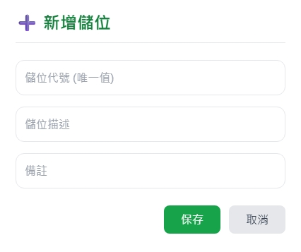
新增儲位 Dialog
locatorNo
locatorName

Slide 16
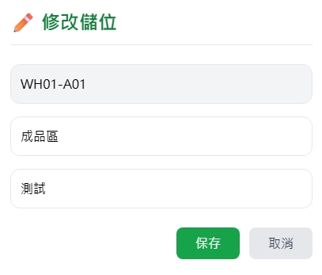
修改儲位Dialog
web/locator/get

Slide 17
刪除儲位 Dialog
類似這樣

Slide 18
點下倉庫
API
完成
web/locator/list
warehouseNo
warehouseName
warehouseTypename
locatorNo
locatorName
remark

Slide 19
點下新增儲位
新增儲位dialog
API
完成
web/locator/create
locatorNo
locatorName

Slide 20
點下
修改儲位
修改儲位dialog
API
完成
web/locator/update

Slide 21
點下
刪除儲位
刪除儲位dialog
API
完成
web/locator/delete
類似這樣

Slide 22
web/locator/list
Server | Method | Request Param | Response Param
https://localhost: | GET | [FromQuery] List<Filter> filter // 目前為空 [FromQuery] int pageIndex [FromQuery] short pageSize [FromQuery] int warehouseId ------------------------------------------- public class Filter { public FilterLogic logic public FilterOp op public string col public string value public string value2 } | Page<Data> --------------------------------- public class Data { public int locatorId public int warehouseId public string locatorNo public string locatorName public string? remark }

Slide 23
web/locator/get
Server | Method | Request Param | Response Param
https://localhost: | GET | [FromQuery] int locatorId | public class Data { public int locatorId public int warehouseId public string locatorNo public string locatorName public string? remark }

Slide 24
web/locator/create
Server | Method | Request Param | Response Param
https://localhost: | Post | public class Create { public int warehouseId public string locatorNo public string locatorName public string? remark } | Page<Data> --------------------------------- public class Data { public int locatorId public int warehouseId public string locatorNo public string locatorName public string? remark }

Slide 25
web/locator/update
Server | Method | Request Param | Response Param
https://localhost: | PUT | public class Update { public int warehouseId public int locatorId public string locatorName public string? remark } | Page<Data> --------------------------------- public class Data { public int locatorId public int warehouseId public string locatorNo public string locatorName public string? remark }

Slide 26
web/locator/delete
Server | Method | Request Param | Response Param
https://localhost: | DELETE | public class Delete { public int warehouseId public int locatorId } | Page<Data> --------------------------------- public class Data { public int locatorId public int warehouseId public string locatorNo public string locatorName public string? remark }

