Slide 1
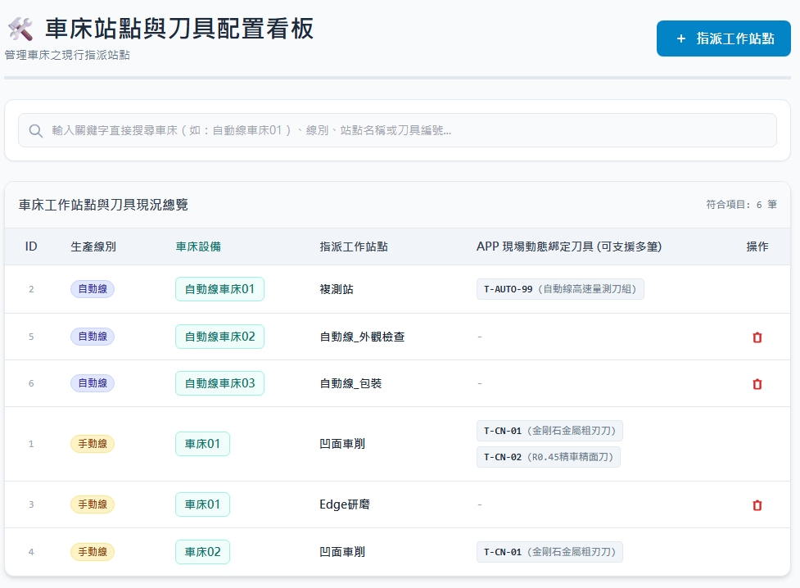
Date | App / Web | Protocol | description
2026/07/06 | Web | Api | 站點機台綁定關係
fctname
eqpname
opname
moldno / moldname

Slide 2
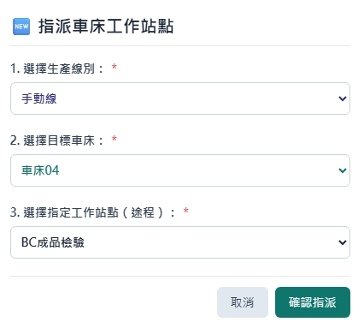
指派 Dialog
web/facility/option/list
web/MapOpEqp/option/eqp/list
web/MapOpEqp/option/op/list

Slide 3
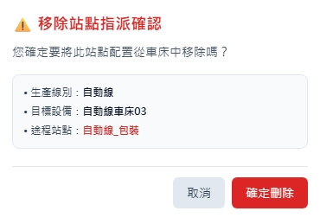
刪除 Dialog

Slide 4
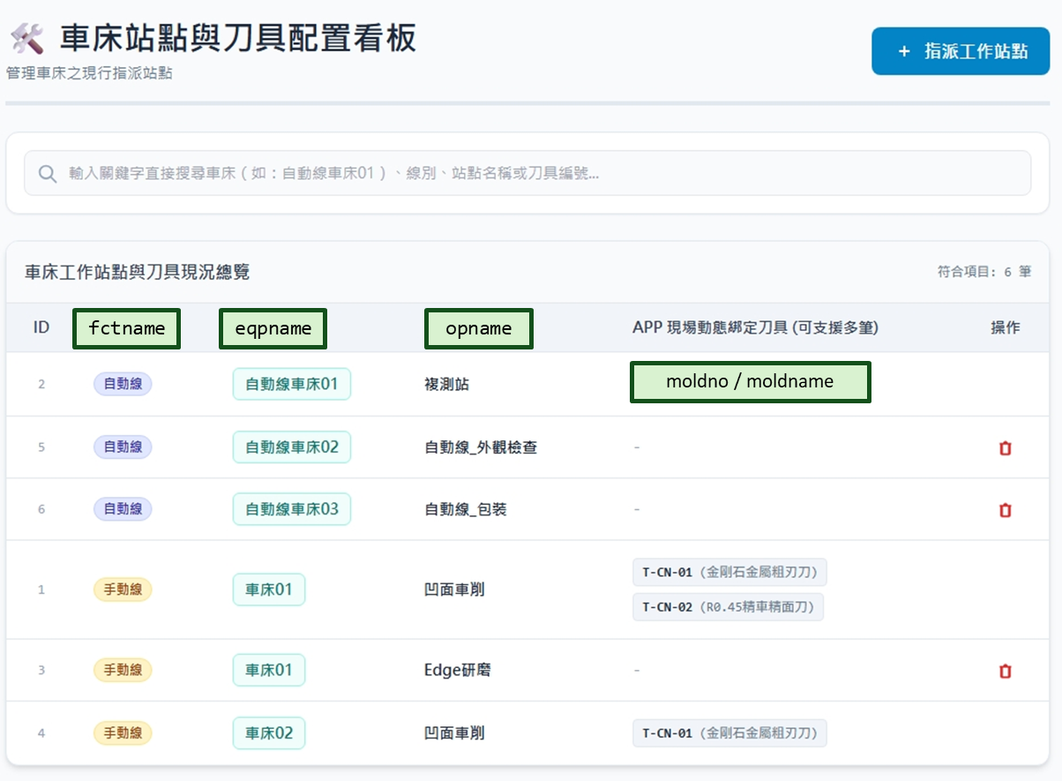
進入頁面
API
完成
web/MapOpEqp/list

Slide 5
點下指派
指派dialog
API
完成
web/MapOpEqp/create

Slide 6
點下刪除
刪除dialog
API
完成
web/MapOpEqp/delete

Slide 7
web/facility/option/list
Server | Method | Request Param | Response Param
https://localhost: | GET |  | List<Option> --------------------------------- public class Option { public byte fctId public string fctNo public string fctName }

Slide 8
web/MapOpEqp/option/eqp/list
Server | Method | Request Param | Response Param
https://localhost: | GET | fctid byte? | List<Equip> --------------------------------- public class Equip { public int eqpid public string eqpno public string eqpname }

Slide 9
web/MapOpEqp/option/op/list
Server | Method | Request Param | Response Param
https://localhost: | GET | fctid byte? | List<Operation> --------------------------------- public class Operation { public int opid public string opname }

Slide 10
web/MapOpEqp/list
Server | Method | Request Param | Response Param
https://localhost: | GET | page int? pageSize int? searchStr string? | Page<Data> ------------------------------------------ public class Data { public byte fctid public string fctno public string fctname public int eqpid public string eqpno public string eqpname public int opid public string opname public List<MoldOption> molds } public class MoldOption { public int moldid public string moldno public string mldname }

Slide 11
web/MapOpEqp/create
Server | Method | Request Param | Response Param
https://localhost: | POST | public class Create { public int? page public int? pageSize public int eqpid public int opid } | Page<Data> ------------------------------------------ public class Data { public byte fctid public string fctno public string fctname public int eqpid public string eqpno public string eqpname public int opid public string opname public List<MoldOption> molds } public class MoldOption { public int moldid public string moldno public string mldname }

Slide 12
web/MapOpEqp/delete
Server | Method | Request Param | Response Param
https://localhost: | DELETE | public class Delete { public int? page public int? pageSize public int eqpid public int opid } | Page<Data> ------------------------------------------ public class Data { public byte fctid public string fctno public string fctname public int eqpid public string eqpno public string eqpname public int opid public string opname public List<MoldOption> molds } public class MoldOption { public int moldid public string moldno public string mldname }

