Slide 1
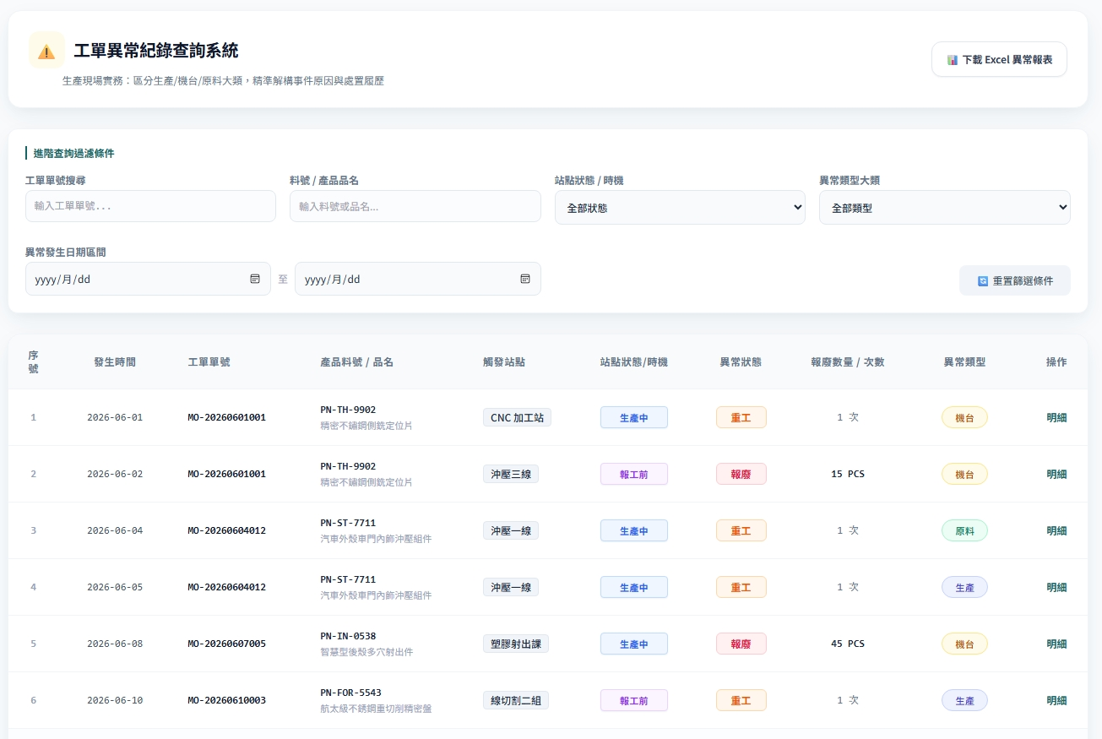
Date | App / Web | Protocol | description
2026/06/16 | Web | Api | 異常紀錄查詢
站點
開工前 / 生產中
strDt
erpOrderNo
pno
opname
Is_checkin
abnormalState
is_checkin = true = 生產中
is_checkin = false = 開工前
count
restname

Slide 2
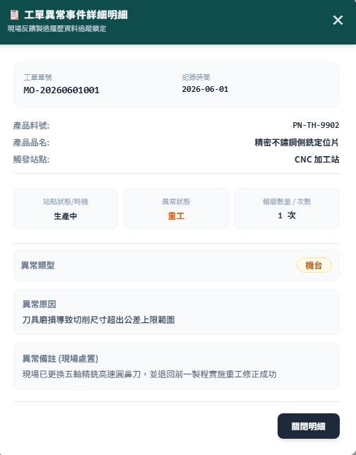
紀錄 Dialog
erpOrderNo
strDt
pno
pname
opname
Is_checkin
abnormalState
count
restname
resname
異常備註(現場紀錄)
remark
異常備註(處置記錄)
remarkAction

Slide 3
搜尋
API
完成
web/rc/traceability/abnormal/list
web/ct/reason/type/list
開工前 / 生產中
strDt
erpOrderNo
pno
opname
Is_checkin
abnormalState
count
restname

Slide 4
點下檢視
檢視dialog
完成
erpOrderNo
strDt
pno
pname
opname
Is_checkin
abnormalState
count
restname
resname
異常備註(現場紀錄)
remark
異常備註(處置記錄)
remarkAction

Slide 5
web/ct/reason/type/list
Server | Method | Request Param | Response Param
https://localhost: | GET |  | List<Reason> ---------------------------------------------------- public class Reason { public int restid public string restname }

Slide 6
web/rc/traceability/abnormal/list
Server | Method | Request Param | Response Param
https://localhost: | GET | int? page int? pageSize string? orderNo string? pno bool? is_checkin int? restid DateTime strDt DateTime endDt | List<TraceabilityAbnormal> ---------------------------------------------------- public class TraceabilityAbnormal { public long rcabnid public string erpOrderNo public string pno public string pname public string opname public string strDt public string endDt public bool is_checkin public string abnormalState public string? remark public string? remarkAction public int count public string restname public string resname }

Slide 7
web/rc/traceability/abnormal/get
Server | Method | Request Param | Response Param
https://localhost: | GET | rcabnid long | public class TraceabilityAbnormal { public long rcabnid public string erpOrderNo public string pno public string pname public string opname public string strDt public string endDt public bool is_checkin public string abnormalState public string? remark public string? remarkAction public int count public string restname public string resname }

