Slide 1
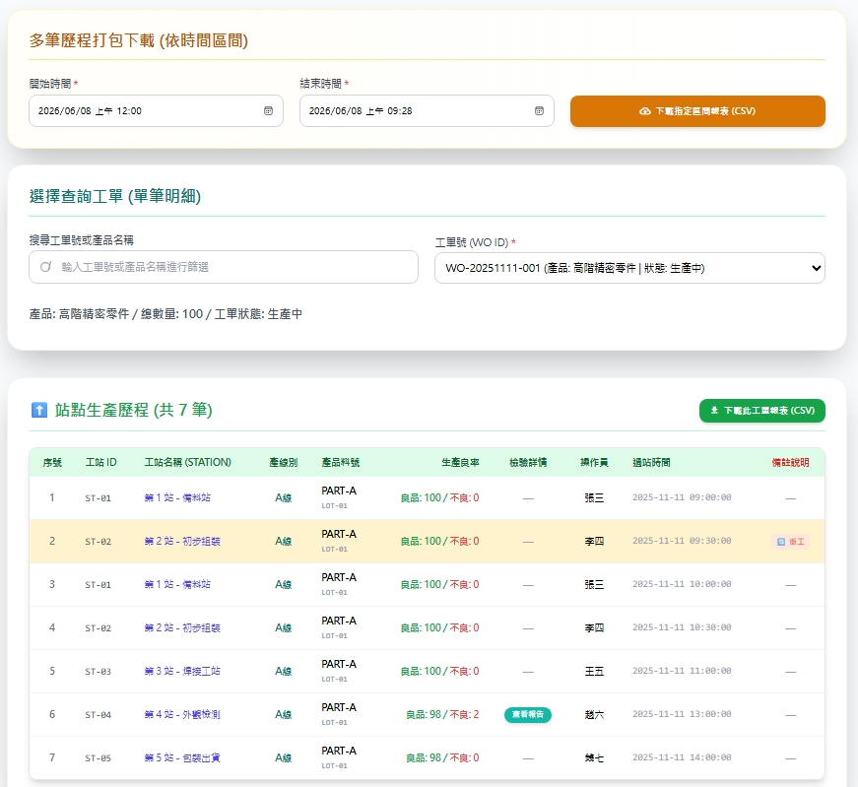
Date | App / Web | Protocol | description
2026/06/08 | Web | Api | 工單生產紀錄查詢-Excel
途程順序
異常紀錄

Slide 2
web/excel/history/download
Server | Method | Request Param | Response Param
https://localhost: | GET | [FromQuery] DateTime startDt, [FromQuery] DateTime endDt | File ( memoryStream, "application/vnd.openxmlformats-officedocument.spreadsheetml.sheet", fileName )

Slide 3
web/excel/runcard/download
Server | Method | Request Param | Response Param
https://localhost: | GET | [FromQuery] long rcid | File ( memoryStream, "application/vnd.openxmlformats-officedocument.spreadsheetml.sheet", fileName )

