Slide 1
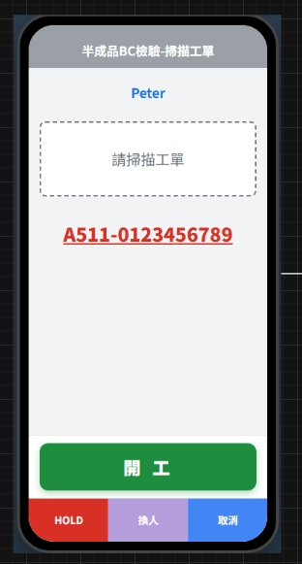
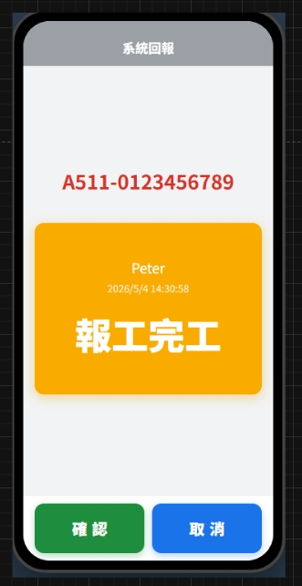
Date | App / Web | Protocol | description
2026/06/09 | App | Api | 複測站
DIA
BC
Power

Slide 2
進入頁面
API
完成
app/rc/remeasure/check

Slide 3
app/rc/remeasure/check
Server | Method | Request Param | Response Param
https://localhost: | POST | List<Selected> --------------------------------------------- public class Selected { public long rcid public long mpoid public int? eqpid public string erpOrderNo public bool is_start } | List<Remeasure> // 理論上只會有三個 elements ------------------------------------- public class Remeasure { public long rcid public long mpoid public int? eqpid // 原則上都是 null public string erpOrderNo public bool is_start public bool is_pass // 用來判斷要不要進檢驗單 public List<Sheet> sheet } public class Sheet // 此為機台和檢驗單綁定 { public int sheetid // public int? eqpid // 如果不是null 要列機台給使用者選 public string eqpno public string eqpname public List<Item> items } public class Item // 顯示與判斷方式與 檢驗 apptype 相同 { public int itid public string itno public string itname public bool isMeasure public string defaultValue public string minValue public string maxValue public byte optid public string opttxt public string optDes public string? routkey public string value // 此欄位用來接收使用者輸入 }

Slide 4
進入頁面
API
完成
app/rc/remeasure/checkin

Slide 5
app/rc/remeasure/checkin
Server | Method | Request Param | Response Param
https://localhost: | POST | List<Remeasure> ------------------------------------- public class Remeasure { public long rcid public long mpoid public int? eqpid public string erpOrderNo public bool is_start public bool is_pass public List<Sheet> sheet } public class Sheet { public int sheetid public int? eqpid public string eqpno public string eqpname public List<Item> items } public class Item { public int itid public string itno public string itname public bool isMeasure public string defaultValue public string minValue public string maxValue public byte optid public string opttxt public string optDes public string? routkey public string value } | String OK

