Slide 1
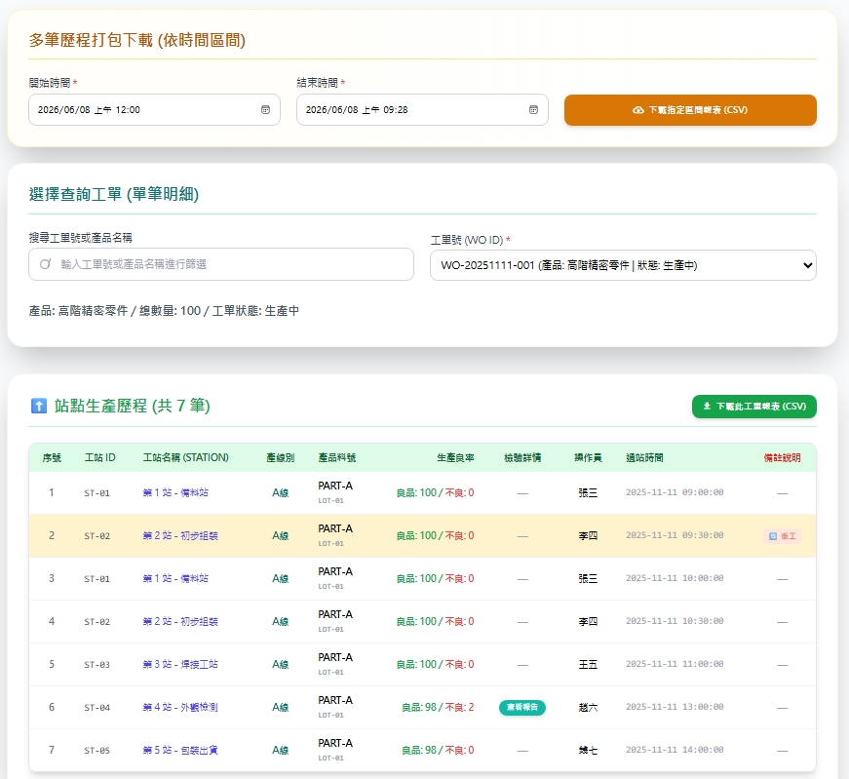
Date | App / Web | Protocol | description
2026/06/08 | Web | Api | 工單生產紀錄查詢
途程順序
異常紀錄

Slide 2
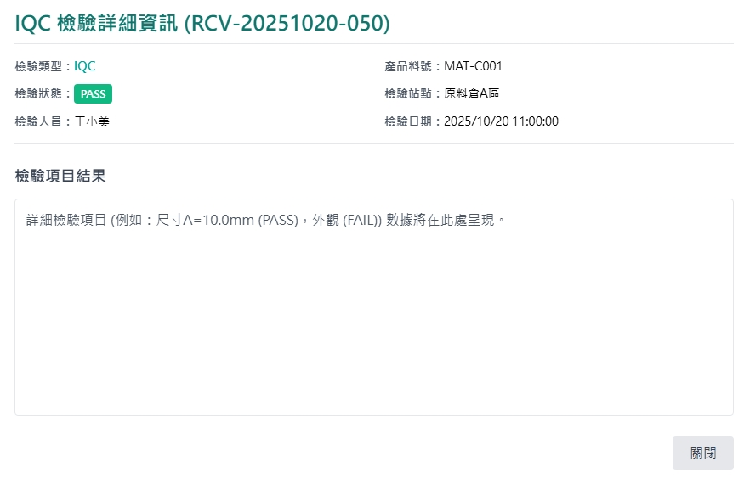
紀錄 Dialog
web/rc/insp/order/get
工單號碼 :
項目編號
項目名稱
單位
檢驗結果
檢驗值

Slide 3
進入頁面
完成
途程順序
異常紀錄

Slide 4
搜尋
API
完成
web/rc/traceability/list
途程順序
異常紀錄

Slide 5
選擇工單
API
完成
web/rc/traceability/get
途程順序
異常紀錄
oseq
fctname
checkinQty / scrapQty
oEndDt
opname
pno
oEndUser
abnormal
apteid = 3 才有

Slide 6
點下檢視
檢視dialog
完成
工單號碼 :
項目編號
項目名稱
單位
檢驗結果
檢驗值
itno
unit
value
itname
isPass

Slide 7
web/rc/traceability/list
Server | Method | Request Param | Response Param
https://localhost: | GET | searchStr string | List<Data> --------------------------------- public class Data { public long rcid public string erpOrderNo public string pno public string runstename }

Slide 8
web/rc/traceability/get
Server | Method | Request Param | Response Param
https://localhost: | GET | rcid long | List<Data> --------------------------------- public class Data { public string erpOrderNo public string pno public string fctname public short apteid public string opname public int oseq public int checkinQty public int checkoutQty public int scrapQty public string oStrUser public string oStrDt public string oEndUser public string oEndDt public string abnormal public long? inspoid }

Slide 9
web/rc/insp/order/get
Server | Method | Request Param | Response Param
https://localhost: | GET | inspoid long | public class Data { public long inspoid public string erpOrderNo public string pno public string opname public bool isPass public string inspBy public string inspDt public List<InspData> data } public class InspData { public string itno public string itname public string unit public bool isPass public string value }

