Slide 1
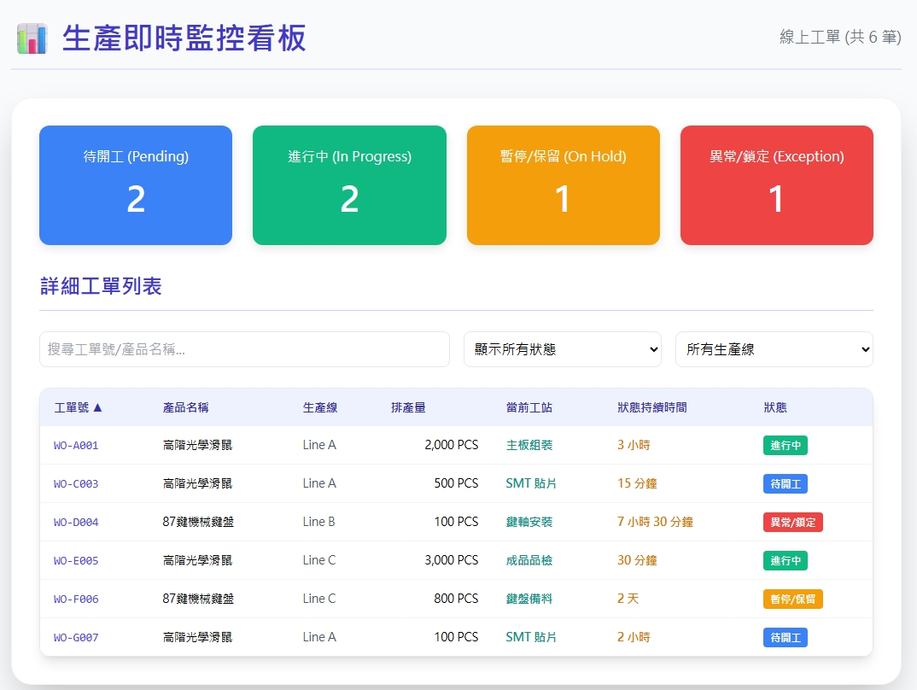
及時Date | App / Web | Protocol | description
2026/06/05 | Web | Api | 生產即時監控
搜尋

Slide 2
進入頁面
API
完成
web/ct/runcard/state/list
web/facility/option/list
web/rc/current/summary
web/rc/current/list
搜尋
erpOrderNo
pno
fctno / fctname
prdqty
opname
Days / hours/ minutes
runstate

Slide 3
web/facility/option/list
Server | Method | Request Param | Response Param
https://localhost: | GET |  | List<Option> -------------------------------------------- public class Option { public byte fctId public string fctNo public string fctName }

Slide 4
web/ct/runcard/state/list
Server | Method | Request Param | Response Param
https://localhost: | GET |  | List<Data> -------------------------------------------- public class Data { public byte runsteid public string runstename public string color public string colorHex }

Slide 5
web/rc/current/summary
Server | Method | Request Param | Response Param
https://localhost: | GET |  | Public class CurrentSummary { public int pendingCount public int processingCount public int holdCount }

Slide 6
web/rc/current/list
Server | Method | Request Param | Response Param
https://localhost: | GET | page int? pageSize int? searchStr string? rcsteid byte? fctid byte? | Page<Data> ----------------------------- public class Data { public long rcid public byte fctid public string erpOrderNo public string pno public string fctno public string fctname public int prdqty public string opname public int days public int hours public int mintes public string runstate public string runstateColorHex }

