Slide 1
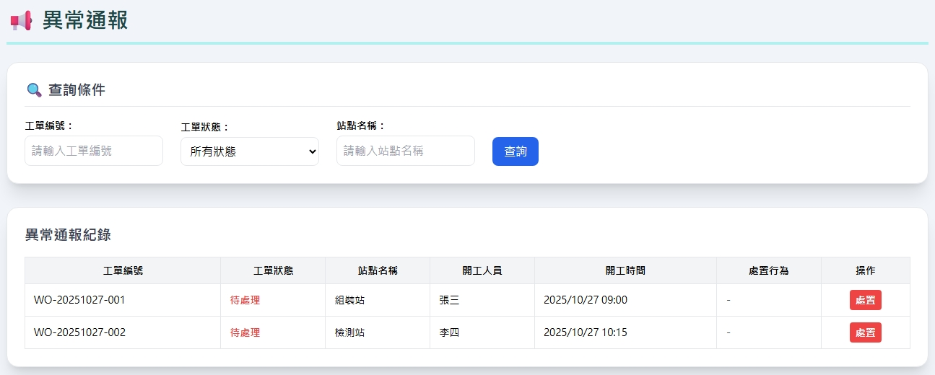
Date | App / Web | Protocol | description
2026/06/01 | Web | Api | 異常通報
備註

Slide 2
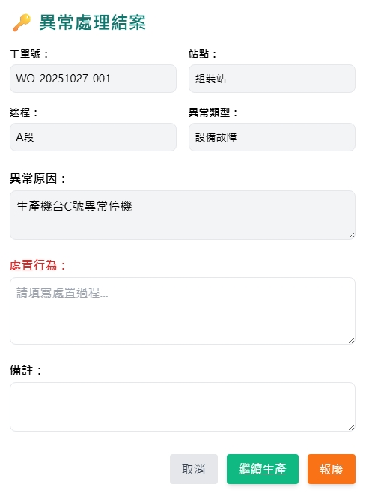
處置 Dialog
web/rc/abnormal/get
erpOrderNo
opname
routingName
restname
web/rc/abnormal/close
resname
remark

Slide 3
進入頁面
API
完成
web/rc/abnormal/list
erpOrderNo
opname
opStrby
opStrDt
remark

Slide 4
點下處置
處置dialog
API
完成

Slide 5
web/rc/abnormal/list
Server | Method | Request Param | Response Param
https://localhost: | GET | page INT? pageSize INT? orderNo string? opname string? | Page<AbnormalData> --------------------------------- public class AbnormalData { public long rcabnid public string erpOrderNo public string opname public string opStrDt public string opStrBy public string? remark }

Slide 6
web/rc/abnormal/get
Server | Method | Request Param | Response Param
https://localhost: | GET | rcabnid long | public class AbnormalData { public long rcabnid public string erpOrderNo public string opname public string opStrDt public string opStrBy public string? remark public string routingName public int resid public string resno public string resname public int restid public string restname }

Slide 7
web/rc/abnormal/close
Server | Method | Request Param | Response Param
https://localhost: | Post | public class AbnormalClose { public int? page public int? pageSize public long rcabnid public bool is_scarp public string? remarkAction } | Page<AbnormalData> --------------------------------- public class AbnormalData { public long rcabnid public string erpOrderNo public string opname public string opStrDt public string opStrBy public string? remark }

