Slide 1
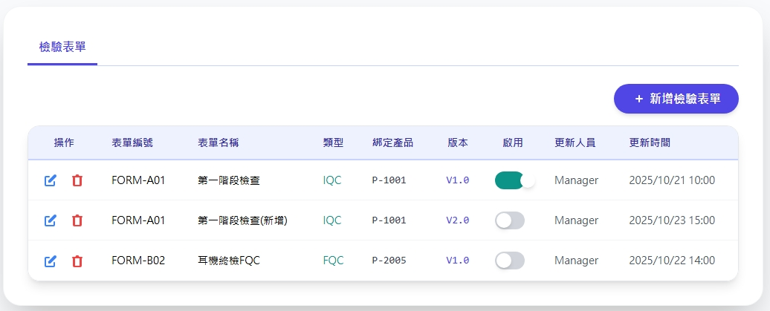
Date | App / Web | Protocol | description
2026/05/12 | Web | Api | 表單項目管理
2026/05/29 | Web | Api | P16 sheet/ver/get response class change P6 補上條件卡控
移至後方

Slide 2
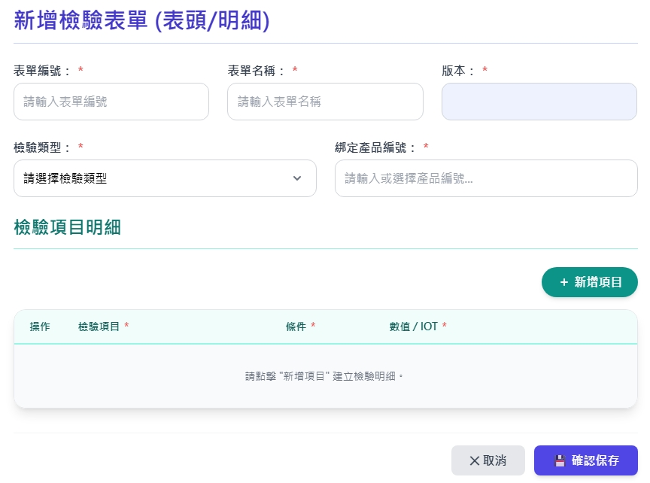
新增 Dialog - 1
表單
web/ct/sheet/type/list
web/sheet/ver/get
填寫完 表單編號與表單類型後跑
預設值
最小值
最大值
IoT

Slide 3
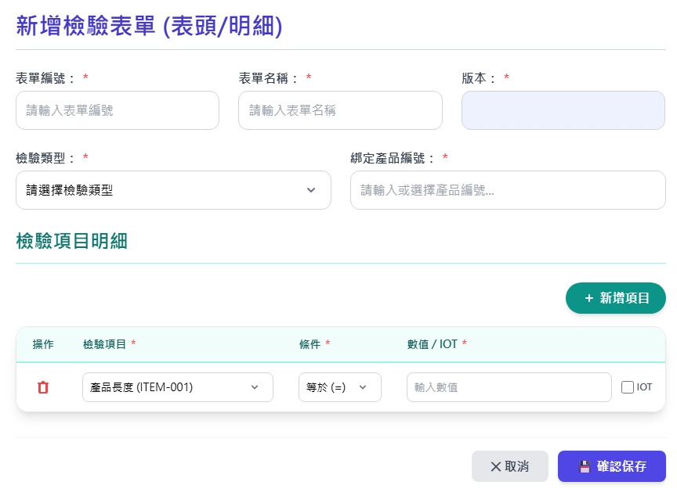
新增 Dialog - 2
表單
web/item/option/list
給isMeasure
web/ct/operator/list
預設值
最小值
最大值
IoT
web/IoT/option/list

Slide 4
複製表單 Dialog
複製
web/sheet/get
web/sheet/ver/get
填寫完 表單編號與表單類型後跑
預設值
最小值
最大值
IoT

Slide 5
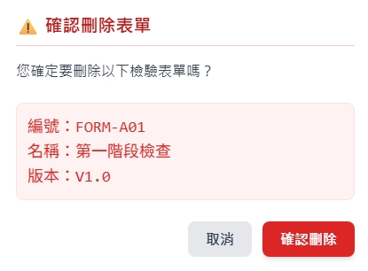
刪除 Dialog

Slide 6
最大值 最小值 預設值 條件限制
optid | 條件 | 預設值 | 最小值 | 最大值
1 | > | O | O | X
2 | >= | O | O | X
3 | < | O | X | O
4 | <= | O | X | O
5 | == | O | X | X
6 | != | O | X | X
7 | Between | O | O | O
8 | AlwaysPass | O | X | X
9 | Boolean | X | X | X

Slide 7
進入頁面
API
完成
web/sheet/list
sheetno
sheetname
cshtname
ver
is_active
updateBy
updateDt

Slide 8
點下新增
新增dialog
API
完成
web/sheet/create
表單
預設值
最小值
最大值
IoT

Slide 9
點下複製
複製
Dialog
API
完成
web/sheet/create
複製
預設值
最小值
最大值
IoT

Slide 10
點下刪除
刪除dialog
API
完成
web/sheet/delete

Slide 11
點下啟用
API
完成
web/sheet/active
sheetno
sheetname
cshtname
ver
is_active
updateBy
updateDt

Slide 12
web/ct/sheet/type/list
Server | Method | Request Param | Response Param
https://localhost: | GET |  | List<Option> --------------------------------- public class SheetType { public byte cshtid public string cshtname }

Slide 13
web/item/option/list
Server | Method | Request Param | Response Param
https://localhost: | GET |  | List<Option> --------------------------------- public class Option { public int itid public string itNo public string itName public bool isMeasure }

Slide 14
web/IoT/option/list
Server | Method | Request Param | Response Param
https://localhost: | GET |  | List<Option> --------------------------------- public class Option { public int iotId public string iotNo public string iotName }

Slide 15
web/ct/operator/list
Server | Method | Request Param | Response Param
https://localhost: | GET | isMeasure bool | List<Option> --------------------------------- public class Operator { public byte optid public string opttxt public string des }

Slide 16
web/sheet/ver/get
Server | Method | Request Param | Response Param
https://localhost: | GET | sheetno string cshid byte | String [ver]

Slide 17
web/sheet/list
Server | Method | Request Param | Response Param
https://localhost: | GET | page int? pageSize int? | Page<Data> ---------------------------------- public class Data { public int sheetid public string sheetno public string sheetname public byte cshtid public string cshtname public string ver public bool is_active public string updateDt public string updateBy }

Slide 18
web/sheet/get
Server | Method | Request Param | Response Param
https://localhost: | GET | sheetid int | public class DataSet { public int sheetid public string sheetno public string sheetname public byte cshtid public string cshtname public string ver public bool is_active public string updateDt public string updateBy public List<BindedItem> items } public class BindedItem { public int itid public string itNo public string itName public bool isMeasure public byte optid public string opttxt public int? iotId public int? spcctid public string? defaultValue public string? minValue public string? maxValue }

Slide 19
web/sheet/create
Server | Method | Request Param | Response Param
https://localhost: | Post | public class Create { public int? page public int? pageSize public string sheetno public string sheetname public byte cshtid public List<Item> items public class Item { public int itid public byte optid public int? iotId public int? spcctid public string? defaultValue public string? minValue public string? maxValue } } | Page<Data> --------------------------------- public class Data { public int sheetid public string sheetno public string sheetname public byte cshtid public string cshtname public string ver public bool is_active public string updateDt public string updateBy }

Slide 20
web/sheet/delete
Server | Method | Request Param | Response Param
https://localhost: | GET | public class Delete { public int? page public int? pageSize public int sheetid } | Page<Data> --------------------------------- public class Data { public int sheetid public string sheetno public string sheetname public byte cshtid public string cshtname public string ver public bool is_active public string updateDt public string updateBy }

Slide 21
web/sheet/active
Server | Method | Request Param | Response Param
https://localhost: | GET | public class Active { public int? page public int? pageSize public int sheetid } | Page<Data> --------------------------------- public class Data { public int sheetid public string sheetno public string sheetname public byte cshtid public string cshtname public string ver public bool is_active public string updateDt public string updateBy }

