Slide 1
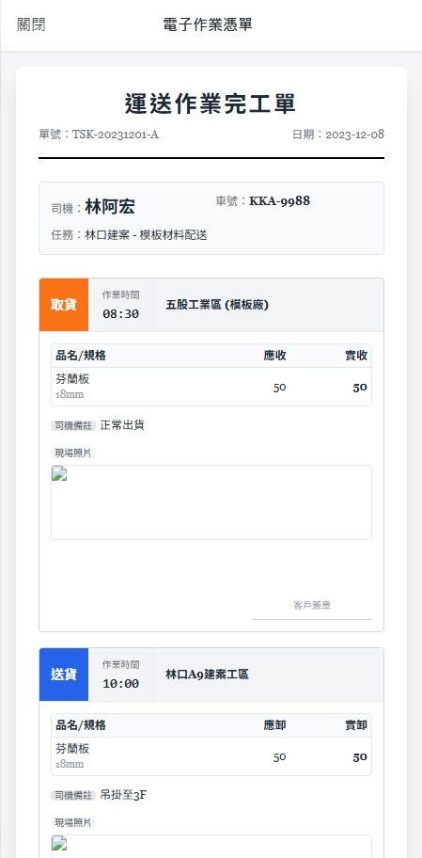
Date | App / Web | Protocol | description
2026/03/02 | App | Api | 拿歷史工作內容(已結案)
2026/03/02 | App | Api | API 重寫

Slide 2
進入頁面
API
完成
app/task/list/Voucher

Slide 3
app/task/order/complete
Server | Method | Request Param | Response Param
https://localhost:7093 | GET | shId BIGINT | public class Voucher { public List<string> FsList { get; set; } }

