Slide 1
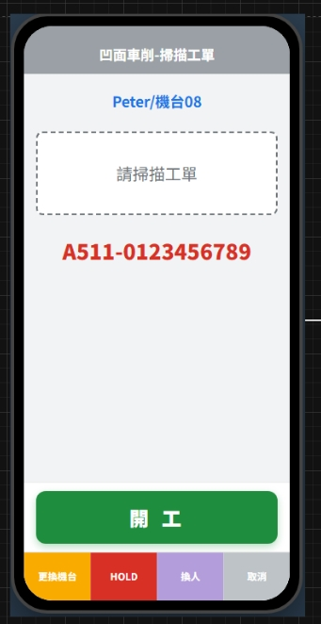
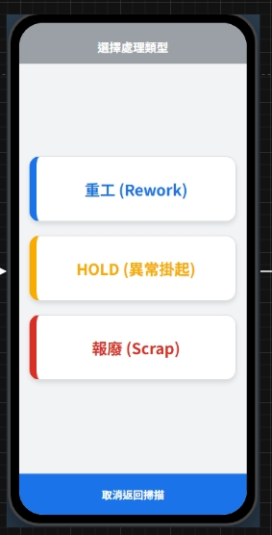
Date | App / Web | Protocol | description
2026/05/28 | App | Api | BTOX 所有異常流程-入口

Slide 2
進入頁面
API
完成
app/user/info
Fncid = 49 AND hasWrite = 1
Fncid = 50 AND hasWrite = 1
Fncid = 51 AND hasWrite = 1

Slide 3
app/user/info
Server | Method | Request Param | Response Param
https://localhost: | GET |  | public class Info { public string userName public string rname public string? email public List<Funcode> funcodes } public class Funcode { public int fncid public string fncname public bool isApp public bool isWeb public bool hasRead public bool hasWrite }

Slide 4
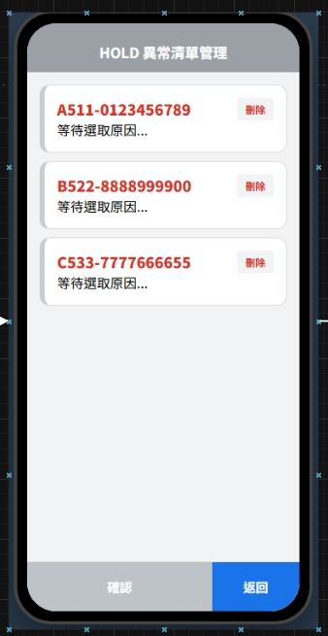
Date | App / Web | Protocol | description
2026/05/28 | App | Api | BTOX 所有異常流程-工單清單

Slide 5
進入頁面
完成

Slide 6
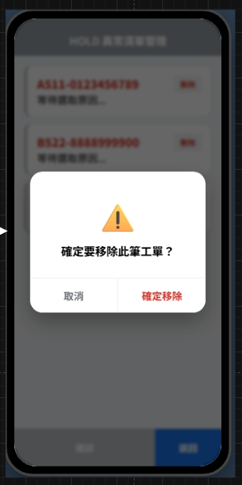
Date | App / Web | Protocol | description
2026/05/28 | App | Api | BTOX 所有異常流程-刪除工單

Slide 7
點下刪除
提醒dialog
完成

Slide 8
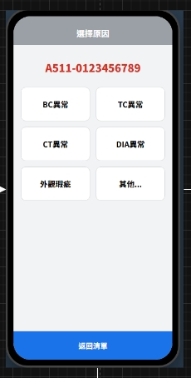
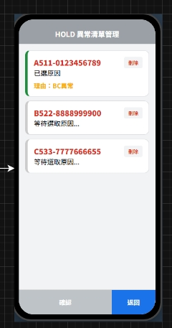
Date | App / Web | Protocol | description
2026/05/28 | App | Api | BTOX 所有異常流程-填寫原因(非其他)
原因類型

Slide 9
進入頁面
API
完成
app/reason/type
app/reason/list
原因類型

Slide 10
app/reason/type
Server | Method | Request Param | Response Param
https://localhost: | GET |  | List<Type> ------------------------------------------- public class Type { public byte restid public string restname }

Slide 11
app/reason/list
Server | Method | Request Param | Response Param
https://localhost: | GET | restid BYTE | List<Data> ------------------------------------------- public class Data { public int resid public byte restid public string resno public string resname }

Slide 12
Date | App / Web | Protocol | description
2026/05/28 | App | Api | BTOX 所有異常流程-填寫原因(其他)
其他
確認
取消

Slide 13
進入頁面
API
完成
app/reason/type
app/reason/list
如果 restid == 0
其他
確認
取消

Slide 14
app/reason/type
Server | Method | Request Param | Response Param
https://localhost: | GET |  | List<Type> ------------------------------------------- public class Type { public byte restid public string restname }

Slide 15
app/reason/list
Server | Method | Request Param | Response Param
https://localhost: | GET | restid BYTE | List<Data> ------------------------------------------- public class Data { public int resid public byte restid public string resno public string resname }

Slide 16
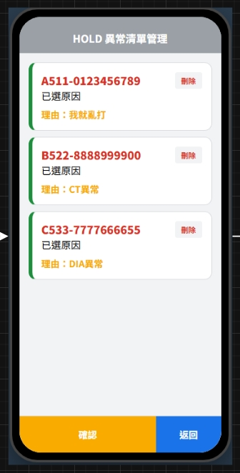
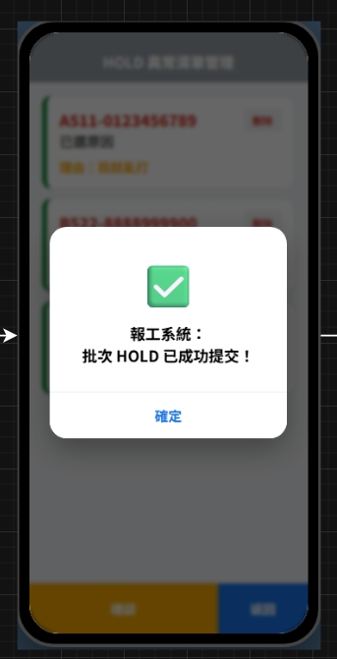
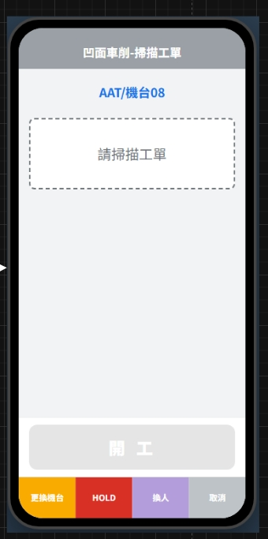
Date | App / Web | Protocol | description
2026/05/28 | App | Api | BTOX 所有異常流程-異常送出

Slide 17
點下確認
都有填寫原因
API
完成
dialog
完成
警告
dialog
必須優要填寫原因

Slide 18
app/rc/abnormal/create
Server | Method | Request Param | Response Param
https://localhost: | POST | List<Abnormal> --------------------------------------- public class Abnormal { public long rcid public long mpoid public int? eqpid public string erpOrderNo public bool is_start public int abnormalType // 1 重工 2 Hold 3 報廢 public int resid // 其他 給 0 public string? remark // 其他原因填寫 } | String OK

