Slide 1
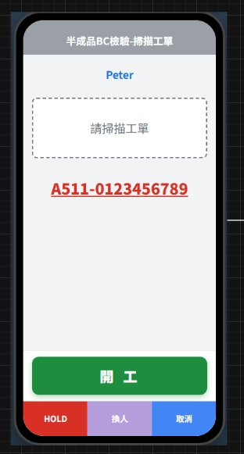
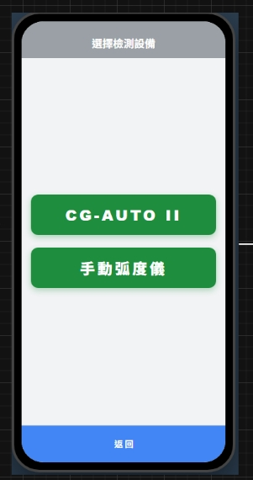
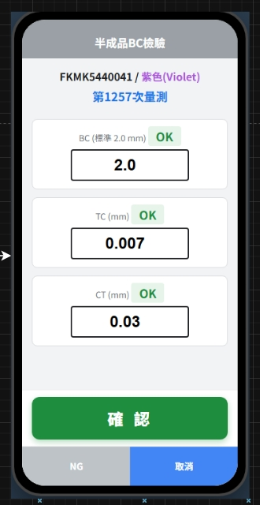
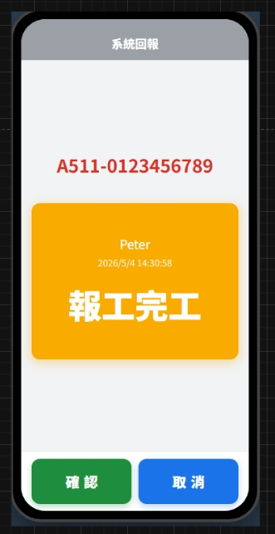
Date | App / Web | Protocol | description
2026/05/25 | App | Api | 檢驗 UI 與 checkin

Slide 2
進入頁面
API
完成

Slide 3
app/equip/insp
Server | Method | Request Param | Response Param
https://localhost: | GET | mpoid long | List <InspEqp> ----------------------------------------------- public class InspEqp { public long mpoid public int eqpid public string eqpno public string eqpname public bool is_bind }

Slide 4
進入頁面
API
完成

Slide 5
app/insp/get
Server | Method | Request Param | Response Param
https://localhost: | GET | mpoid LONG eqpid INT | public class Sheet { public int sheetid public string sheetno public string sheetname public string pno public string color public string colorHex public List<Item> items } public class Item { public int itid public string itno public string itname public bool isMeasure public string defaultValue public string minValue public string maxValue public byte optid public string opttxt public string optDes public string? routkey }

Slide 6
我相信你會需要參考的
var check_item = sheet_items.裡面的某個東西;
bool is_pass = false;
if (bool.Parse(check_item.isMeasure))
{
switch (byte.Parse(check_item.optid))
{
case 1:
is_pass = decimal.Parse(i.value) > decimal.Parse(check_item.min_value);
break;
case 2:
is_pass = decimal.Parse(i.value) >= decimal.Parse(check_item.min_value);
break;
case 3:
is_pass = decimal.Parse(i.value) < decimal.Parse(check_item.max_value);
break;
case 4:
is_pass = decimal.Parse(i.value) <= decimal.Parse(check_item.max_value);
break;
case 5:
is_pass = decimal.Parse(i.value) == decimal.Parse(check_item.default_value);
break;
case 6:
is_pass = decimal.Parse(i.value) != decimal.Parse(check_item.default_value);
break;
case 7:
is_pass = decimal.Parse(i.value) >= decimal.Parse(check_item.min_value) && decimal.Parse(i.value) <= decimal.Parse(check_item.max_value);
break;
case 8:
is_pass = true;
break;
default:
log.Warn($"[{_cmd}] mpoid ${job.mpoid} itid ${i.itid} has error during checking item result.");
throw new StillAckException();
}
}
else
{
switch (byte.Parse(check_item.optid))
{
case 8:
is_pass = true;
break;
case 9:
is_pass = bool.Parse(i.value);
break;
default:
log.Warn($"[{_cmd}] mpoid ${job.mpoid} itid ${i.itid} has error during checking item result.");
throw new StillAckException();
}
}

Slide 7
進入頁面
API
完成

Slide 8
app/rc/insp/checkin
Server | Method | Request Param | Response Param
https://localhost: | POST | public class Insp { public long rcid public long mpoid public int? eqpid public string erpOrderNo public bool is_start public int sheetid public List<InspItem> items } public class InspItem { public int itid public string value } | String OK

