Slide 1
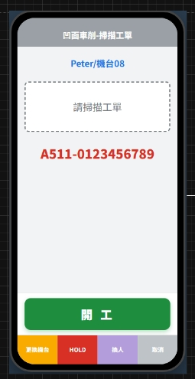
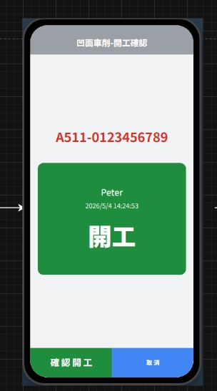
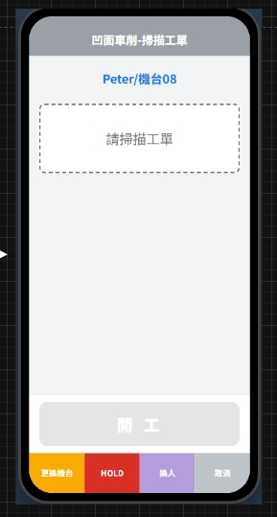
Date | App / Web | Protocol | description
2026/05/25 | App | Api | 開公報工-開工

Slide 2
點下開工
API
完成
app/rc/checkin

Slide 3
app/rc/checkin
Server | Method | Request Param | Response Param
https://localhost: | Post | List<Selected> ----------------------------------------- public class Selected { public long rcid public long mpoid public int? eqpid public string erpOrderNo public bool is_start } | String “OK”

Slide 4
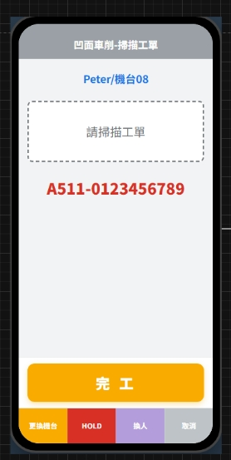
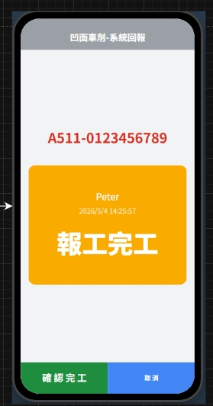
Date | App / Web | Protocol | description
2026/05/25 | App | Api | 開公報工-完工

Slide 5
點下完工
API
完成
app/rc/checkout

Slide 6
app/rc/checkout
Server | Method | Request Param | Response Param
https://localhost: | Post | List<Selected> ----------------------------------------- public class Selected { public long rcid public long mpoid public int? eqpid public string erpOrderNo public bool is_start } | String “OK”

