Slide 1
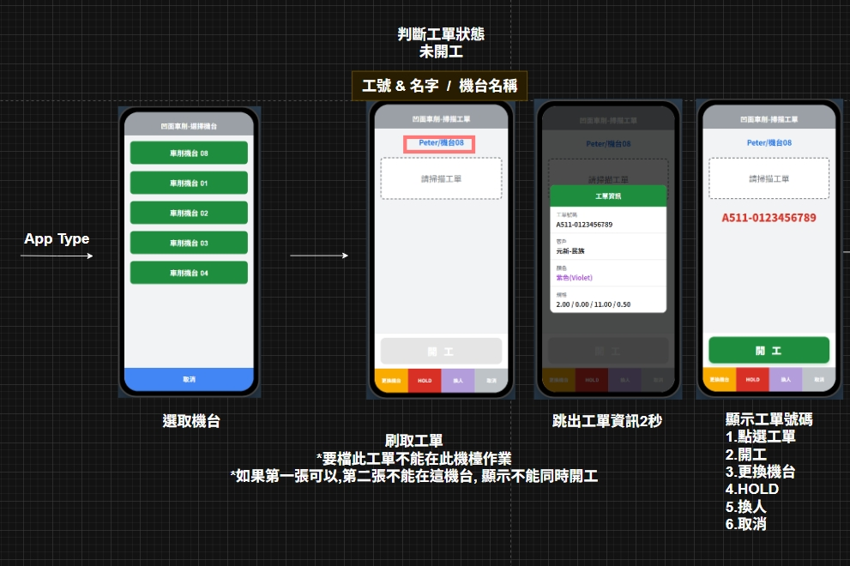
Date | App / Web | Protocol | description
2026/05/25 | App | Api | 開公報工-進入點

Slide 2
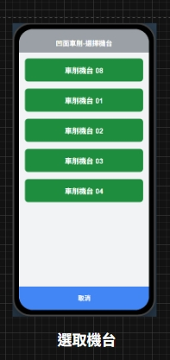
進入頁面
API
完成
app/equip/list

Slide 3
app/equip/list
Server | Method | Request Param | Response Param
https://localhost: | Get | opid int apteid short | List<Data> ------------------------------------------------ public class Data { public int eqpid public string eqpno public string eqpname }

Slide 4
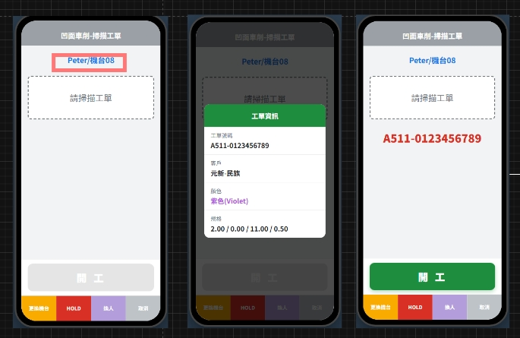
登入
API
完成
app/rc/check
erpOrderNo
erpOrderNo
custName
color
spec

Slide 5
app/rc/check
Server | Method | Request Param | Response Param
https://localhost: | POST | public class Request { public int opid public short apteid public int? eqpid public string erpOrderNo public List<Selected> rcs } public class Selected { public long rcid public long mpoid public int? eqpid public string erpOrderNo public bool is_start } | public class Responce { public string erpOrderNo public string custName public string color public string colorHex public string spec public bool is_start public List<Selected> rcs } public class Selected { public long rcid public long mpoid public int? eqpid public string erpOrderNo public bool is_start }

Slide 6
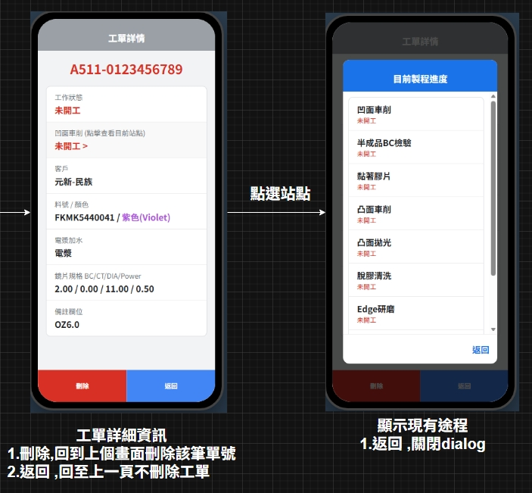
Date | App / Web | Protocol | description
2026/05/25 | App | Api | 開公報工-點下工單

Slide 7
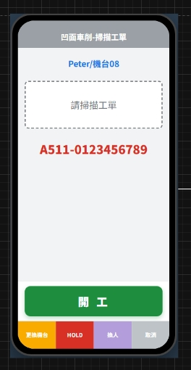
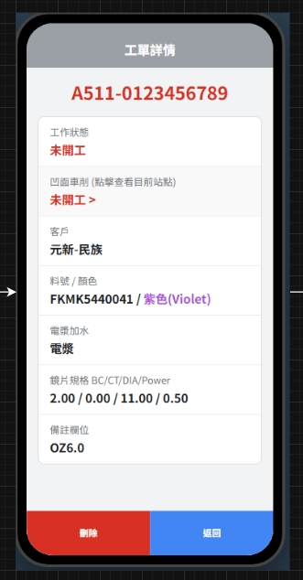
點下工單
API
完成
app/rc/info
erpOrderNo
rcstename
opname
rtstename
custName
pno
color
plasma
spec
remark

Slide 8
app/rc/info
Server | Method | Request Param | Response Param
https://localhost: | GET | rcid long mpoid long | public class Data { public long rcid public string erpOrderNo public string custName public string color public string colorHex public string plasma public string spec public string? remark public string rcstename public string opname public string rtstename }

Slide 9
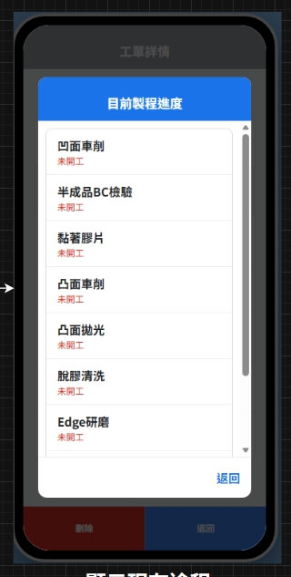
點下工單
API
完成
app/rc/mpo/list

Slide 10
app/rc/mpo/list
Server | Method | Request Param | Response Param
https://localhost: | GET | rcid long | List<Data> ------------------------------------------------ public class Data { public string opname public string rtstename }

