Slide 1
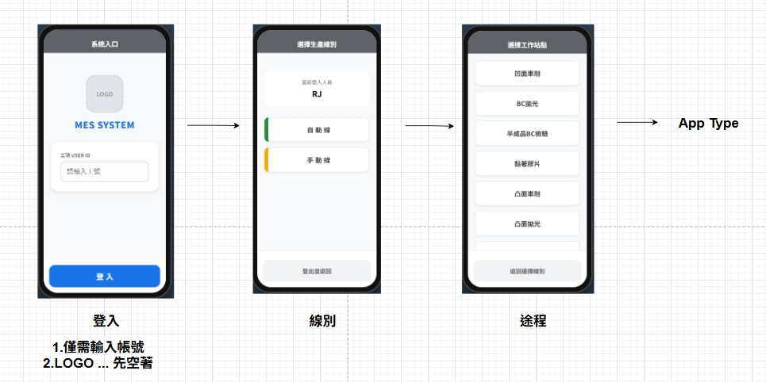
Date | App / Web | Protocol | description
2026/05/25 | App | Api | 公版Flow

Slide 2
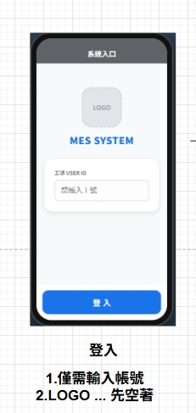
進入頁面
完成

Slide 3
登入
API
完成
app/user/login

Slide 4
app/user/login
Server | Method | Request Param | Response Param
https://localhost: | POST | public class Login { public string account public string? ipAddress public string? tabletId } | public class Login { public int uid public string sha256Token }

Slide 5
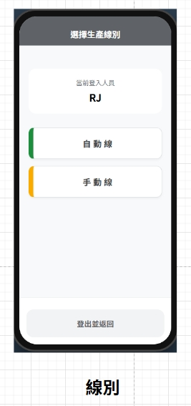
進入頁面
API
完成
app/user/info
app/facility/option/list

Slide 6
app/user/info
Server | Method | Request Param | Response Param
https://localhost: | GET |  | public class Info { public string userName public string rname public string? email public List<Funcode> funcodes } public class Funcode { public int fncid public string fncname public bool isApp public bool isWeb public bool hasRead public bool hasWrite }

Slide 7
app/facility/option/list
Server | Method | Request Param | Response Param
https://localhost: | GET |  | List<Option> --------------------------------- public class Option { public byte fctId public string fctNo public string fctName }

Slide 8
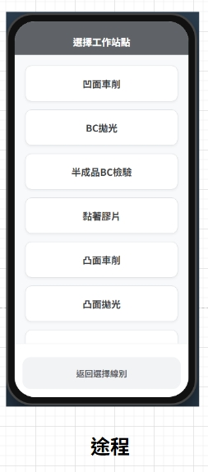
進入頁面
API
完成
app/mpo/list

Slide 9
app/mpo/list
Server | Method | Request Param | Response Param
https://localhost: | GET | fctid BYTE | List<Data> --------------------------------- public class Data { public int opid public string opname public short apteid }

Slide 10
點下站點
API
完成
app/mpo/check

Slide 11
app/mpo/check
Server | Method | Request Param | Response Param
https://localhost: | POST | public class CheckOpAuth { public int opid public short apteid } | public class Result { public int opid public string opname public short apteid }

