Slide 1
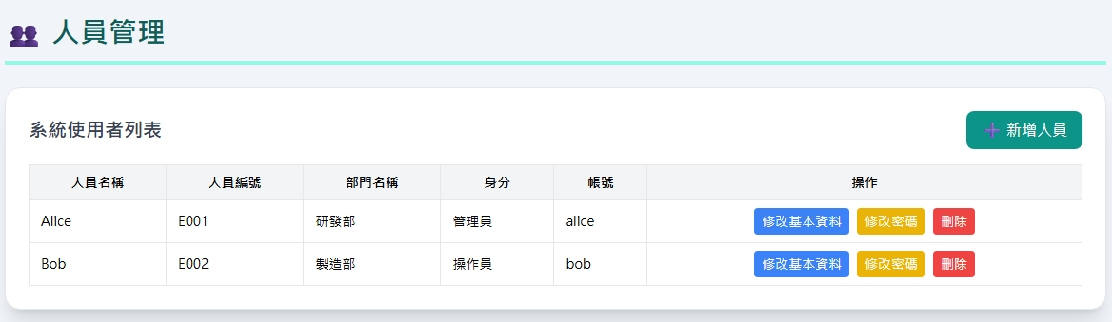
Date | App / Web | Protocol | description
2026/04/27 | Web | Api | 人員管理
2026/05/21 | Web | Api | 增加 tag list get create update delete 調整 class

Slide 2
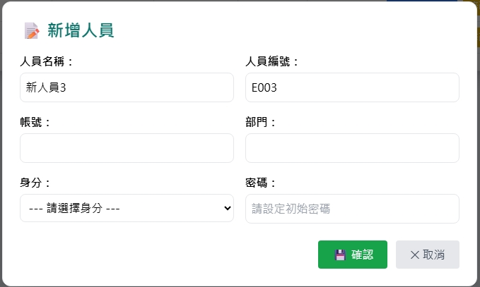
新增 Dialog
web/dept/option/list
web/auth/role/option/list

Slide 3
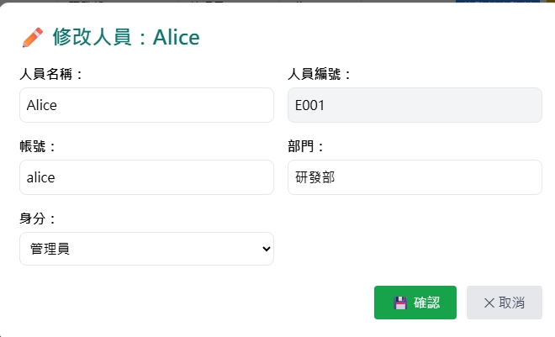
修改 Dialog
userName
userNo
web/dept/option/list
account
deptId
web/auth/role/option/list
rid
web/user/get

Slide 4
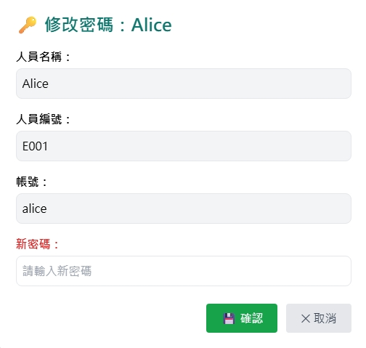
修改密碼 Dialog
userName
web/user/get
userNo
account

Slide 5
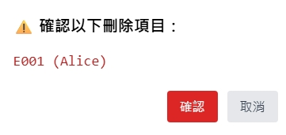
刪除 Dialog

Slide 6
進入頁面
API
完成
web/user/list
userName
userNo
deptNo / deptName
rname
account

Slide 7
點下新增
新增dialog
API
完成
web/user/create

Slide 8
點下修改
修改Dialog
API
完成
web/user/update

Slide 9
點下
修改密碼
修改密碼
dialog
API
完成
web/user/update/pwd

Slide 10
點下刪除
刪除dialog
API
完成
web/user/delete

Slide 11
web/dept/option/list
Server | Method | Request Param | Response Param
https://localhost: | GET |  | List<Option> --------------------------------- public class Option { public int deptId public string deptNo public string deptName }

Slide 12
web/auth/role/option/list
Server | Method | Request Param | Response Param
https://localhost: | GET |  | List<RoleOption> --------------------------------- public class RoleOption { public int rid public string rno public string rname }

Slide 13
web/tag/option/list
Server | Method | Request Param | Response Param
https://localhost: | GET |  | List<Option> --------------------------------- public class Option { public int tagid public string tag }

Slide 14
web/user/list
Server | Method | Request Param | Response Param
https://localhost: | GET | page INT? pageSize INT? deptId SHORT? // 先給 null | Page<Data> --------------------------------- public class Data { public short uid public string userNo public string userName public string account public short? deptId public string deptNo public string deptName public short rid public string rname public string? email public List<Tag> tags } public class Tag { public int tagid public string tag }

Slide 15
web/user/get
Server | Method | Request Param | Response Param
https://localhost: | GET | uid short | public class Data { public short uid public string userNo public string userName public string account public short? deptId public string deptNo public string deptName public short rid public string rname public string? email public List<Tag> tags } public class Tag { public int tagid public string tag }

Slide 16
web/user/create
Server | Method | Request Param | Response Param
https://localhost: | Post | public class Create { public string account public string password public short rid public short? deptId public short? spvrid public string userNo public string userName public string? email } | Page<Data> --------------------------------- public class Data { public short uid public string userNo public string userName public string account public short? deptId public string deptNo public string deptName public short rid public string rname public string? email public List<Tag> tags } public class Tag { public int tagid public string tag }

Slide 17
web/user/update
Server | Method | Request Param | Response Param
https://localhost: | GET | public class Update { public short uid public short deptId public short rid public string username public string? email } | Page<Data> --------------------------------- public class Data { public short uid public string userNo public string userName public string account public short? deptId public string deptNo public string deptName public short rid public string rname public string? email public List<Tag> tags } public class Tag { public int tagid public string tag }

Slide 18
web/user/update/pwd
Server | Method | Request Param | Response Param
https://localhost: | GET | public class UpdatePwd { public short uid public string password } | “OK” string

Slide 19
web/user/delete
Server | Method | Request Param | Response Param
https://localhost: | GET | public class Delete { public short uid } | Page<Data> --------------------------------- public class Data { public short uid public string userNo public string userName public string account public short? deptId public string deptNo public string deptName public short rid public string rname public string? email public List<Tag> tags } public class Tag { public int tagid public string tag }

