Slide 1
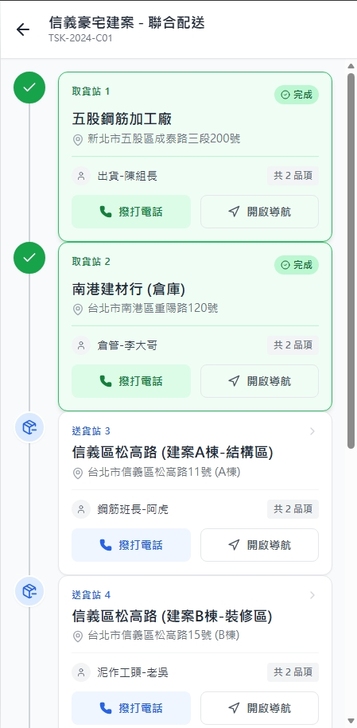
Date | App / Web | Protocol | description
2026/02/25 | App | Api | 拿工作項目清單
2026/03/04 | App | Api | 輸出新增狀態 Id (action state 和 task state)
2026/03/11 | App | Api | 增加 司機簽名

Slide 2



PPT
orderProcess
進入頁面
API
完成
Pass [shId]
app/task/list/processing
[taskAction] + [seq]
[taskState]
[目前DB沒有欄位]
[addr]
[custName]
共 [itemCount]品項
撥打電話
開啟導航
藏在按鈕裡面或是顯示
[custPhone]

Slide 3
點下task
Pass
[shId] / [seq]
ppt
taskInfo

Slide 4
完成所有task後簽名
API
完成
app/task/driver/sign

Slide 5
app/task/list/processing
Server | Method | Request Param | Response Param
https://localhost:7093 | GET | shId long | List<Processing> -------------------------------------- public class Processing { public int seq public short taskStateId public short taskActionId public string taskState public string taskAction public string addr public string custName public string custPhone public int itemCount }

Slide 6
app/task/driver/sign
Server | Method | Request Param | Response Param
https://localhost:7093 | GET | shId long fsId string | String “工作項目已完成”

