Slide 1
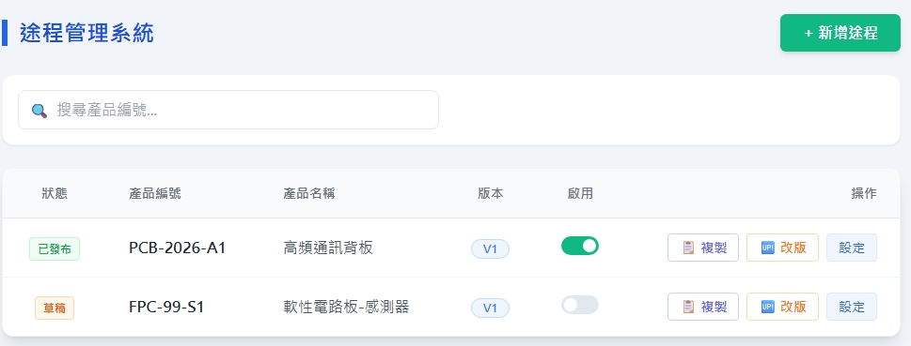
Date | App / Web | Protocol | description
2026/05/20 | Web | Api | 途程設定
2026/05/21 | Web | Api | 新增 P14 : AppType API 新增 P17 : Tag option List 修改 P22 : mdc get class 修改 P23 : mdc create class 修改 P24 : mdc save class
設定 / 檢視
設定 / 檢視

Slide 2
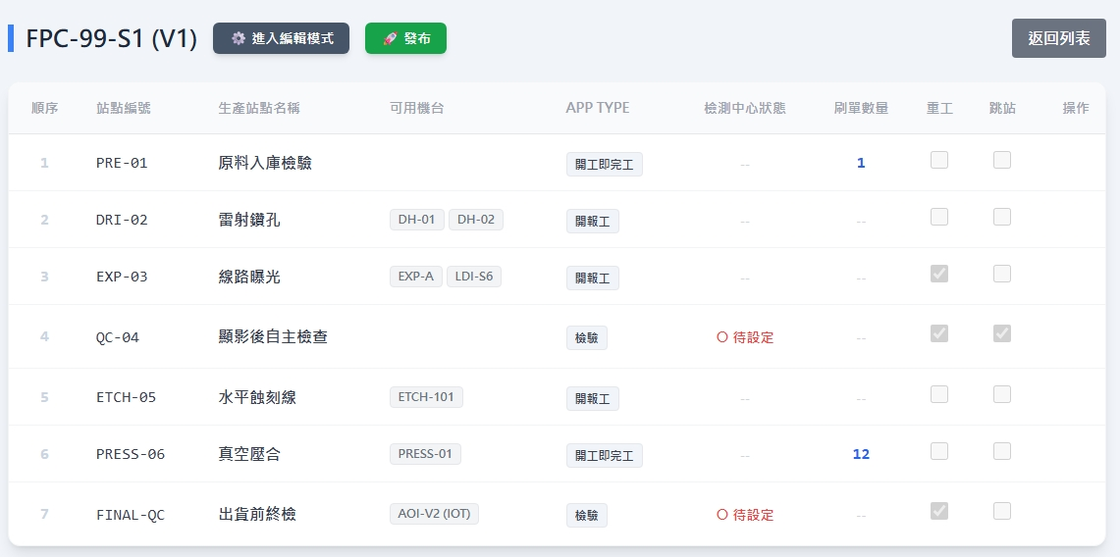
站點清單頁面
web/mdc/operation/list
oseq
mdoname
eqps
apteDes
isSheetBinded
rcQty
rewk
ismand

Slide 3
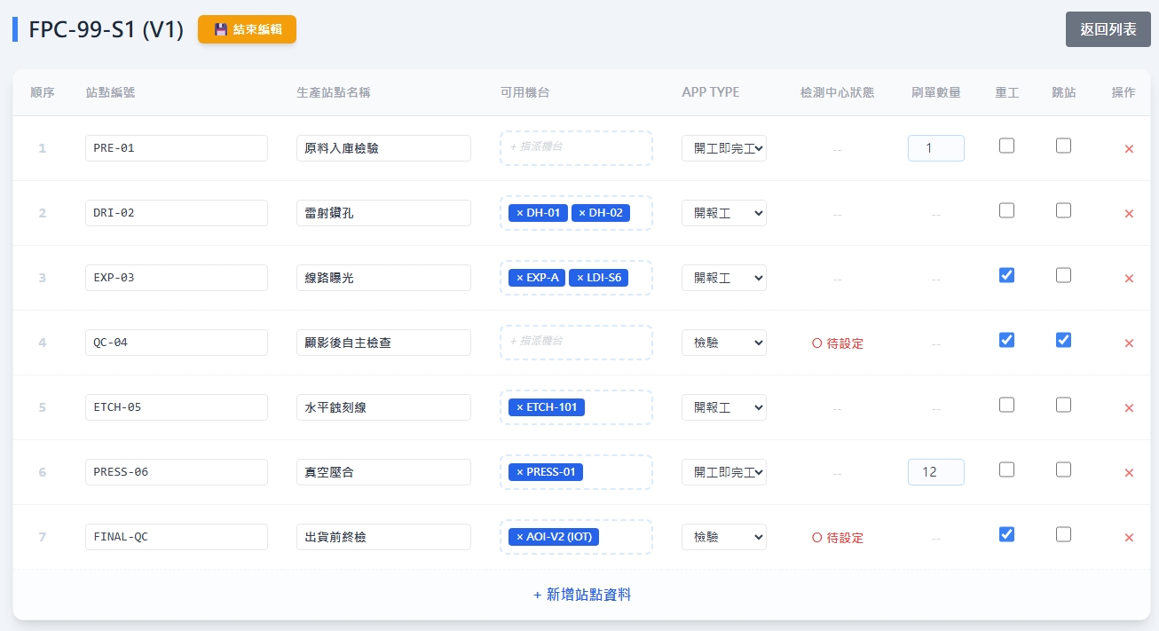
編輯站點
web/mdc/operation/list
eqps
isSheetBinded
mdoname
機台 dialog
apteDes
表單 dialog
rcQty
rewk
ismand
oseq

Slide 4
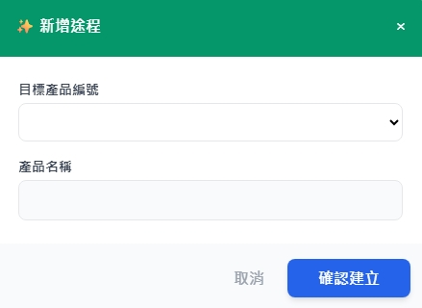
料號 dialog
web/ct/pt/option/list
全部
成品
廢品
web/part/option/list

Slide 5
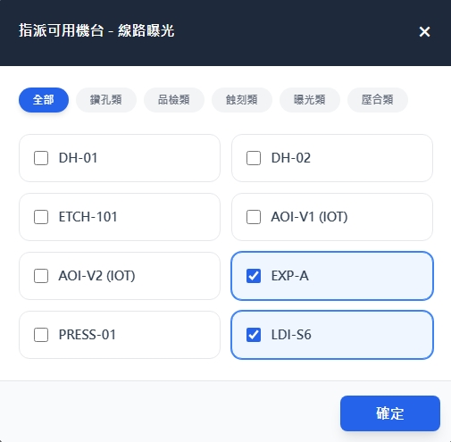
機台 dialog
web/ct/equip/type/list
web/equip/option/list

Slide 6
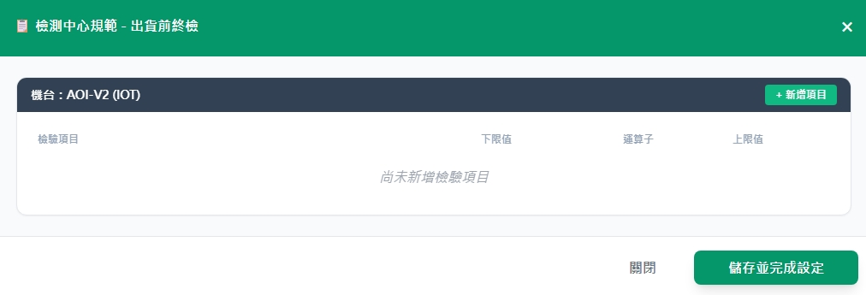
表單dialog
每個機台單選表單，機台必綁表單
web/sheet/option/list
[sheetno] [sheetname]-[ver]

Slide 7
進入頁面
API
完成
web/mdc/list
isPublish
mdcno
mdcname
ver
isActive
設定 / 檢視
設定 / 檢視

Slide 8
點下新增
料號dialog
編輯站點
頁面
save
API
站點清單
頁面
完成
返回列表
途程
主頁面
web/mdc/create
設定 / 檢視
設定 / 檢視

Slide 9
點下複製
料號dialog
編輯站點
頁面
save
API
站點清單
頁面
完成
返回列表
途程
主頁面
web/mdc/create
設定 / 檢視
設定 / 檢視

Slide 10
點下改版
編輯站點
頁面
save
API
站點清單
頁面
完成
返回列表
途程
主頁面
web/mdc/create
設定 / 檢視
設定 / 檢視

Slide 11
點下
設定/檢視
站點清單
頁面
編輯站點
頁面
save
API
站點清單
頁面
完成
web/mdc/save
返回列表
途程
主頁面
設定 / 檢視
設定 / 檢視

Slide 12
點下啟用
API
完成
web/mdc/active
設定 / 檢視
設定 / 檢視

Slide 13
點下發布
API
完成
web/mdc/publish

Slide 14
web/ct/app/type/list
Server | Method | Request Param | Response Param
https://localhost: | GET |  | List<Data> --------------------------------- public class Option { public short apteid public string apteDes }

Slide 15
web/ct/pt/option/list
Server | Method | Request Param | Response Param
https://localhost: | GET |  | List<Data> --------------------------------- public class Data { public int ptid public string ptno public string ptname }

Slide 16
web/part/option/list
Server | Method | Request Param | Response Param
https://localhost: | GET | ptid int? pno string? | List<Option> --------------------------------- public class Option { public long pid public string pno public string pname }

Slide 17
web/tag/option/list
Server | Method | Request Param | Response Param
https://localhost: | GET |  | List<Option> --------------------------------- public class Option { public int tagid public string tag }

Slide 18
web/ct/equip/type/list
Server | Method | Request Param | Response Param
https://localhost: | GET |  | List<Type> --------------------------------- public class Type { public short eqptid public string eqptname }

Slide 19
web/equip/option/list
Server | Method | Request Param | Response Param
https://localhost: | GET | eqptid short? | List<Option> --------------------------------- public class Option { public int eqpid public string eqpno public string eqpname }

Slide 20
web/sheet/option/list
Server | Method | Request Param | Response Param
https://localhost: | GET |  | List<Option> --------------------------------- public class Option { public int sheetid public string sheetno public string sheetname public string ver }

Slide 21
web/mdc/list
Server | Method | Request Param | Response Param
https://localhost: | GET | page INT? pageSize INT? searchStr STRING? | Page<Data> --------------------------------- public class Data { public long mdcid public string mdcno public string mdcname public string ver public long pid public string pno public string pname public bool isActive public bool isPublish public decimal basicUnit public string? remark public string updateDt public string updateBy }

Slide 22
web/mdc/get
Server | Method | Request Param | Response Param
https://localhost: | GET | mdcid LONG | List<Data> --------------------------------- public class Data { public long mdoid public string mdoname public int oseq public short apteid public string apteDes public bool ismand public bool rewk public byte rcQty public bool isSheetBinded public List<Eqp> eqps public List<Insp> insps public List<Tag> tags } public class Eqp { public int eqpid public string eqpno public string eqpname } public class Insp { public int sheetid public int eqpid public string eqpno public string eqpname public string sheetno public string sheetname } public class Tag { public int tagid public string tag }

Slide 23
web/mdc/create
Server | Method | Request Param | Response Param
https://localhost: | Post | public class Create { public int? page public int? pageSize public long pid public List<Mdo> ops } public class Mdo { public string opname public byte oseq public short apteid public bool ismand public bool rewk public byte rc_qty public List<Mdoeqp> eqps public List<MdoInsp> insps public List<int> tags } public class Mdoeqp { public int eqpid } public class MdoInsp { public int eqpid public int sheetid } | Page<Data> --------------------------------- public class Data { public long mdcid public string mdcno public string mdcname public string ver public long pid public string pno public string pname public bool isActive public bool isPublish public decimal basicUnit public string? remark public string updateDt public string updateBy }

Slide 24
web/mdc/save
Server | Method | Request Param | Response Param
https://localhost: | Post | public class Create { public int? page public int? pageSize public long mdcid public List<Mdo> ops } public class Mdo { public string opname public byte oseq public short apteid public bool ismand public bool rewk public byte rc_qty public List<Mdoeqp> eqps public List<MdoInsp> insps public List<int> tags } public class Mdoeqp { public int eqpid } public class MdoInsp { public int eqpid public int sheetid } | Page<Data> --------------------------------- public class Data { public long mdcid public string mdcno public string mdcname public string ver public long pid public string pno public string pname public bool isActive public bool isPublish public decimal basicUnit public string? remark public string updateDt public string updateBy }

Slide 25
web/mdc/active
Server | Method | Request Param | Response Param
https://localhost: | Post | public class Active { public int? page public int? pageSize public int mdcid } | Page<Data> --------------------------------- public class Data { public long mdcid public string mdcno public string mdcname public string ver public long pid public string pno public string pname public bool isActive public bool isPublish public decimal basicUnit public string? remark public string updateDt public string updateBy }

Slide 26
web/mdc/publish
Server | Method | Request Param | Response Param
https://localhost: | Post | public class Publish { public int? page public int? pageSize public int mdcid } | Page<Data> --------------------------------- public class Data { public long mdcid public string mdcno public string mdcname public string ver public long pid public string pno public string pname public bool isActive public bool isPublish public decimal basicUnit public string? remark public string updateDt public string updateBy }
會檢查檢驗站是否都有綁定表單

