Slide 1
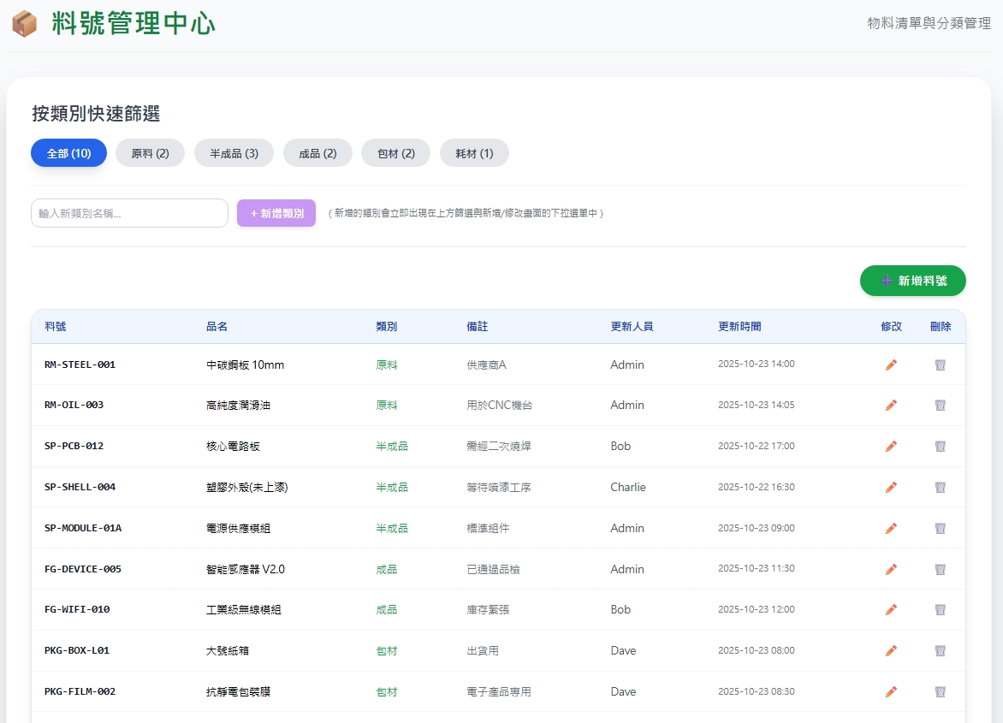
Date | App / Web | Protocol | description
2026/04/27 | Web | Api | 權限管理

Slide 2
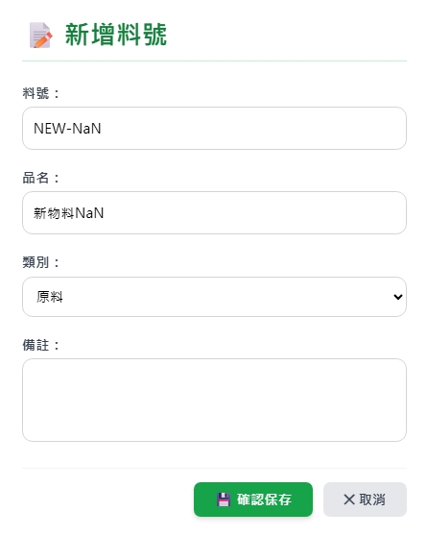
新增 Dialog
web/ct/pt/option/list

Slide 3
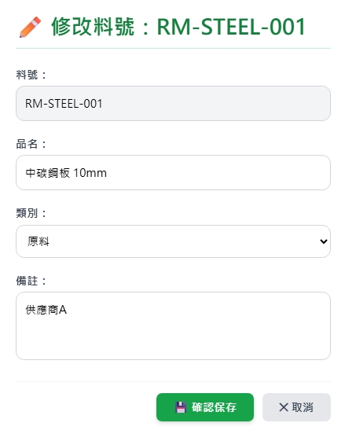
修改 Dialog
web/part/get
web/ct/pt/option/list

Slide 4
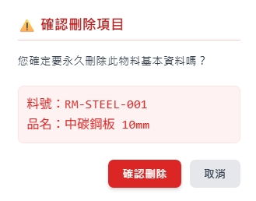
刪除 Dialog

Slide 5
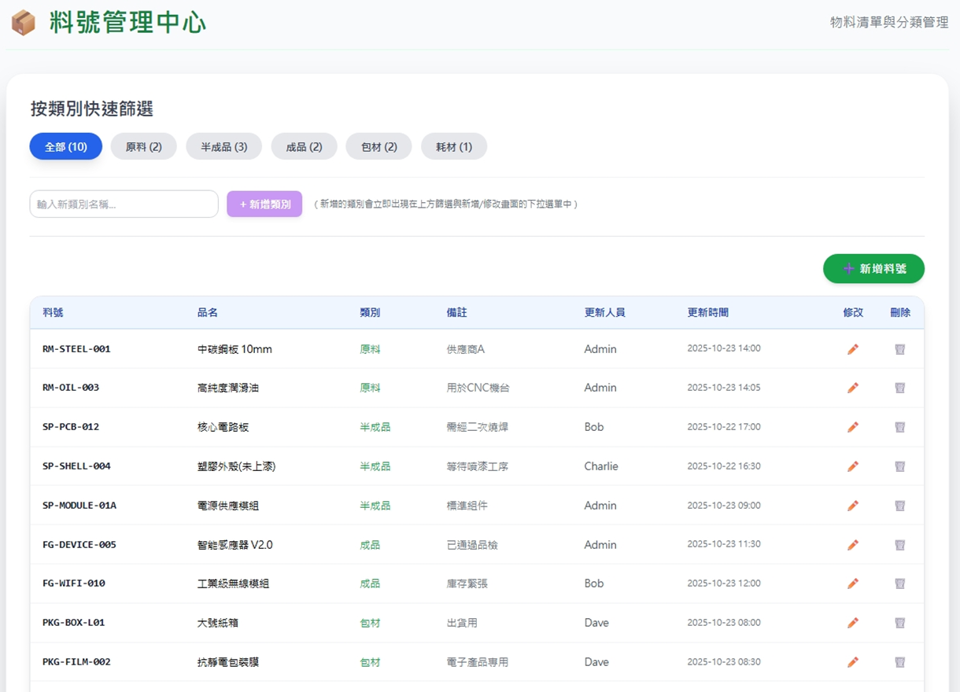
進入頁面
API
完成
web/part/list
web/ct/pt/option/list
ptname
pno
pname
ptname
remark
updateBy
updateDt

Slide 6
輸入類別
API
完成
web/ct/pt/create

Slide 7
點下新增
新增dialog
API
完成
web/part/create

Slide 8
點下修改
修改dialog
API
完成
web/part/update

Slide 9
點下刪除
刪除dialog
API
完成
web/part/delete

Slide 10
web/ct/pt/option/list
Server | Method | Request Param | Response Param
https://localhost: | GET |  | List<Data> --------------------------------- public class Data { public int ptid { get; set; } public string ptno { get; set; } public string ptname { get; set; } }

Slide 11
web/ct/pt/create
Server | Method | Request Param | Response Param
https://localhost: | POST | public class Create { public string ptno { get; set; } public string ptname { get; set; } } | List<Data> --------------------------------- public class Data { public int ptid { get; set; } public string ptno { get; set; } public string ptname { get; set; } }

Slide 12
web/part/list
Server | Method | Request Param | Response Param
https://localhost: | GET | page INT? pageSize INT? ptid STRING? – 1,25,3264 | Page<Data> --------------------------------- public class Page<Data> { public int PageNumber public int PageSize public int TotalPage public int TotalCount public List<Data> List } public class Data { public int pid public int ptid public string pno public string pname public string remark public string ptno public string ptname public string updateDt public string updateBy }

Slide 13
web/part/get
Server | Method | Request Param | Response Param
https://localhost: | GET | pid LONG | public class Data { public int pid public int ptid public string pno public string pname public string remark public string ptno public string ptname public string updateDt public string updateBy }

Slide 14
web/part/create
Server | Method | Request Param | Response Param
https://localhost: | Post | public class Create { public int? page public int? pageSize public int ptid public string pno public string pname public string? remark } | Page<Data> --------------------------------- public class Page<Data> { public int PageNumber public int PageSize public int TotalPage public int TotalCount public List<Data> List } public class Data { public int pid public int ptid public string pno public string pname public string remark public string ptno public string ptname public string updateDt public string updateBy }

Slide 15
web/part/update
Server | Method | Request Param | Response Param
https://localhost: | PUT | public class Update { public int? page public int? pageSize public int pid public int ptid public string pname public string remark } | Page<Data> --------------------------------- public class Page<Data> { public int PageNumber public int PageSize public int TotalPage public int TotalCount public List<Data> List } public class Data { public int pid public int ptid public string pno public string pname public string remark public string ptno public string ptname public string updateDt public string updateBy }

Slide 16
web/part/delete
Server | Method | Request Param | Response Param
https://localhost: | DELETE | public class Delete { public int? page { get; set; } public int? pageSize { get; set; } public int pid { get; set; } } | Page<Data> --------------------------------- public class Page<Data> { public int PageNumber public int PageSize public int TotalPage public int TotalCount public List<Data> List } public class Data { public int pid public int ptid public string pno public string pname public string remark public string ptno public string ptname public string updateDt public string updateBy }

