Slide 1
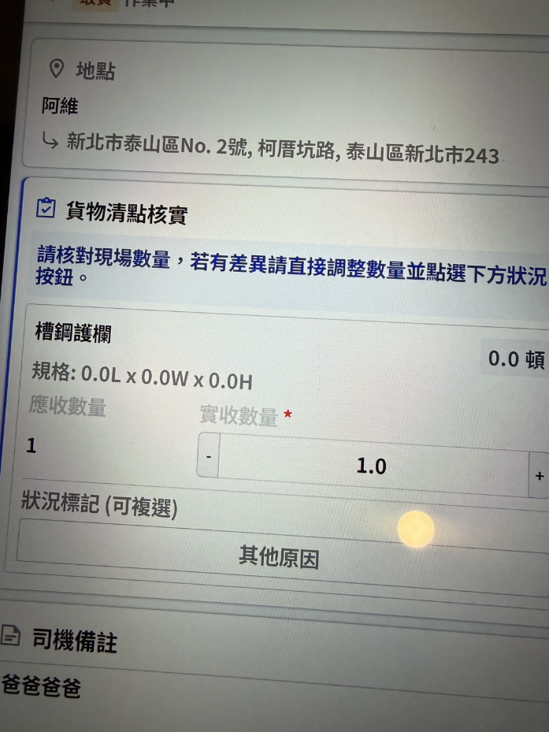
加入一欄 給司機備註要帶到APP的
1.寫在task上

Slide 2
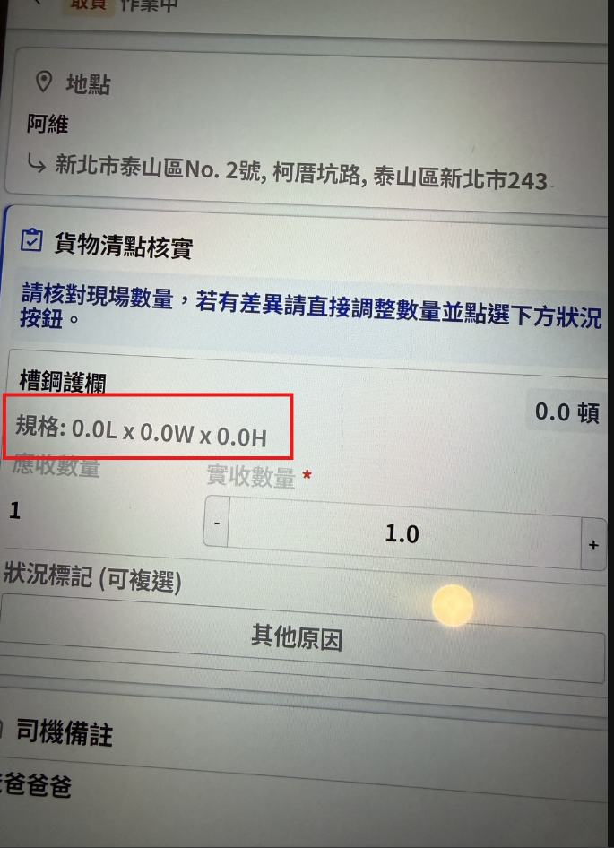
帶入產品規格

Slide 3
app/task/info
Server | Method | Request Param | Response Param
https://localhost:7093 | GET | shId long seq int | public class Info { public string addr public string custName public string custPhone public string remarkDriver public List <Item> items public string pic public string sign public int ctSoTypeId public string ctSoTypeName public string? taskRemark public class Item { public long shiptaskId public string goodsName public float length public float width public float height public float weight public int boardQty public int? handoverQty public bool isOtherReason public List<Reason> reasons } } ------------------------------------ public class Reason { public int ct_reason_id public string reason_no public string reason_name public bool is_checked } ------------------------------------ public class Pic { public FileInfo file public string content_type }

Slide 4
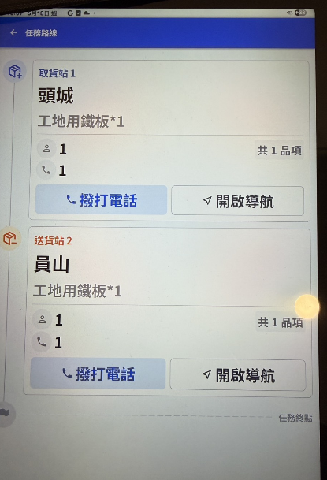
帶入產品規格

Slide 5
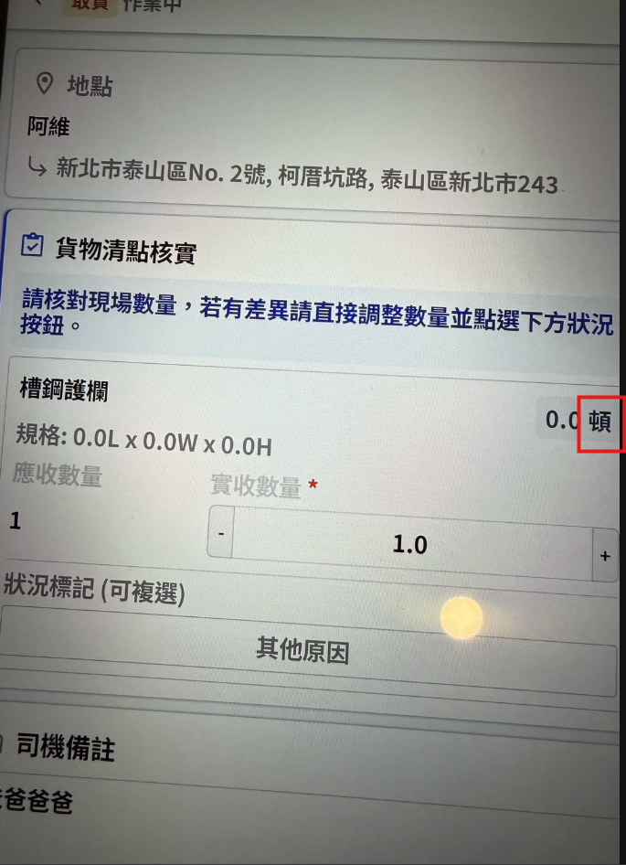
有口 >> 噸

