Slide 1
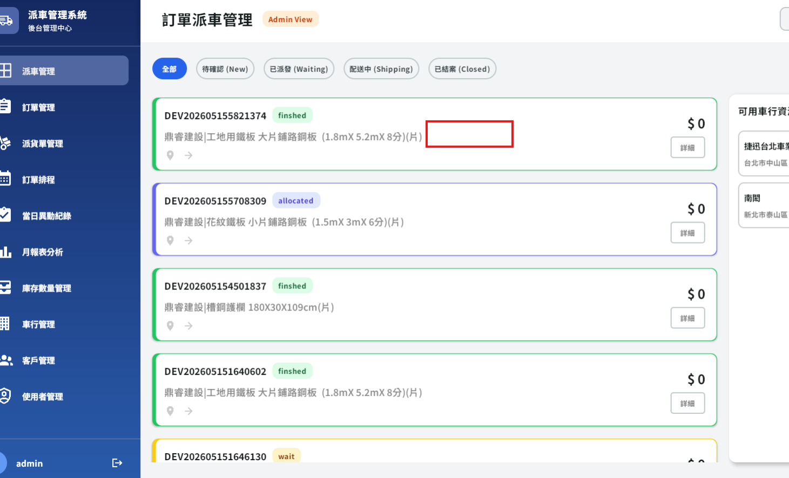
要帶入商品數量

Slide 2
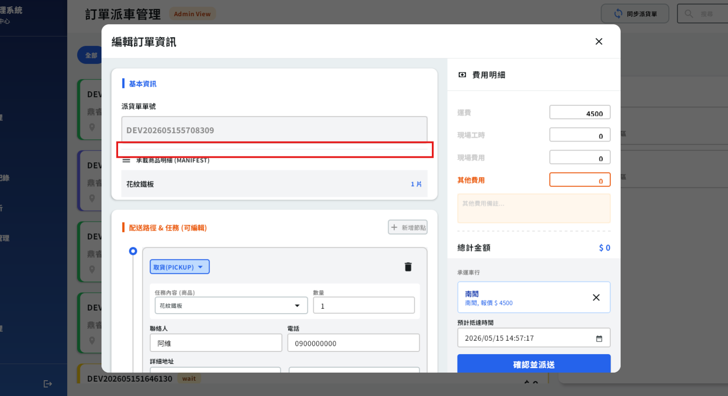
加入一欄 給司機備註要帶到APP的
1.寫在task上

Slide 3
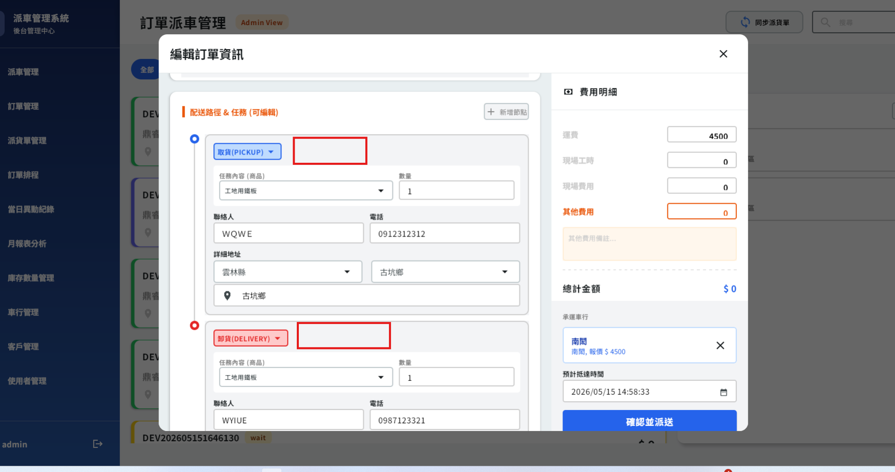
加入預計抵達時間
1.不同單有不同時間
2.併單的時間會不一樣
3.此欄位可以NULL

Slide 4
Mgmt/delivery/task/update
Server | Method | Request Param | Response Param
https://localhost: | PUT | public class TaskUpdate { public int shId public int deliverId public string estArrivedDt public double deliveryPrice public double workTime public double workPrice public double otherPrice public string otherNotes public List<TaskUpdateRowItem> tasks public List<int> shiptaskIds } public class TaskUpdateRowItem { public int shiptaskId public string addr public string taskAction public string custName public string custPhone public int shelfId public int boardQty public int depId public int facId public DateTime orderSchArrDt public int cityId public int districtId public string? taskRemark } | 不動

Slide 5
Mgmt/delivery/order/detail
Server | Method | Request Param | Response Param
https://localhost: | PUT | public List<DeliveryTask> deliveryTasks ---------------------------------------------- public class DeliveryTask { public int shelfId public int boardQty public int taskId public int seq public int taskStateId public string taskStateStr public string prodName public string attr public string customerName public string phone public string addr public int cityId public int districtId public int ctStateTaskId public string ctStateTaskNo public string? taskRemark public string schArriveDate } | 不動

