Slide 1
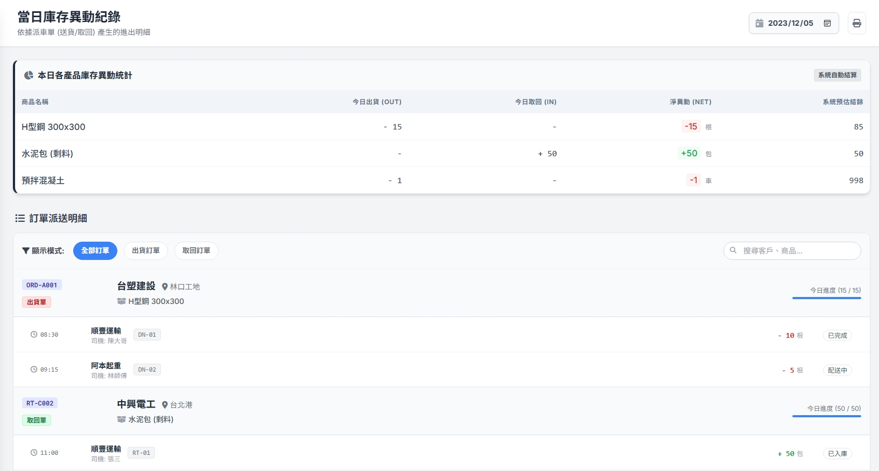


Date | App / Web | Protocol | description
2026/03/03 | Web | Api | 當日異動紀錄
2026/05/13 | Web | Api | 調整規格
yyyy/MM/dd
~
yyyy/MM/dd
車行 :
Sh_no
[compName]
產品名稱 : goodName
規格 : spec

Slide 2
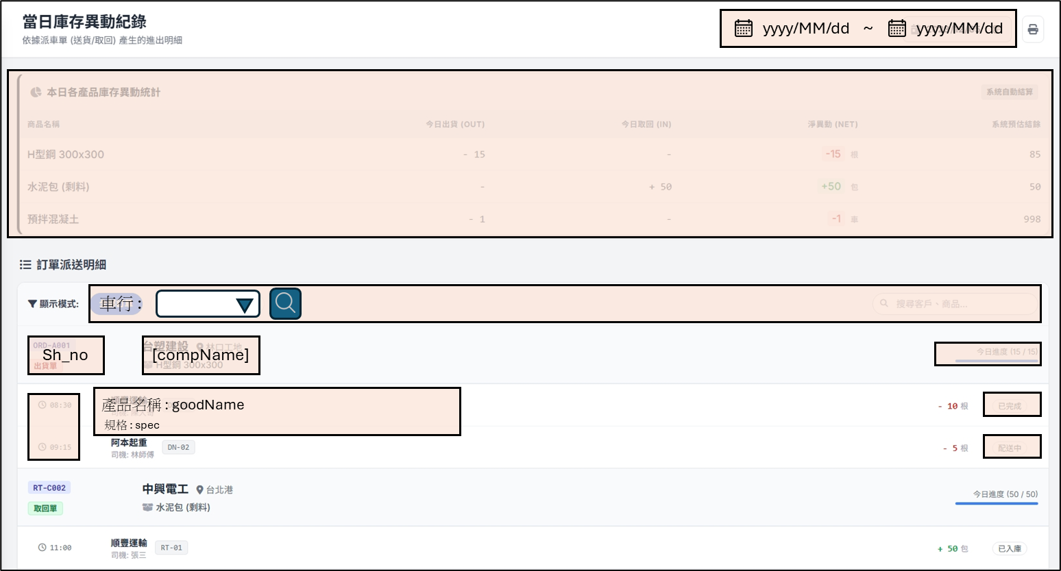
進入頁面
API
完成
mgmt/ct/comp/list

Slide 3
點下搜尋
API
完成
mgmt/delivery/history/search

Slide 4
mgmt/ct/comp/list
Server | Method | Request Param | Response Param
https://localhost:7093 | GET |  | List<Comp> ------------------------------ public class Comp { public int compId public string compNo public string compName }

Slide 5
mgmt/delivery/history/search
Server | Method | Request Param | Response Param
https://localhost:7093 | Post | public class SearchBody { public int? compId public DateTime strDt public DateTime endDt } | public class OrderHistory { public long shId public string shNo public string compName public List<Item> items public class Item { public int qty public string goodsName public string ctSoTypeName public string spec public string regionFrom public string regionFromCode public string addrFrom public string userFrom public string regionTo public string regionToCode public string addrTo public string userTo } }

