Slide 1
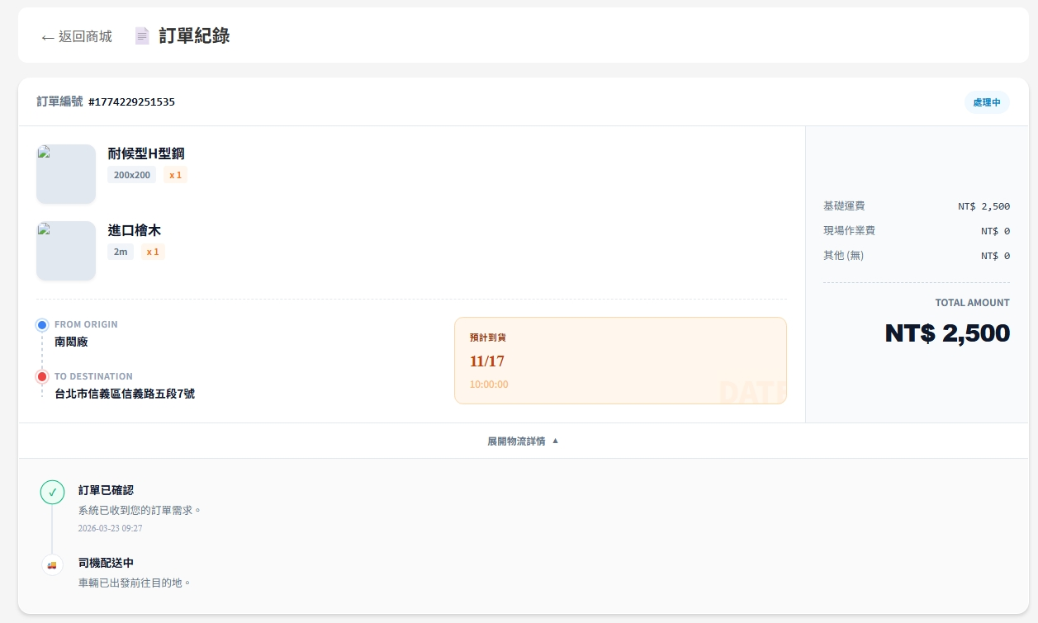
Date | App / Web | Protocol | description
2026/03/23 | web | Api | 訂單紀錄
2026/04/02 | Web | Api | 增加項目單位金額
2026/05/13 | Web | Api | 增加 PDF 下載
[soNo]
[soState]
[shelfNo]/[shelfName]
[attrName]
[amount]
[price]
[deliveryPrice]
[workPrice]
[otherPrice]
[userFrom]
[totalPrice]
[orderSchArrDt]
[addrTo]
[is_create]
[is_process]
[is_ship]
[is_close]

Slide 2
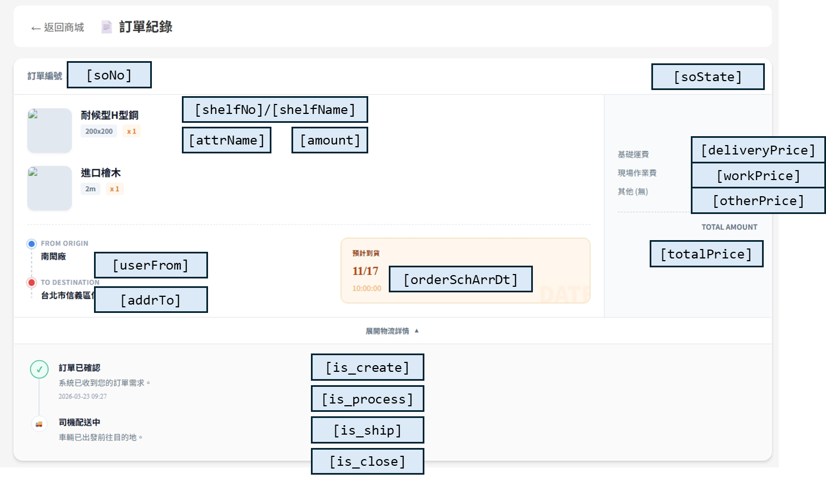
進入頁面
API
完成
mark/order/user/record

Slide 3
點下物流
API
展開下方流程
mark/order/state
[soNo]
[soState]
[shelfNo]/[shelfName]
[attrName]
[amount]
[deliveryPrice]
[workPrice]
[otherPrice]
[userFrom]
[totalPrice]
[orderSchArrDt]
[addrTo]
[is_create]
[is_process]
[is_ship]
[is_close]

Slide 4
mark/order/user/record
Server | Method | Request Param | Response Param
https://localhost: | GET | userId INT | List<Order> -------------------------------- public class Order { public long soId public string soNo public string soState public decimal totalPrice public decimal deliveryPrice public decimal workPrice public decimal otherPrice public string regionFrom public string regionFromCode public string addrFrom public string userFrom public string regionTo public string regionToCode public string addrTo public string userTo public DateTime? orderSchArrDt public List<Item> items public List<File> files } public class Item { public int shelfId public string shelfNo public string shelfName public int amount public decimal price public string attrName public List<string> fsId } public class File { public string fs_id public string fs_name }

Slide 5
mark/order/state
Server | Method | Request Param | Response Param
https://localhost: | GET | soId long | public class State { public bool is_create public bool is_process public bool is_ship public bool is_close }

