Slide 1
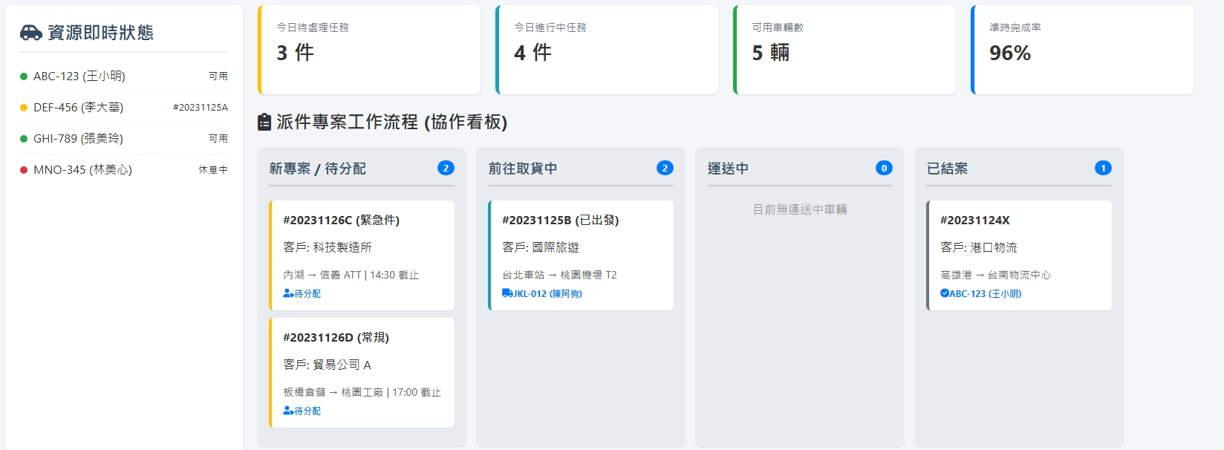
Date | App / Web | Protocol | description
2026/03/24 | web | Api | 車輛資源清單
2026/05/12 | Web | Api | resource/order/detail 增加 remark 與 reason 欄位
pendingCount
processCount
vehicleCount
licensePlate(driverName)
shNo
custName
regionFrom > regionTo orderSchArrDt
State = 1 >> 可用
State = 2 >>List<string>shNos
State = 3 >> 休息
licensePlate(driverName)

Slide 2
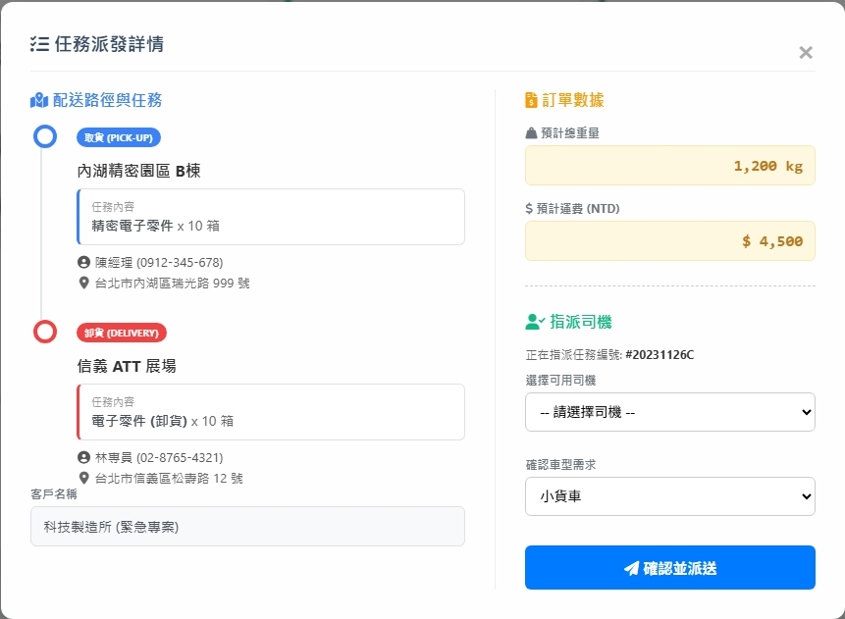
taskAction
taskState
totalWeight
resource/order/detail
goods
deliveryPrice
custName / custPhone
addr
備註 : remark
resource/driver/list
異常原因 : reason
shNo
resource/order/assign

Slide 3
進入頁面
API
完成
resource/order/dashboard/list
resource/driver/current/list
resource/order/dashboard/summary

Slide 4
指派
指派 dialog
API
完成
resource/order/assign

Slide 5
resource/order/dashboard/list
Server | Method | Request Param | Response Param
https://localhost: | GET |  | public class Order { public List<OrderBase> pendingOrder public List<OrderBase> processingOrder public List<OrderBase> closedOrder public class OrderBase { public long shId public string shNo public List<Routing> routings public class Routing { public string custName public string region_from public string region_to public string? orderSchArrDt public string userTo public string? driverName public string? licensePlate } } }

Slide 6
resource/order/dashboard/summary
Server | Method | Request Param | Response Param
https://localhost: | GET |  | public class OrderSummary { public int processCount public int pendingCount public int vehicleCount }

Slide 7
resource/driver/current/list
Server | Method | Request Param | Response Param
https://localhost: | GET |  | public class CurrentData { public int driverId public string driverNo public string driverName public string licensePlate { get; set; } public int state // 1 可用 2 配送 3 休息 public List<string> shNos }

Slide 8
resource/driver/list
Server | Method | Request Param | Response Param
https://localhost: | GET | page INT? pageSize INT? searchStr STRING is_free bool // true 拿未綁的司機 | Page<Data> --------------------------------- public class Page<Data> { public int PageNumber public int PageSize public int TotalPage public int TotalCount public List<Data> List } public class Data { public int driverId public int? vehicleId public int? compId public string driverNo public string driverName public string phone public string licensePlate public bool isAppAuth public string appAc }

Slide 9
resource/order/detail
Server | Method | Request Param | Response Param
https://localhost: | GET | shId long | public class OrderDetail { public float totalWeight public decimal deliveryPrice public string shNo public List<Task> tasks public class Task { public int seq public int taskStateId public string taskState public int taskActionId public string taskAction public string addr public string custName public string custPhone public string goods public int itemCount public string goodName public string remark public string reason } }

Slide 10
resource/order/assign
Server | Method | Request Param | Response Param
https://localhost: | GET | public class Assing { public long shId public int driverId } | STRING OK

