Slide 1
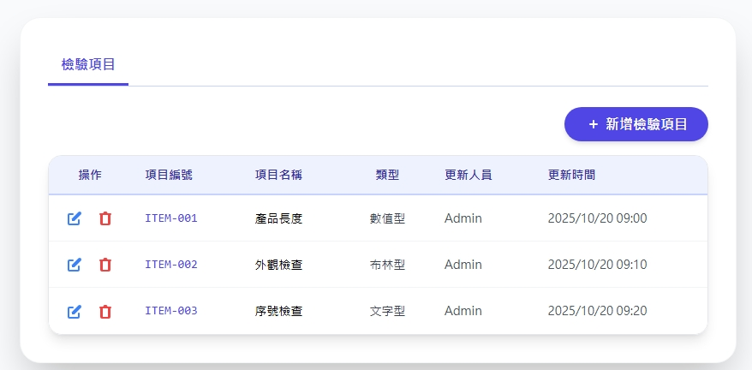
Date | App / Web | Protocol | description
2026/05/12 | Web | Api | 表單項目管理
移至後方

Slide 2
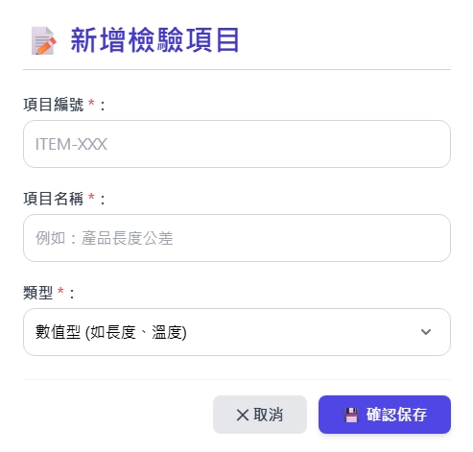
新增 Dialog
只有
量測型 (is_measure = true)
文字型 (is_measure = false)
單位 : (選填)
備註 : (選填)

Slide 3
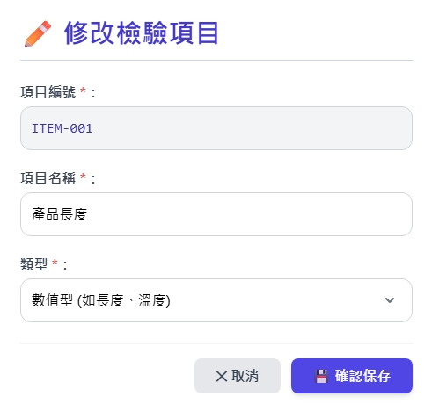
修改 Dialog
只有
量測型 (is_measure = true)
文字型 (如顏色、外觀) (is_measure = false)
單位 : (選填)
備註 : (選填)

Slide 4
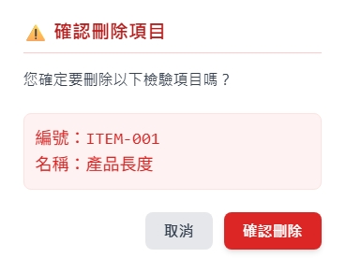
刪除 Dialog

Slide 5
進入頁面
API
完成
web/item/list
itNo
itName
isMeasure
updateBy
updateDt

Slide 6
點下新增
新增dialog
API
完成
web/item/create

Slide 7
點下修改
修改dialog
API
完成
web/item/update

Slide 8
點下刪除
刪除dialog
API
完成
web/item/delete

Slide 9
web/item/list
Server | Method | Request Param | Response Param
https://localhost: | GET | page INT? pageSize INT? searchStr string? | Page<Data> --------------------------------- public class Data { public int itid public string itNo public string itName public bool is_measure public string? remark public string? unit public string updateBy public string updateDt }

Slide 10
web/item/get
Server | Method | Request Param | Response Param
https://localhost: | GET | itemId int | public class Data { public int itid public string itNo public string itName public bool is_measure public string? remark public string? unit public string updateBy public string updateDt }

Slide 11
web/item/create
Server | Method | Request Param | Response Param
https://localhost: | Post | public class Create { public int? page public int? pageSize public string itNo public string itName public bool is_measure public string? remark public string? unit } | Page<Data> --------------------------------- public class Data { public int itid public string itNo public string itName public bool is_measure public string? remark public string? unit public string updateBy public string updateDt }

Slide 12
web/item/update
Server | Method | Request Param | Response Param
https://localhost: | PUT | public class Update { public int? page public int? pageSize public int itid public string itName public bool is_measure public string? remark public string? unit } | Page<Data> --------------------------------- public class Data { public int itid public string itNo public string itName public bool is_measure public string? remark public string? unit public string updateBy public string updateDt }

Slide 13
web/item/delete
Server | Method | Request Param | Response Param
https://localhost: | GET | public class Delete { public int? page public int? pageSize public int itid } | Page<Data> --------------------------------- public class Data { public int itid public string itNo public string itName public bool is_measure public string? remark public string? unit public string updateBy public string updateDt }

