Slide 1
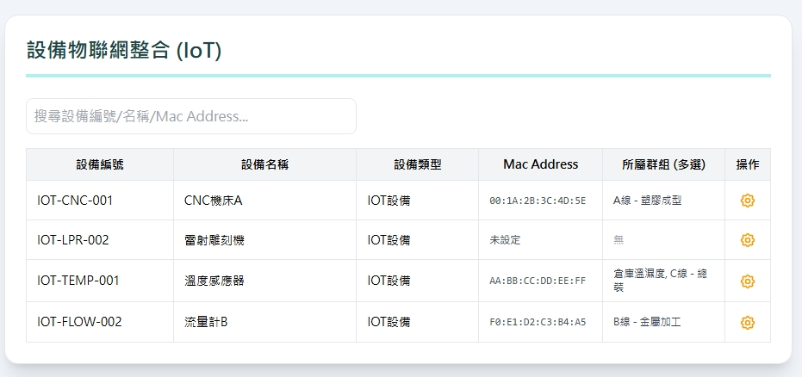



Date | App / Web | Protocol | description
2026/05/07 | Web | Api | 生產線管理
IoT編號
IoT名稱
設備編號
設備名稱
Mac address
路由鍵
操作
iotNo
iotName
eqpno
eqpname
macAddress
routkey

Slide 2
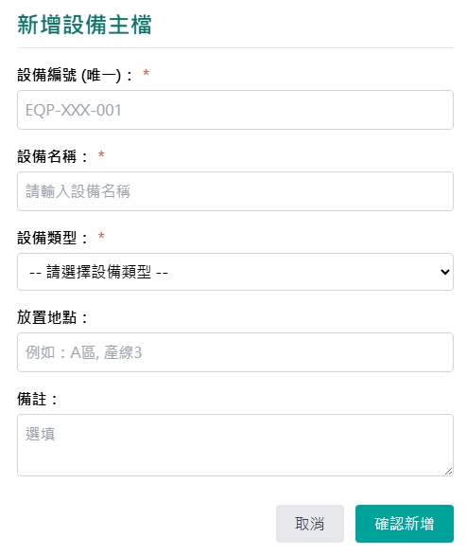
新增 Dialog
IoT
IoT
IoT
所屬設備
web/equip/option/list
Mac Address :
路由鍵 :

Slide 3
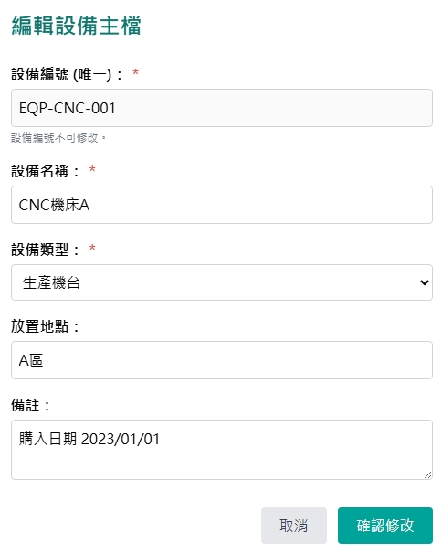
修改 Dialog
IoT
IoT
IoT
所屬設備
web/equip/option/list
Mac Address :
路由鍵 :

Slide 4
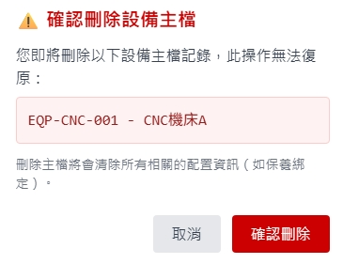
刪除 Dialog
IoT主檔

Slide 5
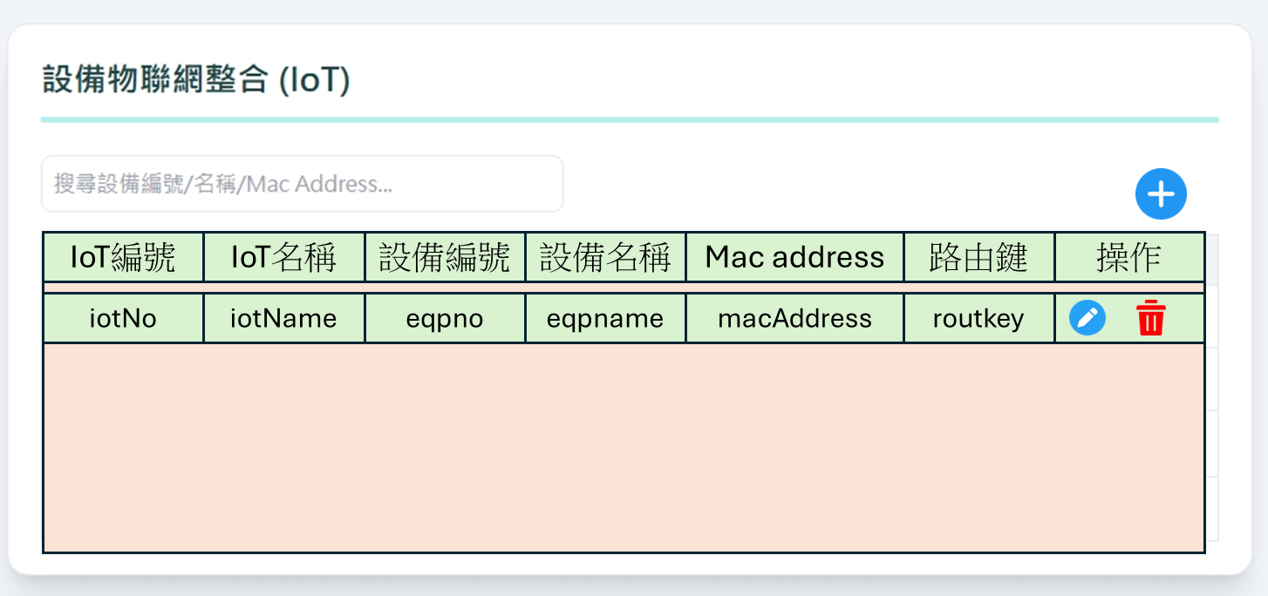
進入頁面
API
完成
web/IoT/list

Slide 6
點下新增
新增dialog
API
完成
web/IoT/create
IoT
IoT
IoT
所屬設備
Mac Address :
路由鍵 :

Slide 7
點下修改
修改dialog
API
完成
web/IoT/update
IoT
IoT
IoT
所屬設備
Mac Address :
路由鍵 :

Slide 8
點下刪除
刪除dialog
API
完成
web/IoT/delete
IoT主檔

Slide 9
web/equip/option/list
Server | Method | Request Param | Response Param
https://localhost: | GET |  | List<Option> --------------------------------- public class Option { public int eqpid public string eqpno public string eqpname }

Slide 10
web/IoT/list
Server | Method | Request Param | Response Param
https://localhost: | GET | page INT? pageSize INT? searchStr String? | Page<Data> --------------------------------- public class Data { public int iotId public int eqpid public string iotNo public string iotName public string eqpno public string eqpname public string macAddress public string routkey public string updateBy public string updateDt }

Slide 11
web/Iot/get
Server | Method | Request Param | Response Param
https://localhost: | GET | iotId int | public class Data { public int iotId public int eqpid public string iotNo public string iotName public string eqpno public string eqpname public string macAddress public string routkey public string updateBy public string updateDt }

Slide 12
web/Iot/create
Server | Method | Request Param | Response Param
https://localhost: | Post | public class Create { public int? page public int? pageSize public int eqpid public string iotNo public string iotName public string macAddress public string routkey public string? remark } | Page<Data> --------------------------------- public class Data { public int iotId public int eqpid public string iotNo public string iotName public string eqpno public string eqpname public string macAddress public string routkey public string updateBy public string updateDt }

Slide 13
web/IoT/update
Server | Method | Request Param | Response Param
https://localhost: | PUT | public class Update { public int? page public int? pageSize public int iotId public int eqpid public string iotName public string macAddress public string routkey public string remark } | Page<Data> --------------------------------- public class Data { public int iotId public int eqpid public string iotNo public string iotName public string eqpno public string eqpname public string macAddress public string routkey public string updateBy public string updateDt }

Slide 14
web/IoT/delete
Server | Method | Request Param | Response Param
https://localhost: | DELETE | public class Delete { public int? page public int? pageSize public int iotId } | Page<Data> --------------------------------- public class Data { public int iotId public int eqpid public string iotNo public string iotName public string eqpno public string eqpname public string macAddress public string routkey public string updateBy public string updateDt }

