Slide 1
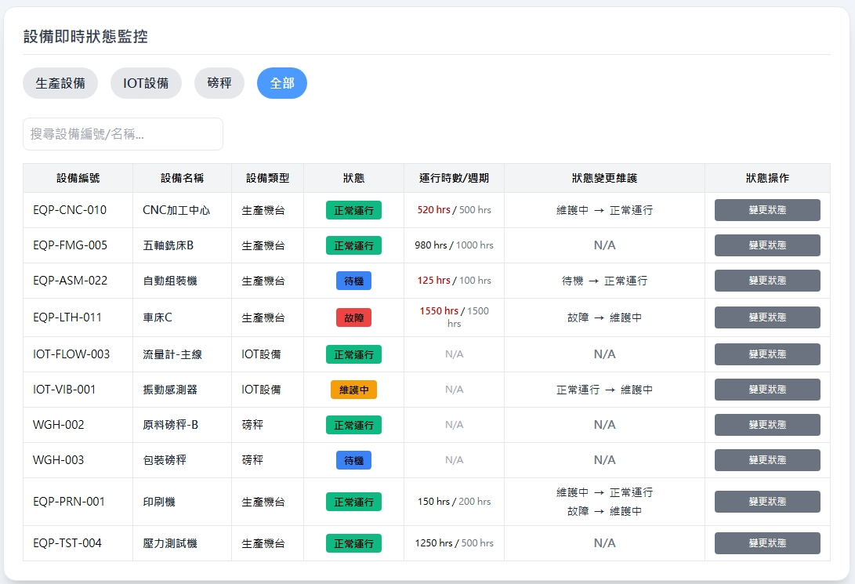


Date | App / Web | Protocol | description
2026/05/07 | Web | Api | 生產線管理
操作

Slide 2
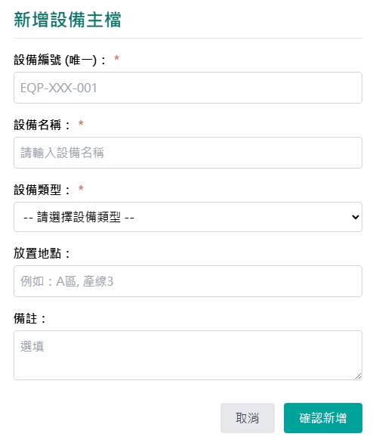
新增 Dialog
web/ct/equip/type/list
生產線
web/facility/option/list

Slide 3
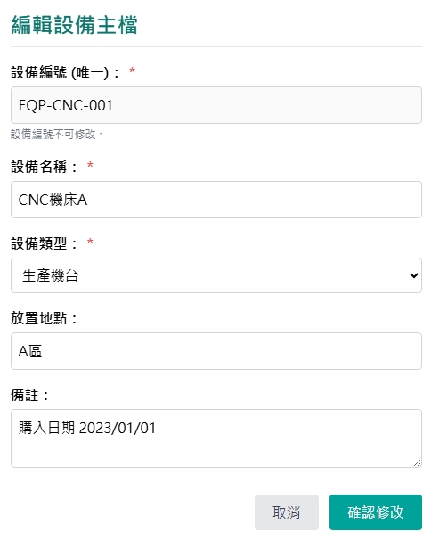
修改 Dialog
web/ct/equip/type/list
生產線
web/facility/option/list

Slide 4
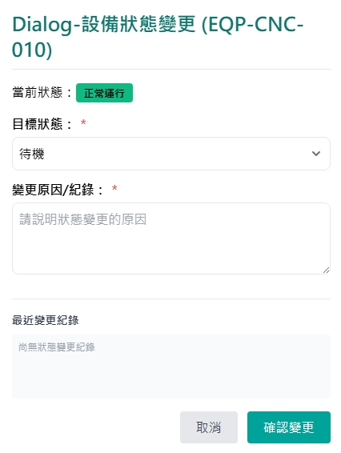
狀態修改 Dialog
web/ct/equip/state/list
web/equip/get/state
更新時間
更新人員
更新狀態
工單
備註
updateDt
updateBy
eqpsname
erpNo
remark

Slide 5
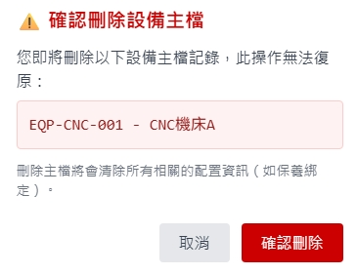
刪除 Dialog

Slide 6
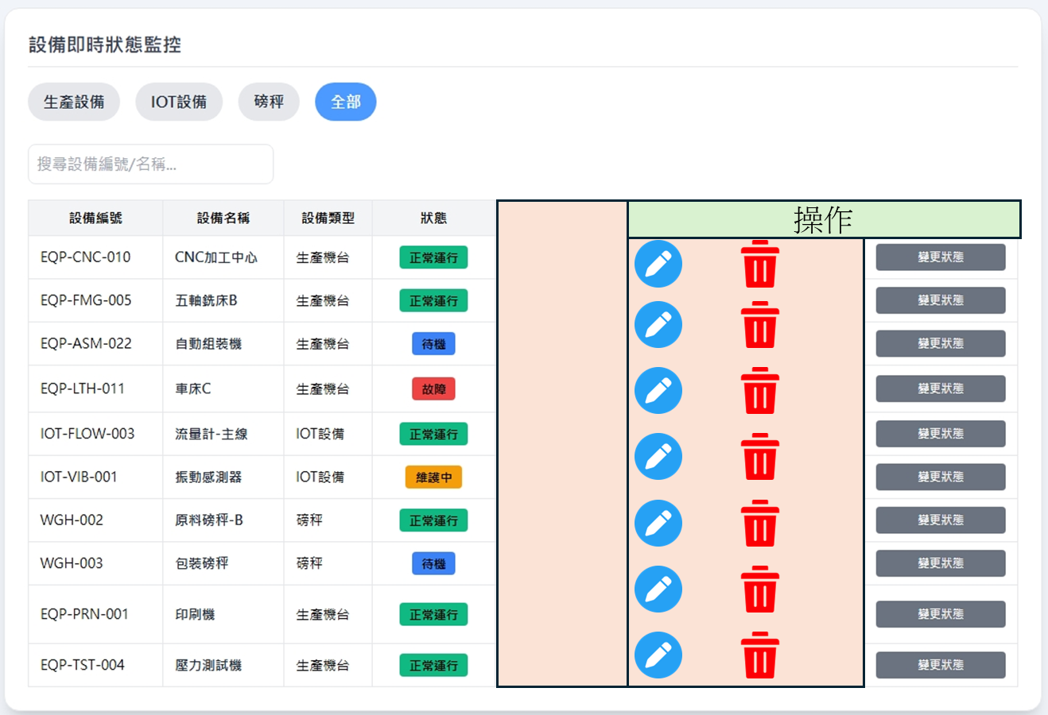
進入頁面
API
完成
web/equip/list
eqpno
eqpname
eqptname
eqpsname

Slide 7
點下新增
新增dialog
API
完成
web/equip/create

Slide 8
點下修改
修改dialog
API
完成
web/equip/update

Slide 9
點下
修改狀態
修改狀態dialog
API
完成
web/equip/update/state

Slide 10
點下刪除
刪除dialog
API
完成
web/equip/delete

Slide 11
web/facility/option/list
Server | Method | Request Param | Response Param
https://localhost: | GET |  | List<Option> --------------------------------- public class Option { public byte fctId public string fctNo public string fctName }

Slide 12
web/ct/equip/type/list
Server | Method | Request Param | Response Param
https://localhost: | GET |  | List<Type> --------------------------------- public class Type { public short eqptid public string eqptname }

Slide 13
web/ct/equip/state/list
Server | Method | Request Param | Response Param
https://localhost: | GET |  | List<State> --------------------------------- public class State { public byte eqpsid public string eqpsno public string eqpsname }

Slide 14
web/equip/list
Server | Method | Request Param | Response Param
https://localhost: | GET | page INT? pageSize INT? searchStr String? | Page<Data> --------------------------------- public class Data { public int eqpid public byte fctid public short eqptid public byte eqpsid public string eqpno public string eqpname public string eqptname public string eqpsno public string eqpsname public string? remark public string updateDt public string updateBy }

Slide 15
web/equip/get
Server | Method | Request Param | Response Param
https://localhost: | GET | eqpid int | public class Data { public int eqpid public byte fctid public short eqptid public byte eqpsid public string eqpno public string eqpname public string eqptname public string eqpsno public string eqpsname public string? remark public string updateDt public string updateBy }

Slide 16
web/equip/create
Server | Method | Request Param | Response Param
https://localhost: | Post | public class Create { public int? page public int? pageSize public byte fctid public short eqptid public string eqpno public string eqpname public string? remark } | Page<Data> --------------------------------- public class Data { public int eqpid public byte fctid public short eqptid public byte eqpsid public string eqpno public string eqpname public string eqptname public string eqpsno public string eqpsname public string? remark public string updateDt public string updateBy }

Slide 17
web/equip/update
Server | Method | Request Param | Response Param
https://localhost: | PUT | public class Update { public int? page public int? pageSize public int eqpid public byte fctid public short eqptid public string eqpname public string? remark } | Page<Data> --------------------------------- public class Data { public int eqpid public byte fctid public short eqptid public byte eqpsid public string eqpno public string eqpname public string eqptname public string eqpsno public string eqpsname public string? remark public string updateDt public string updateBy }

Slide 18
web/equip/delete
Server | Method | Request Param | Response Param
https://localhost: | DELETE | public class Delete { public int? page public int? pageSize public int eqpid } | Page<Data> --------------------------------- public class Data { public int eqpid public byte fctid public short eqptid public byte eqpsid public string eqpno public string eqpname public string eqptname public string eqpsno public string eqpsname public string? remark public string updateDt public string updateBy }

Slide 19
web/equip/get/state
Server | Method | Request Param | Response Param
https://localhost: | GET | eqpid INT dataCount INT = 5 // 先都給前五筆 | List<StateLog> --------------------------------- public class StateLog { public string eqpsno public string eqpsname public string? remark public string updateDt public string updateBy public string erpNo }

Slide 20
web/equip/update/state
Server | Method | Request Param | Response Param
https://localhost: | PUT | public class UpdateState { public int? page public int? pageSize public int eqpid public short eqpsid public string? remark } | Page<Data> --------------------------------- public class Data { public int eqpid public byte fctid public short eqptid public byte eqpsid public string eqpno public string eqpname public string eqptname public string eqpsno public string eqpsname public string? remark public string updateDt public string updateBy }

