Slide 1
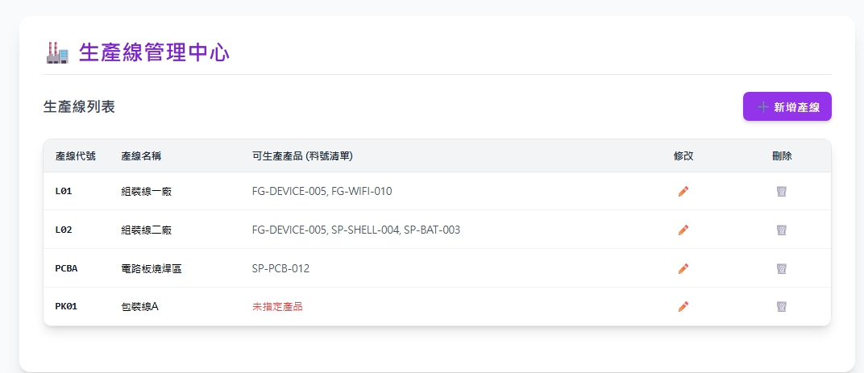
Date | App / Web | Protocol | description
2026/05/07 | Web | Api | 生產線管理

Slide 2
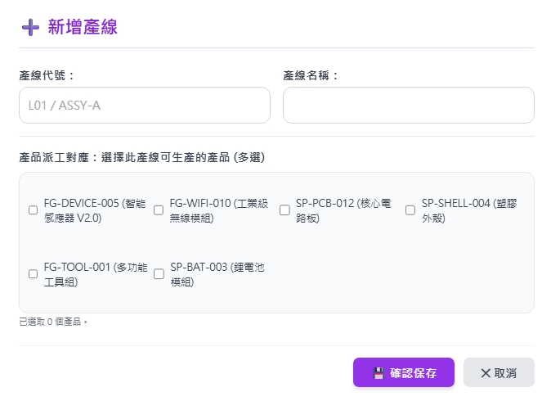
新增 Dialog
web/part/option/list

Slide 3
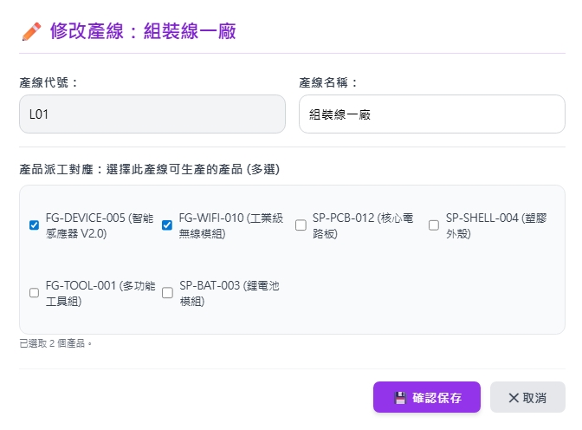
修改 Dialog
web/facility/get
web/part/option/list

Slide 4
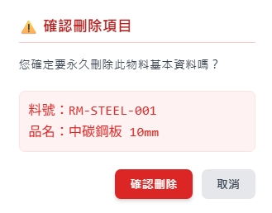
刪除 Dialog
產線編號
產線名稱

Slide 5
進入頁面
API
完成
web/facility/list
fctNo
fctName
parts

Slide 6
點下新增
新增dialog
API
完成
web/facility/create

Slide 7
點下修改
修改dialog
API
完成
web/facility/update

Slide 8
點下刪除
刪除dialog
API
完成
web/facility/delete

Slide 9
web/part/option/list
Server | Method | Request Param | Response Param
https://localhost: | GET |  | List<Option> --------------------------------- public class Option { public long pid public string pno public string pname }

Slide 10
web/facility/list
Server | Method | Request Param | Response Param
https://localhost: | GET | page INT? pageSize INT? | Page<Data> --------------------------------- public class Data { public byte fctId public string fctNo public string fctName public List<Option> parts } public class Option { public long pid public string pno public string pname }

Slide 11
web/facility/get
Server | Method | Request Param | Response Param
https://localhost: | GET | fcid LONG | public class Data { public byte fctId public string fctNo public string fctName public List<Option> parts } public class Option { public long pid public string pno public string pname }

Slide 12
web/facility/create
Server | Method | Request Param | Response Param
https://localhost: | Post | public class Create { public int? page public int? pageSize public string fctNo public string fctName public List<long> partIds } | Page<Data> --------------------------------- public class Data { public byte fctId public string fctNo public string fctName public List<Option> parts } public class Option { public long pid public string pno public string pname }

Slide 13
web/facility/update
Server | Method | Request Param | Response Param
https://localhost: | PUT | public class Update { public int? page public int? pageSize public byte fctId public string fctName public List<long> partIds } | Page<Data> --------------------------------- public class Data { public byte fctId public string fctNo public string fctName public List<Option> parts } public class Option { public long pid public string pno public string pname }

Slide 14
web/facility/delete
Server | Method | Request Param | Response Param
https://localhost: | DELETE | public class Delete { public int? page public int? pageSize public byte fctId } | Page<Data> --------------------------------- public class Data { public byte fctId public string fctNo public string fctName public List<Option> parts } public class Option { public long pid public string pno public string pname }

