Slide 1
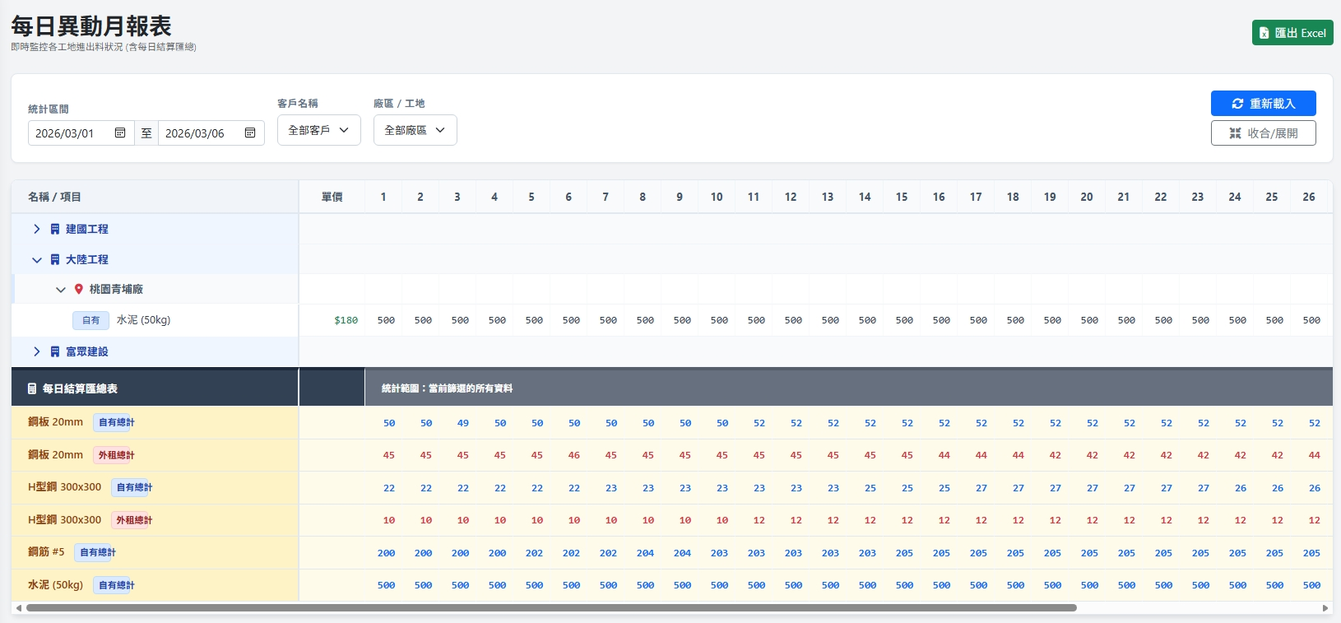
Date | App / Web | Protocol | description
2026/03/06 | Web | Api | 根據時間區間彙整客戶與廠區每日庫存量

Slide 2
進入頁面
API
完成
mgmt/ct/custinfo/filter
mgmt/inventory/change/daily
mgmt/inventory/change/daily/product

Slide 3
選擇
篩選項目
API
更新項目
mgmt/ct/custinfo/filter

Slide 4
點下搜尋
API
完成
mgmt/inventory/change/daily
mgmt/inventory/change/daily/product

Slide 5
mgmt/ct/custinfo/filter
Server | Method | Request Param | Response Param
https://localhost:7093 | GET | custId INT? = NULL //固定 deptId INT? facId INT? | public class CustomerFilter { public List<CustomerPartial> customers public List<DepartmentPartial> depts public List<FacilityPartial> facilities public class CustomerPartial { public int custId public string cust_no public string cust_name public string phone } public class DepartmentPartial { public int deptId public string dept_no public string dept_name public string dept_region public string dept_address } public class FacilityPartial { public int facId public string facNo public string facName public string facRegion public string facAddress } }

Slide 6
mgmt/inventory/change/daily/product
Server | Method | Request Param | Response Param
https://localhost:7093 | GET | depId INT? facId INT? strDt DATETIME endDt DATETIME | List<Item> -------------------------------------- public class Item { public int productId public string productNo public string productName public bool is_self public List<StockCount> stocks public class StockCount { public DateTime date public int count } }

Slide 7
mgmt/inventory/change/daily/depfac
Server | Method | Request Param | Response Param
https://localhost:7093 | GET | depId INT? facId INT? strDt DATETIME endDt DATETIME | List<DepFacInventory> -------------------------------------- public class DepFacInventory { public int depId public string depNo public string depName public List<Fac> facs public class Fac { public int facId public string facNo public string facName public List<Item> items public class Item { public int productId public string productNo public string productName public bool is_self public List<StockCount> stocks public class StockCount { public DateTime date public int count } } } }

